Slide 1

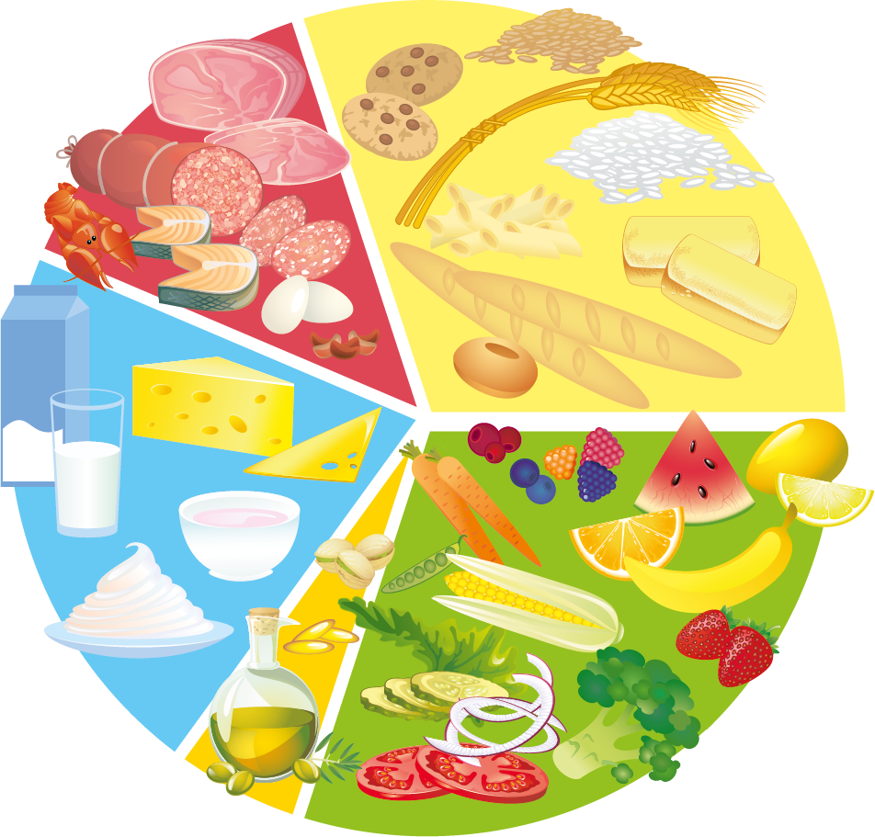
HEALTHY
EATING
Key Stage 2

Slide 2
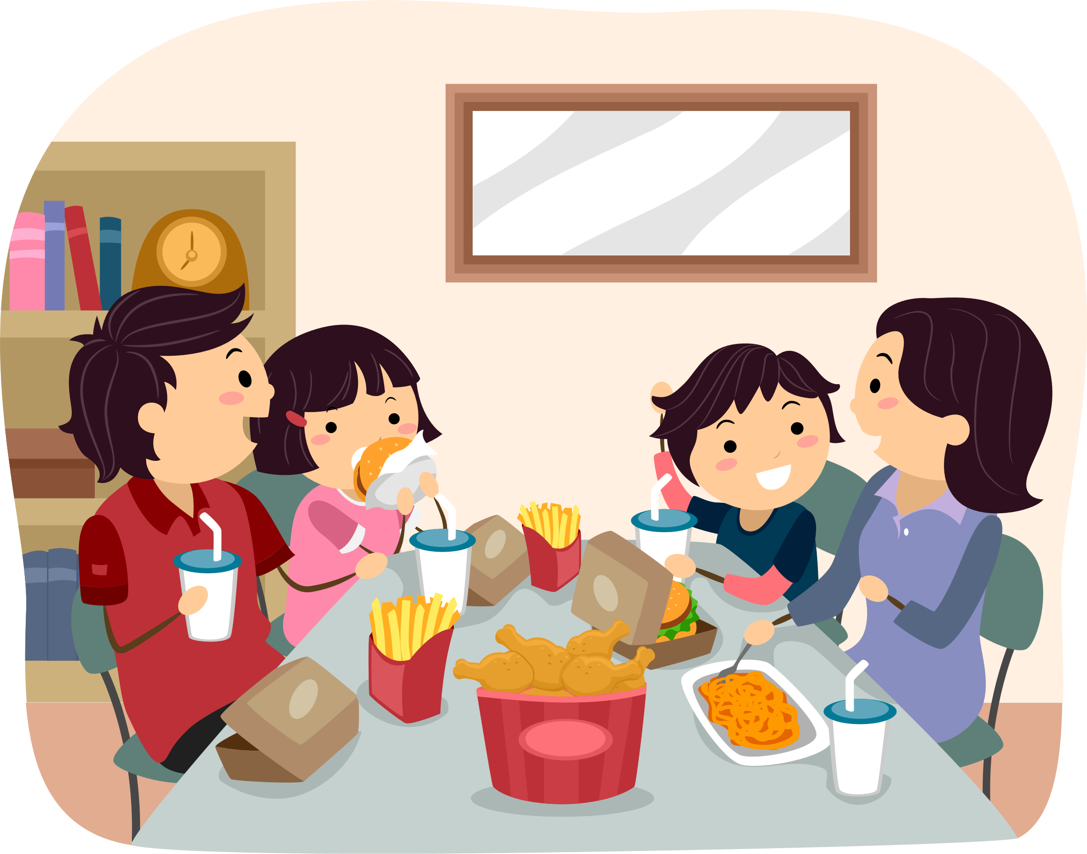
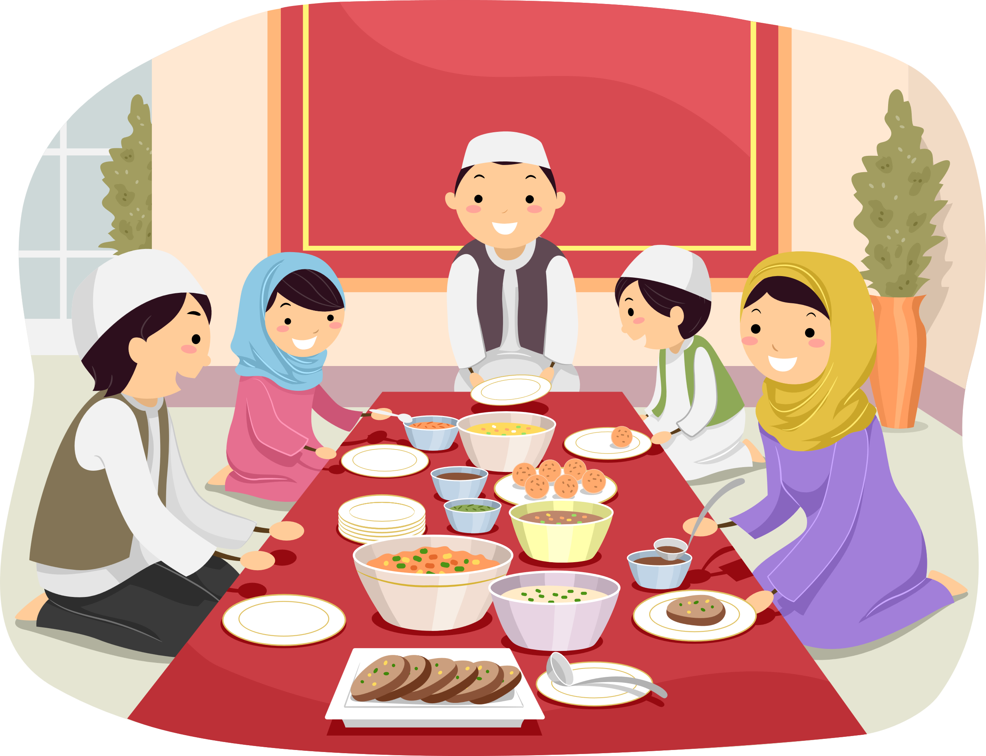
WHY DO WE EAT FOOD?
Food provides energy which we need to:
To grow
To be active
To keep healthy
Food tastes nice and is enjoyable to eat
Eating food is an opportunity to spend time with our friends and families
KNOWLEDGE

Slide 3



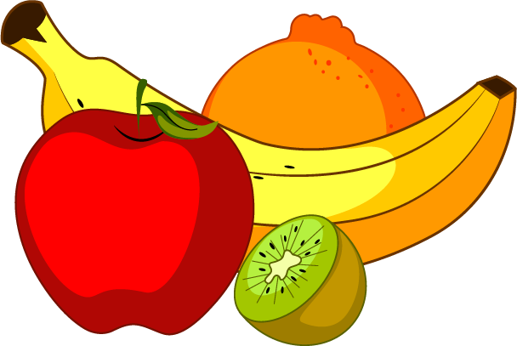
Food and drinks contain different substances that are needed to keep our bodies healthy.
Nutrients
Nutrients are the substances in food that allow people to live and grow and stay healthy.
Water
Water helps us to digest our food, fight illness and keep our bodies at the right temperature.
Fibre
Fibre helps to keep our digestive system healthy.
KNOWLEDGE

Slide 4
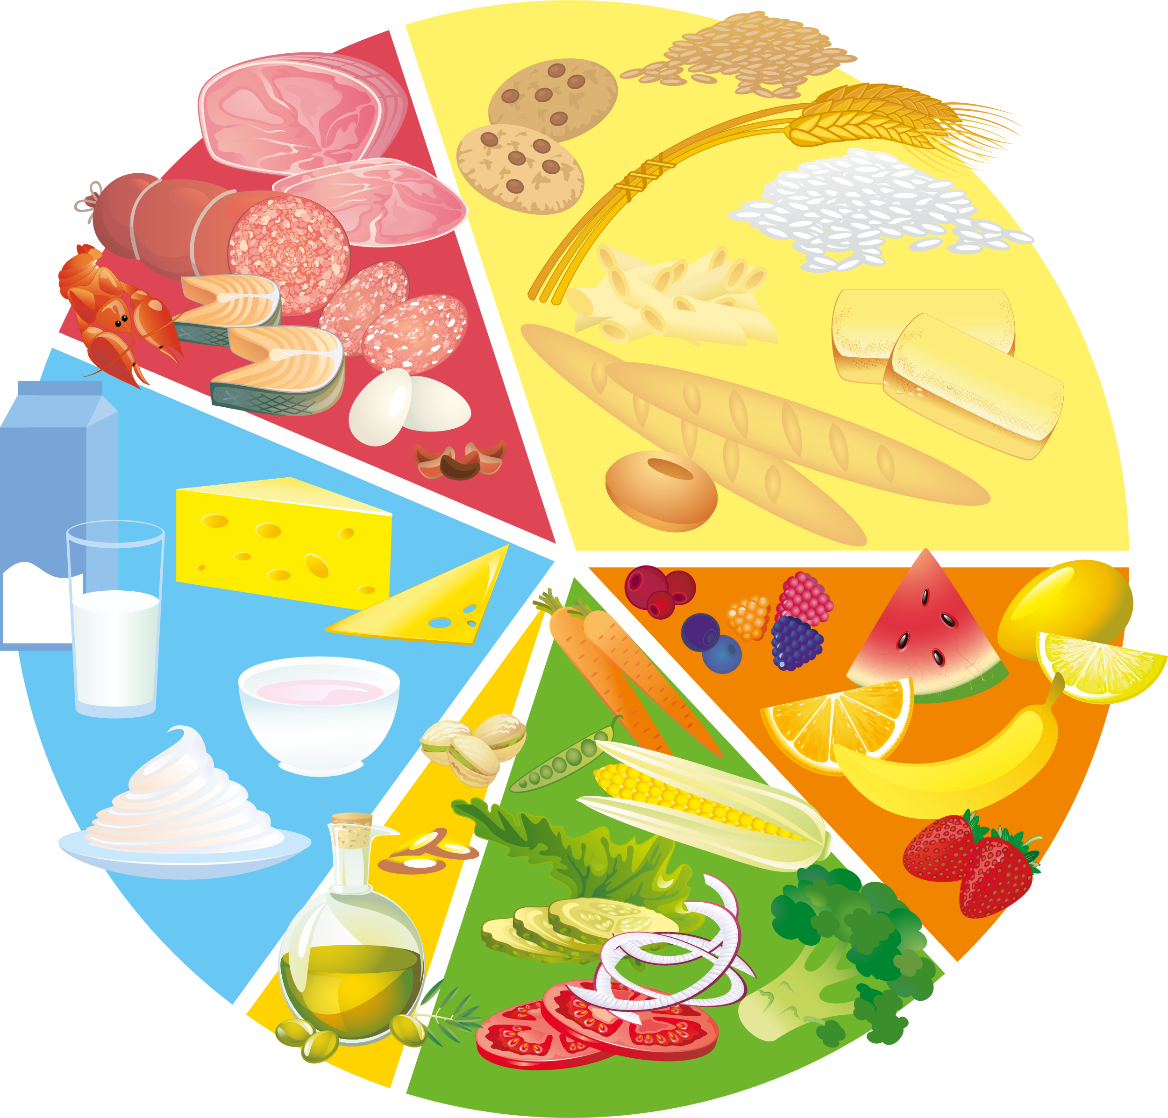
THE EATWELL PLATE
The Eatwell Plate is a guide to healthy eating.
It shows the types of food that should be eaten and the proportions of each food group that should be eaten to keep us healthy.
KNOWLEDGE

Slide 5
THE EATWELL PLATE
There are five main food groups
Fruit and Vegetables
Starchy Carbohydrates
Proteins
Dairy
Oils and Spreads
KNOWLEDGE

Slide 6
FRUIT & VEGETABLES
These foods contain fibre which helps our body to digest our food.
These foods are a good source of vitamins and minerals that keep our bodies healthy such as vitamin C which prevents us from getting ill.
KNOWLEDGE
Healthy Eating Guidance : Eat at least five portions of a variety of fruit and vegetables every day

Slide 7
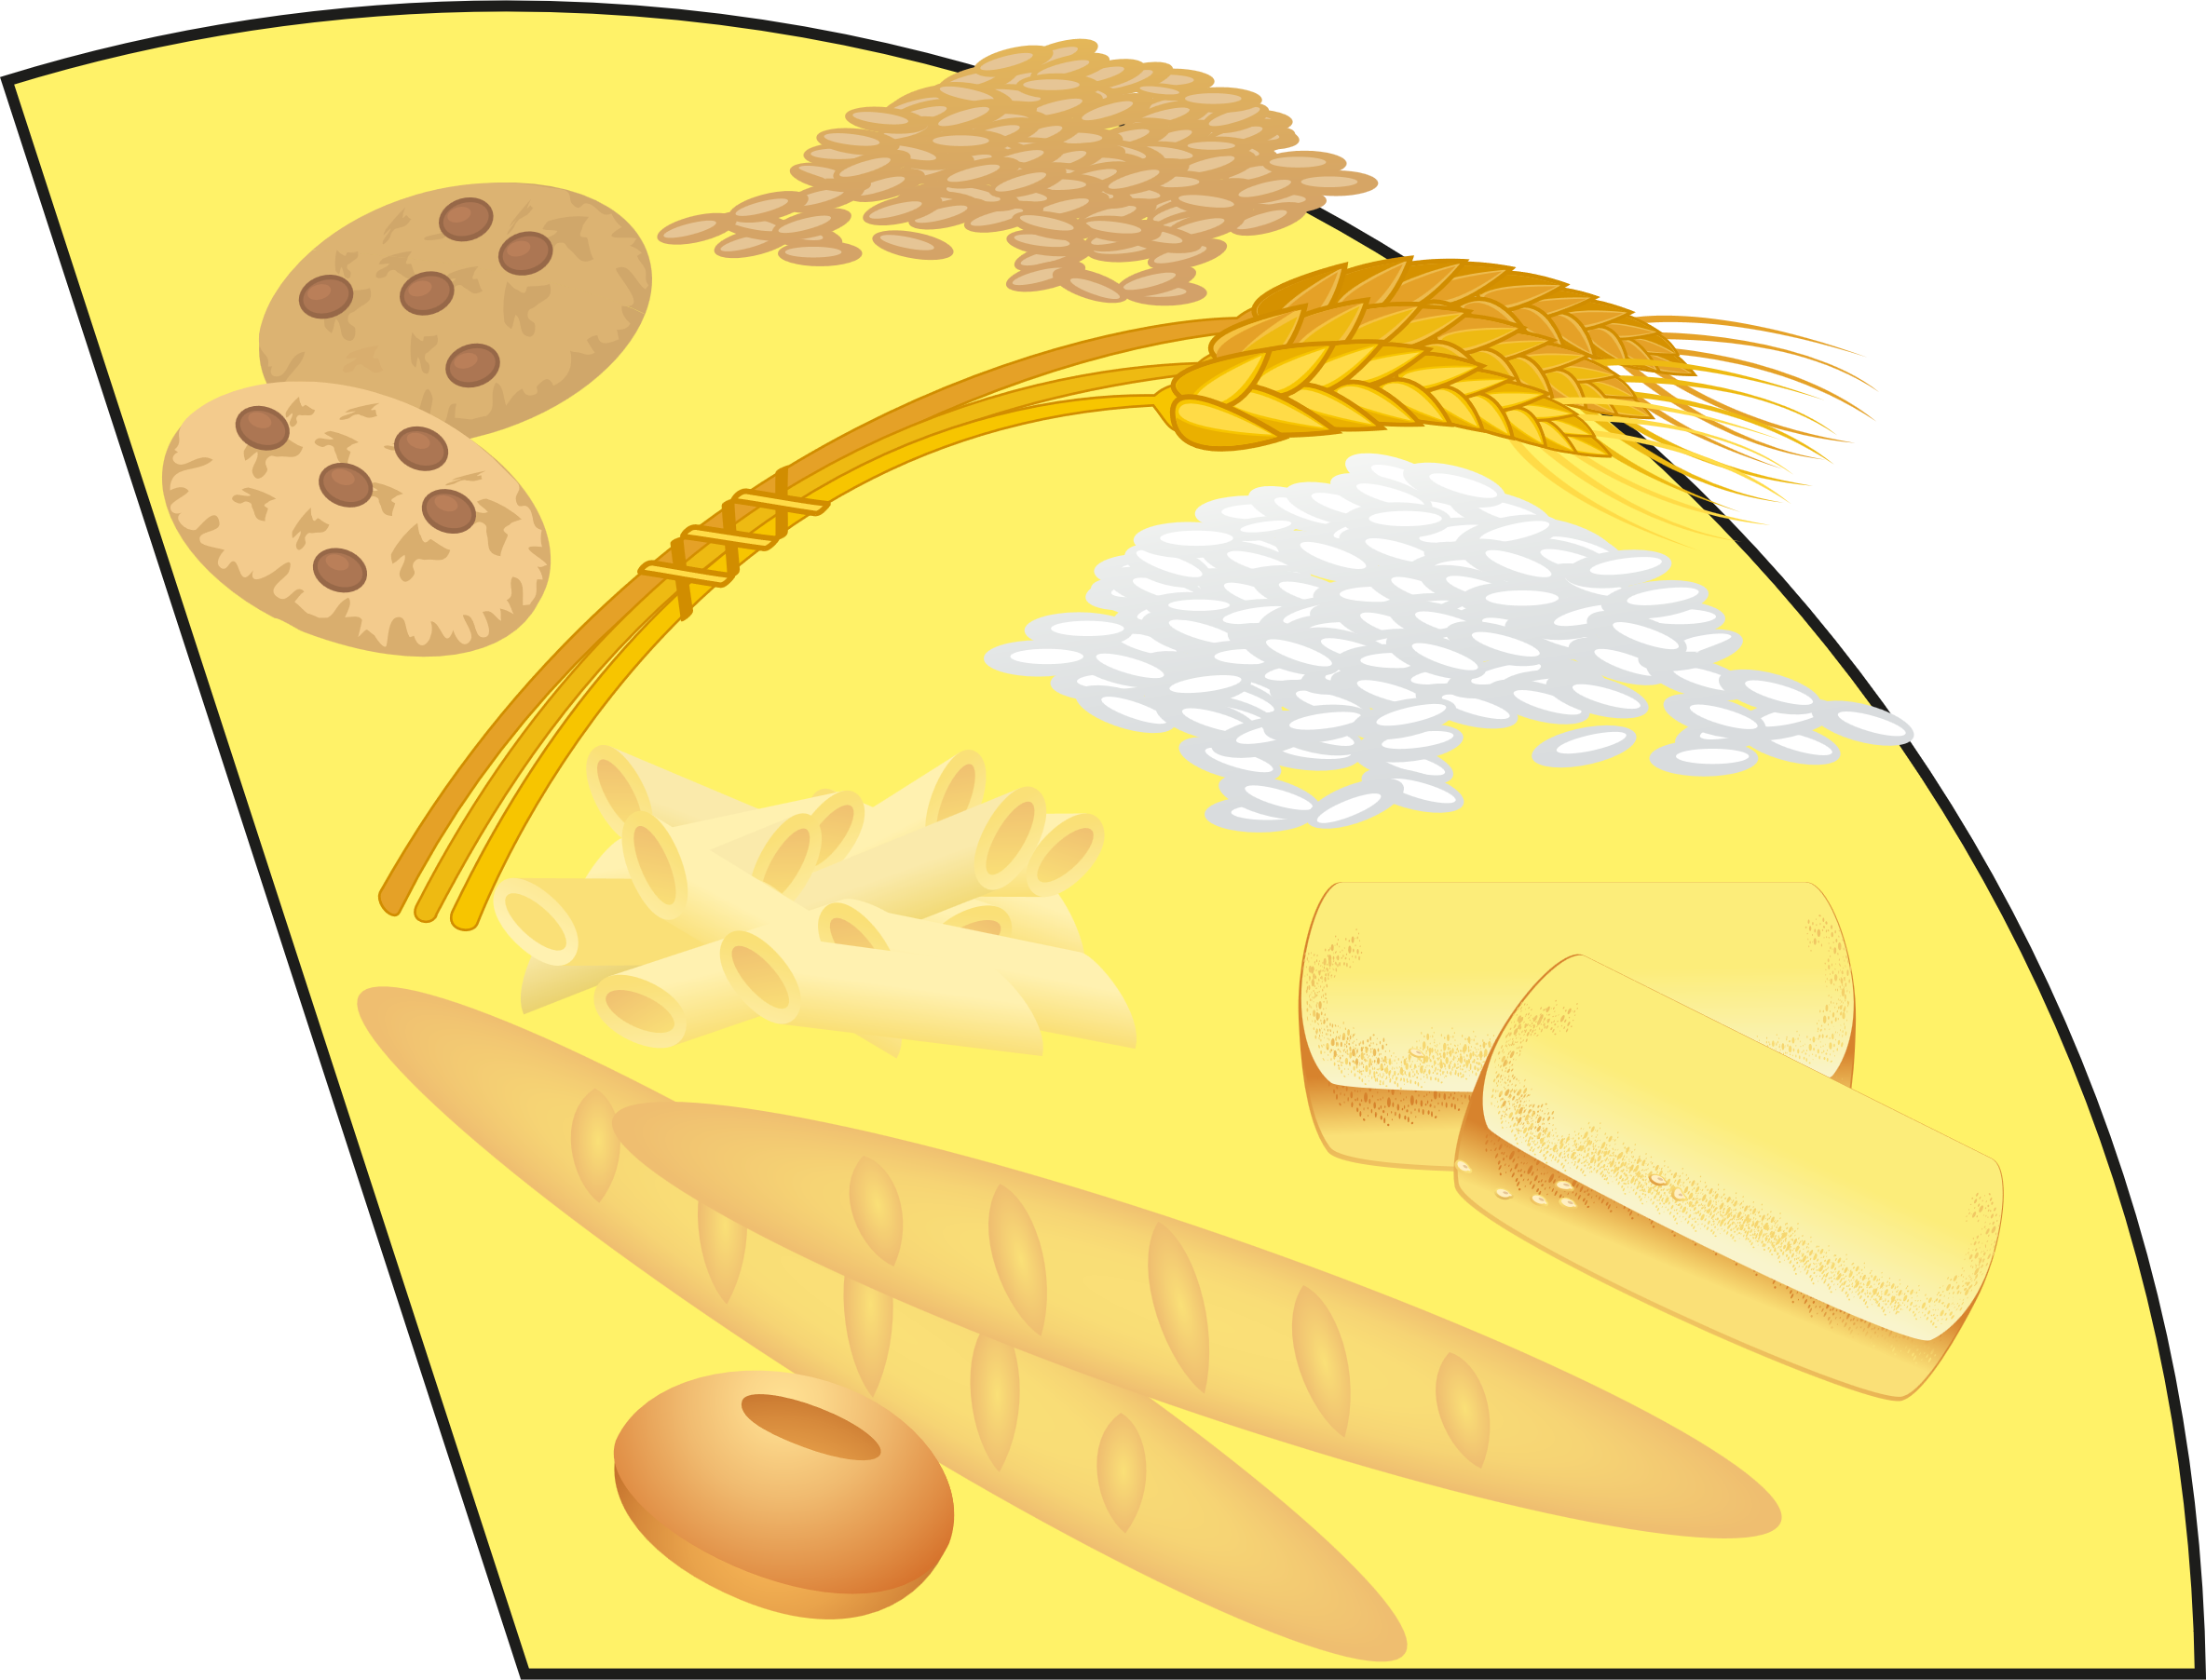
STARCHY CARBOHYDRATES
These foods provide a good source of carbohydrates that provide energy for our body.
These foods contain fibre which helps our body to digest our food. These foods are a good source of vitamins and minerals that keep our bodies healthy such as calcium for our bones and teeth.
KNOWLEDGE
Healthy Eating Guidance : Include food from this group at every meal. Choose wholegrain and high fibre carbohydrates with less added fat, salt & sugar.

Slide 8
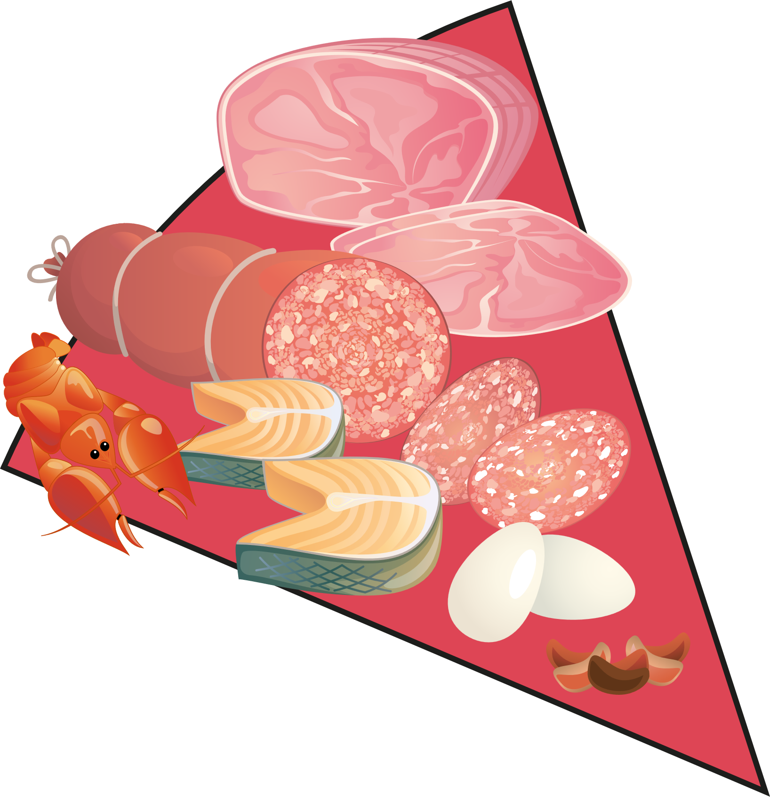
PROTEINS
These foods contain protein which helps our body to grow and repair itself. These foods are a good source of vitamins and minerals that keep our bodies healthy such as vitamin D which keeps our bones, teeth and muscles healthy.
KNOWLEDGE
Healthy Eating Guidance : Eat some foods from this group every day. Eat more beans and pulses. Eat two portions of fish per week, one of those should be oily fish. Cut down on red and processed meat.

Slide 9

DAIRY
Dairy foods are a good source of protein and vitamins. They also contain calcium which allows our bones, teeth and nails to grow and keeps them healthy.
KNOWLEDGE
Healthy Eating Guidance : Have some foods from this group every day. Choose lower fat and lower sugar options

Slide 10

OIL AND SPREADS
These foods are a good source of fat which is needed (in small amounts) to keep our cells and organs working properly.
KNOWLEDGE
Healthy Eating Guidance : Eat in small amounts.
Choose unsaturated fats and oils.

Slide 11
DO NOT FORGET TO DRINK
Without water our bodies would stop working.
Water helps to keep your body temperature normal, helps you to digest your food and to fight illnesses.
KNOWLEDGE
Guidance: Drink 6 – 8 glasses every day
Water and low-fat milk are healthy choices.
You can have one glass of fruit juice or a smoothie per day.

Slide 12








WHAT ABOUT THESE?
These foods you do not need to keep healthy.
If you eat these foods, do not eat them often and eat only small amounts as a treat.
KNOWLEDGE

Slide 13
GETTING THE BALANCE RIGHT!
There is no such thing as ‘bad’ or ‘good’ food. It is important that we eat a balanced diet and do not eat too much food from one group. That is why we have guidance from the Eatwell Plate .
KNOWLEDGE

Slide 14
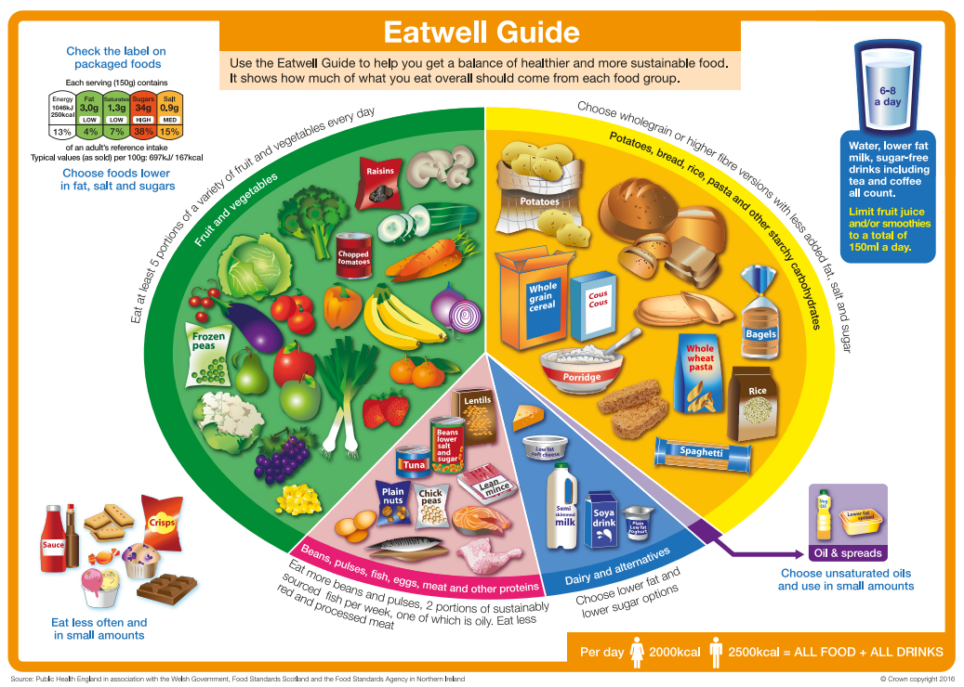
The Eatwell Guide is used to help us choose food for a healthy and balanced diet.
We should eat the proportions shown on the Eatwell Guide.
KNOWLEDGE

Slide 15
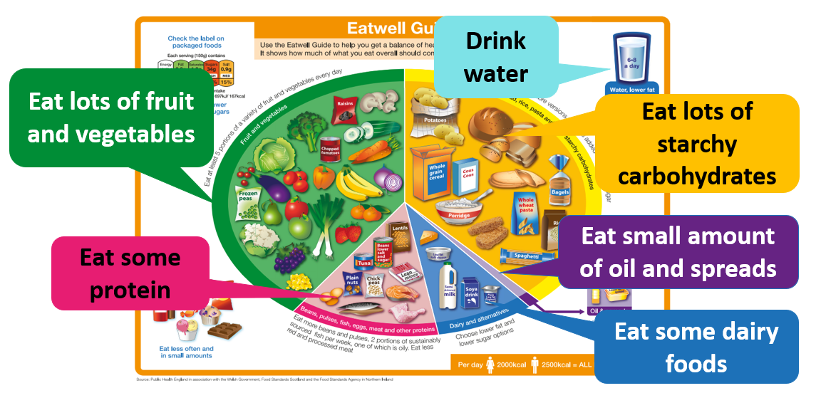
THE EATWELL GUIDE MESSAGE
KNOWLEDGE

Slide 16
THE EATWELL GUIDE SUMMARY
Eat lots of fruit and vegetables. At least 5 portions every day.
Eat lots of starchy carbohydrates. Meals should include either potatoes, bread, rice or pasta.
Have some dairy (or alternatives) and choose the low-fat, low sugar options.
Have some protein every day such as beans, meat, eggs or fish (try to eat two portions of fish each week).
Use little oil and spreads and when you do, choose unsaturated oils and fat.
Drink 6-8 glasses of water or fluids every day.
Limit the number of foods containing high levels of fat, sugar or salt
KNOWLEDGE

Slide 17
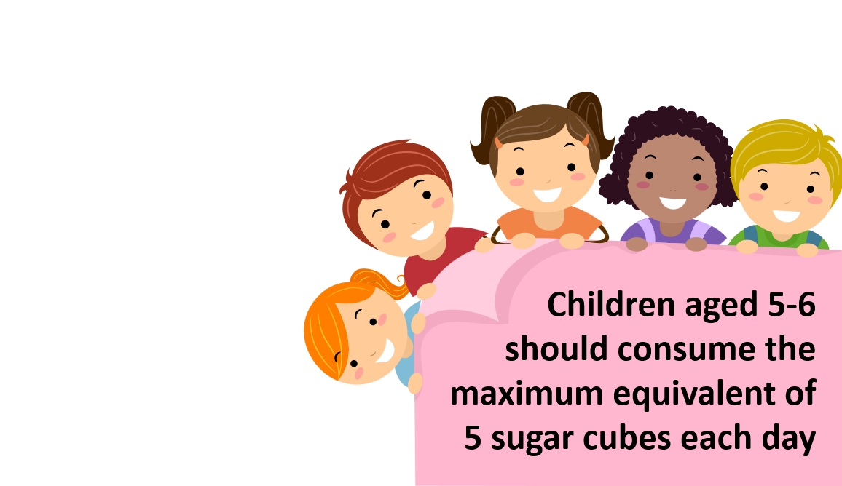

We are all eating too much sugar!
Too much sugar can lead to too much fat on the inside of our bodies.
Too much sugar can cause illnesses when we get older such as diabetes.
Too much sugar can cause tooth decay
KNOWLEDGE

Slide 18

Sugar Swap – Making the Right Choices
BREAKFAST CEREALS
Swap those sugary and chocolate cereals to plain cereals such as porridge, Weetabix or Corn Flakes. Whole grain cereals are even better!
Add a topping of fresh fruit to count towards your five-a-day target for eating fruit and vegetables.
KNOWLEDGE

Slide 19
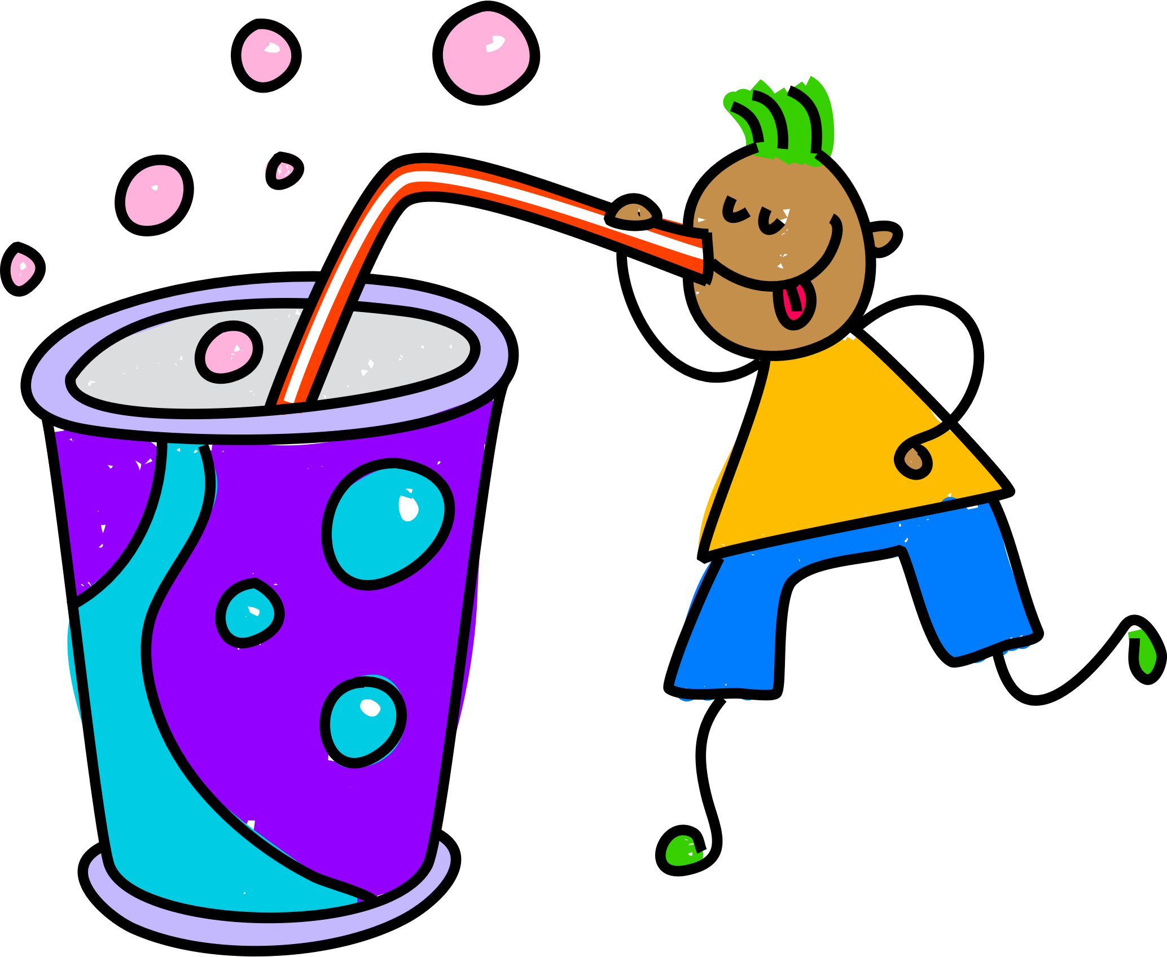
Sugar Swap – Making the Right Choices
FIZZY DRINKS
Swap those sugary and fizzy drinks for water, low fat milk or sugar free drinks. Limit drinking fruit juice to one cup per day – ideally at mealtimes.
KNOWLEDGE
To stay healthy, drink eight cups of water per day

Slide 20


Sugar Swap – Making the Right Choices
SUGARY TREATS
Swap sugary biscuits, cakes, sweets and chocolate for fruits, nuts, chopped vegetables and low-fat dips.
KNOWLEDGE
DESSERTS
Swap From sugary puddings such as ice cream, pies and tarts to a piece of fruit, fruit salad, low-fat yoghurt or sugar-free jelly.

