Slide 1
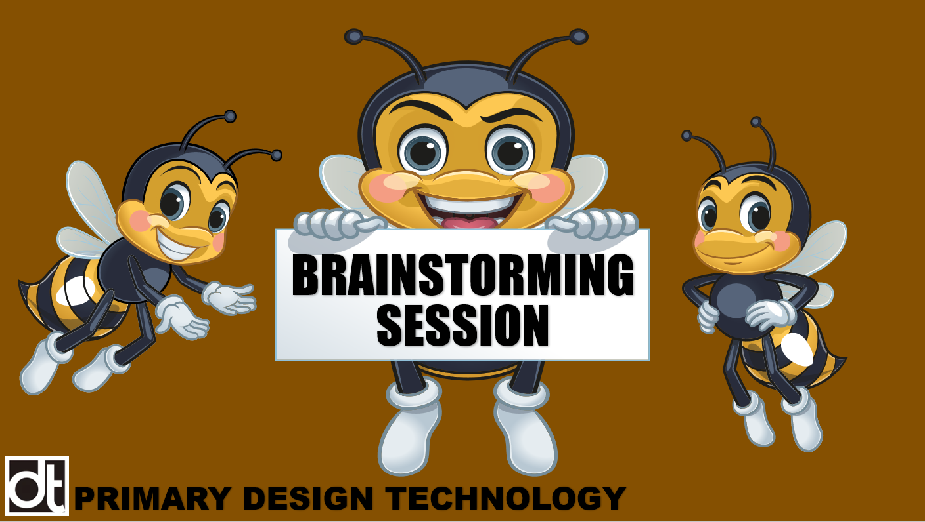

Slide 2

WHAT IS BRAINSTORMING?
Brainstorming is an activity used by designers to:
Generate ideas
Solve a problem
Answer a question
You can brainstorm on your own, but it most often done in small groups where everyone contributes their ideas and thoughts.
BRAINSTORM
BRAINSTORM

Slide 3

RULES OF BRAINSTORMING
Everyone contributes, everything is allowed.
Encourage wild ideas.
Create as many ideas as possible .
​Build on the ideas of others​
Postpone your judgement ​
​One speaker at a time- take turns
Keep focused
Ideas are owned by everyone!
BRAINSTORM
BRAINSTORM

Slide 4

MAKING DESIGN DECISIONS
Will your model ride be a vertical or horizontal ride?
Will your model ride be based on an existing ride or a completely new idea?
How will your ride be themed?
What will make your ride original and authentic?
BRAINSTORM
10 minutes
BRAINSTORM

Slide 5
MAKING DESIGN DECISIONS
Once your group has agreed on your design, write a short paragraph to explain your product.
What will your airline meal menu consist of:
Starter
Main Course
Dessert
BRAINSTORM
BRAINSTORM

Slide 6
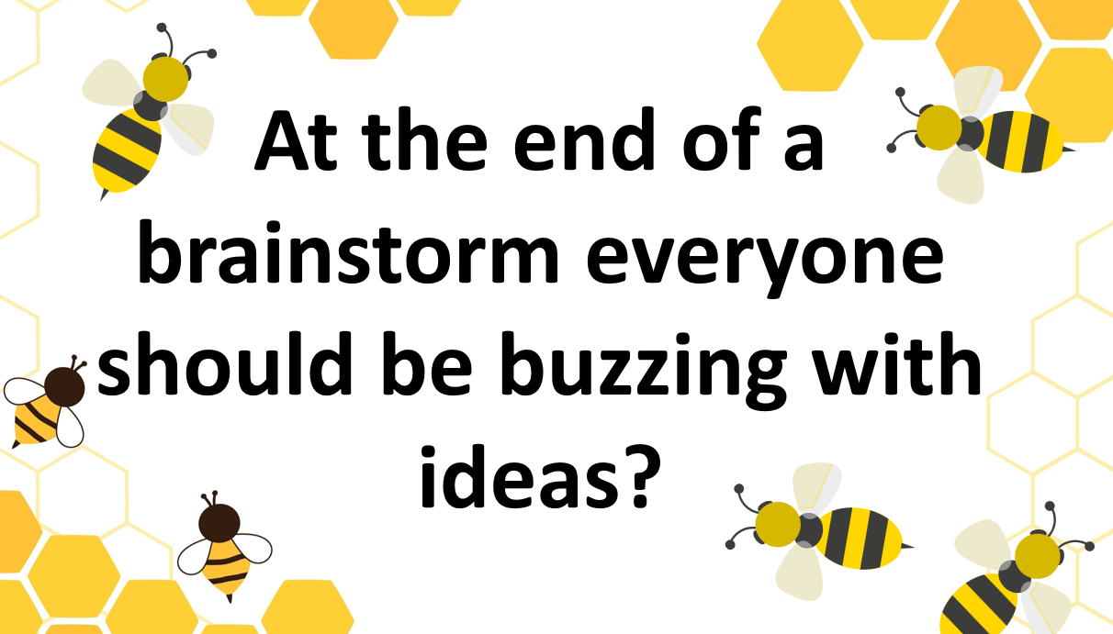
BRAINSTORM
BRAINSTORM

