Slide 1

HOW TO WRITE A
RECIPE

Slide 2

Writing a Recipe
A recipe is a list of ingredients and instructions for making a food dish.
KNOWLEDGE

Slide 3
Writing a Recipe
Ingredients: Foods that are combined to create a dish.
What ingredients do you need to make your fruit kebab?
KNOWLEDGE

Slide 4
Writing a Recipe
Equipment: Cooking tools that are needed for a particular purpose or task.
What equipment do you need to make your fruit kebab?
KNOWLEDGE

Slide 5
Method: A set of actions that are followed to perform a task.
What do you need to do to make your fruit kebab?
KNOWLEDGE

Slide 6



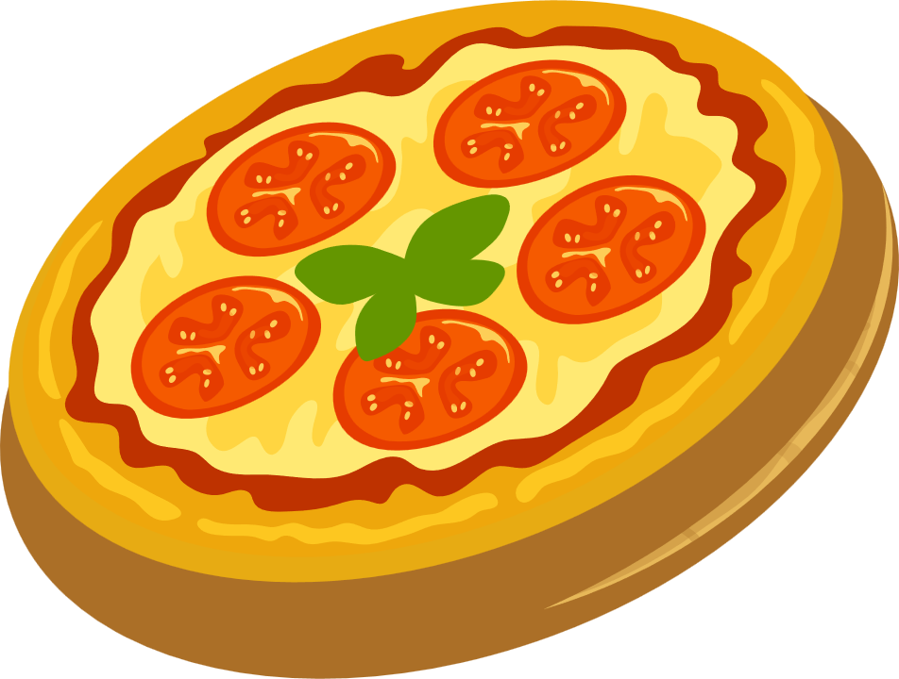
WHAT IS A RECIPE?
A recipe is an instruction
Instructions are written for someone who needs to know how to do something.
A recipe is an instruction for someone who needs to prepare a food dish.
The food dish could be:
KNOWLEDGE
Healthy wrap Pizza Cupcake Fruit smoothie

Slide 7
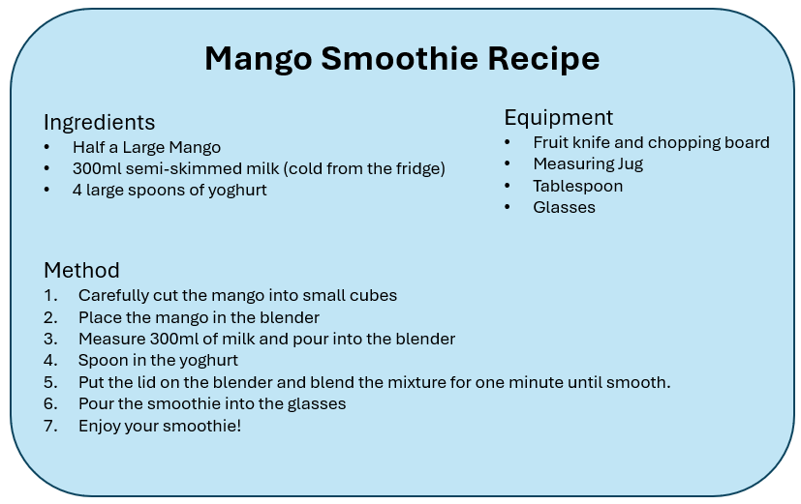
WRITING A RECIPE
The recipe has four parts
Title
Ingredients
Equipment
Method
Make the title simple – make it clear what is going to be made.
KNOWLEDGE

Slide 8

Post-It Note Planning
Write down all the tasks that you are going to do to make your food product.
Washing
Cutting
Slicing
Chopping
Grating
Mixing
Then put them in the order that you are going to need to do them.
KNOWLEDGE

Slide 9


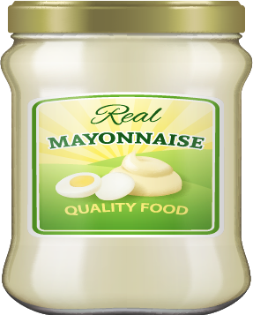








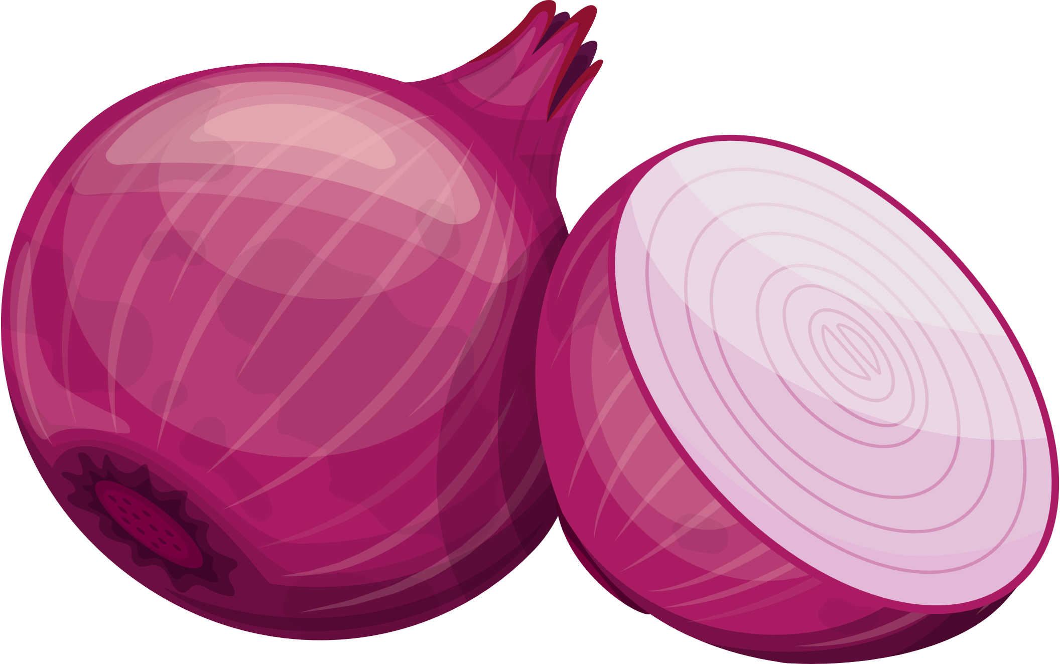

WRITING A RECIPE
The ingredients are a list of all the different foods and the quantities that you will need to create the dish.
KNOWLEDGE

Slide 10







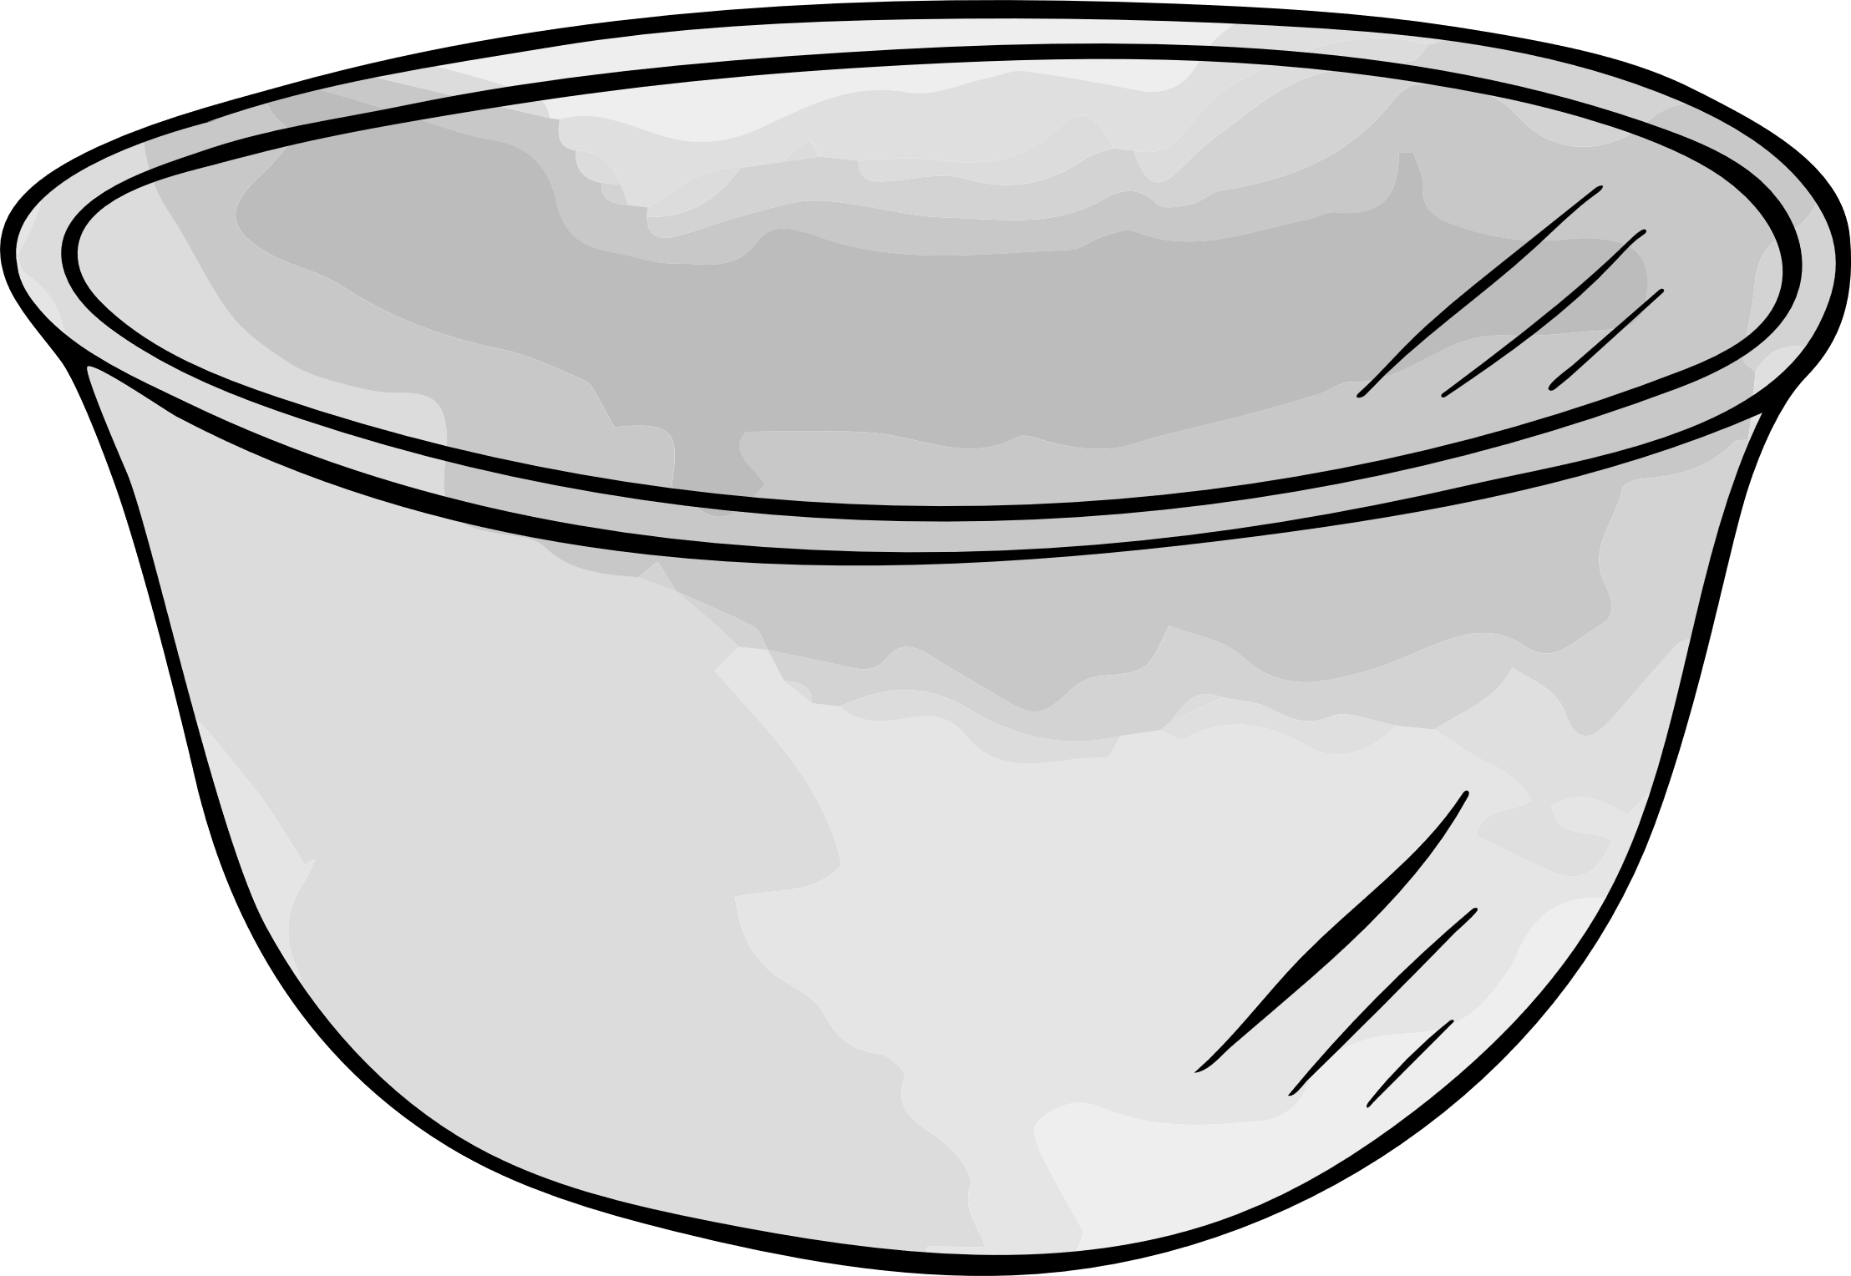
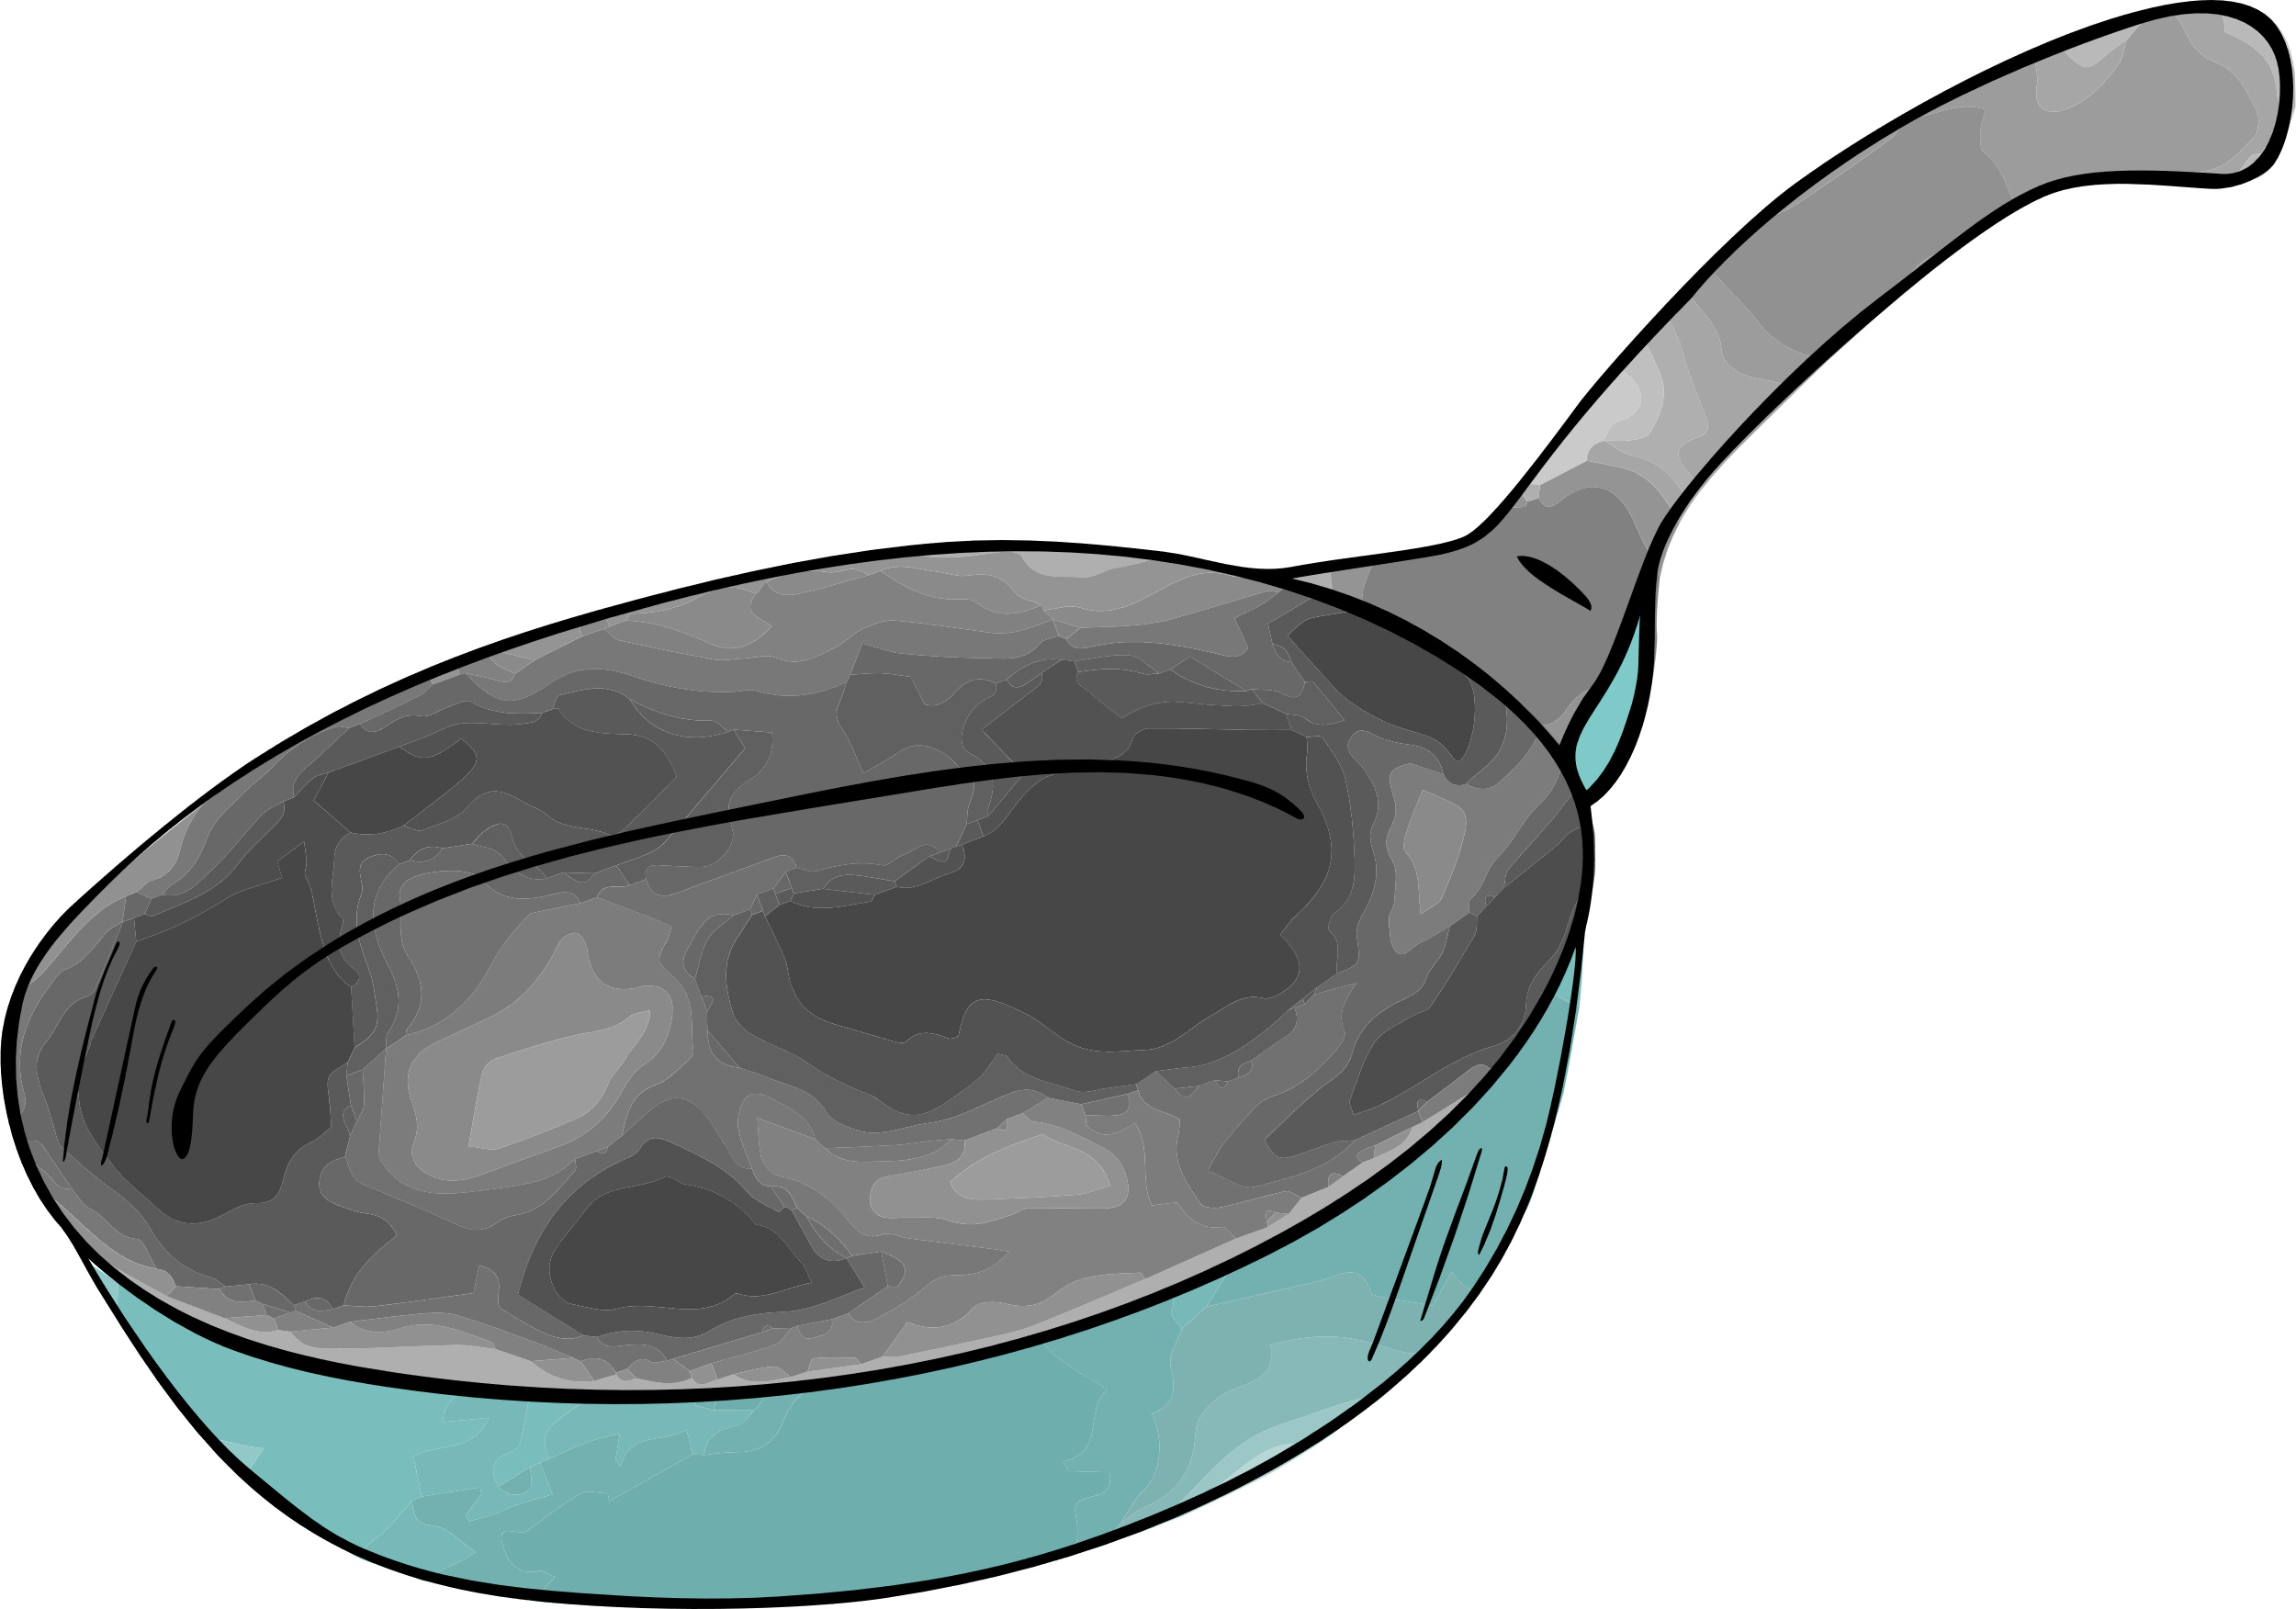
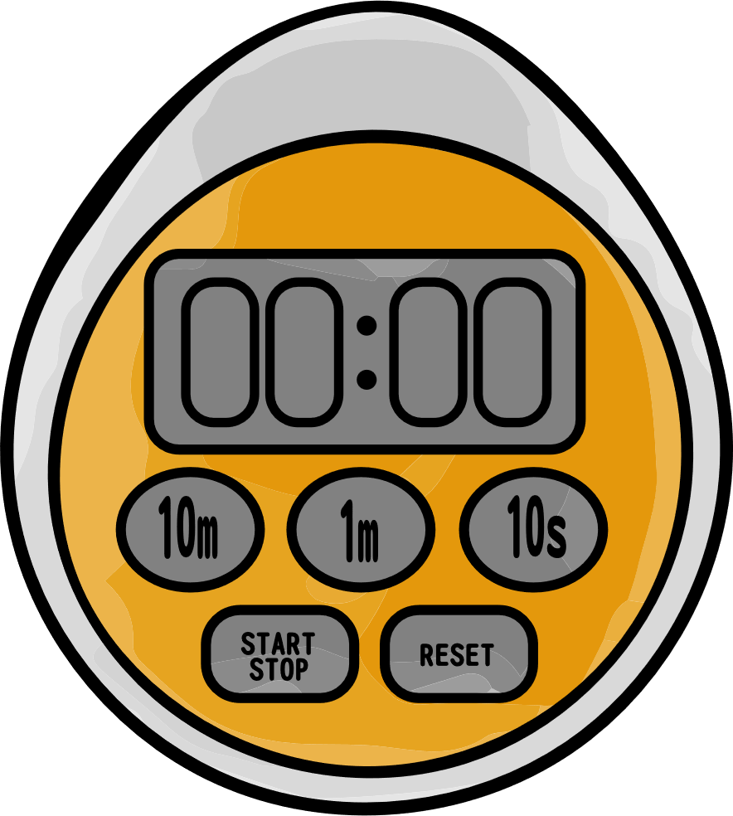
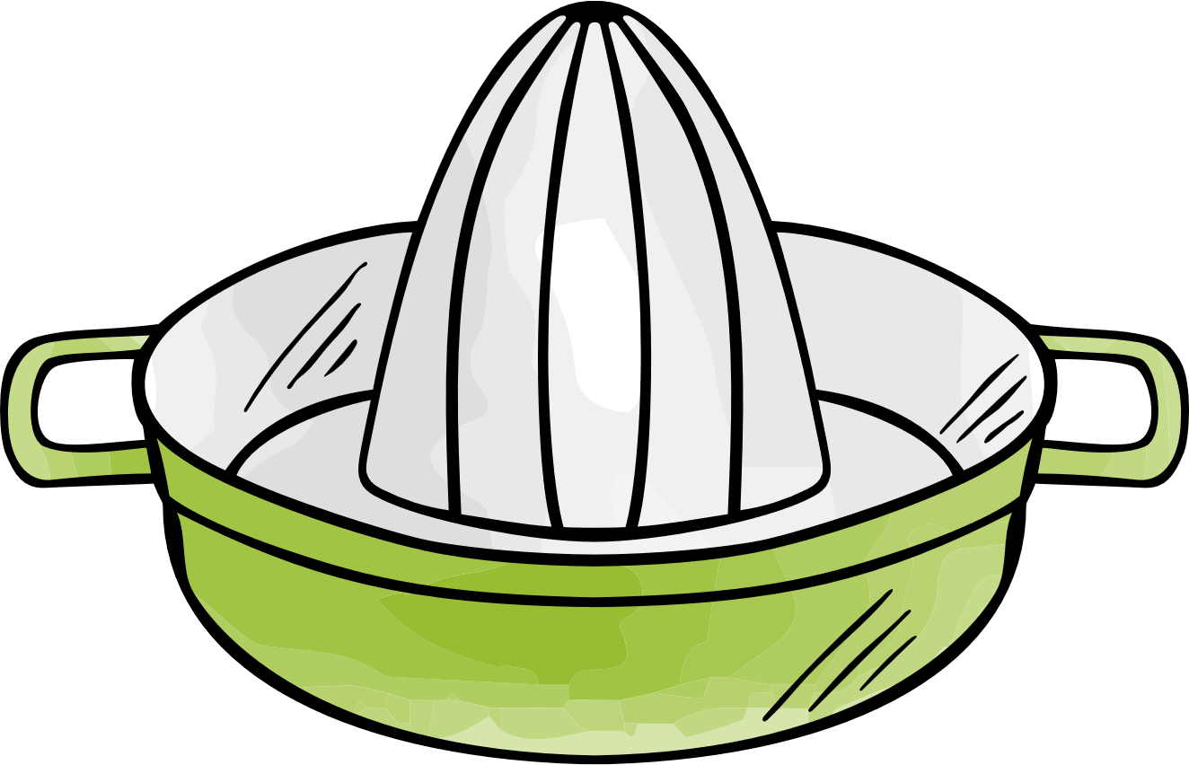

WRITING A RECIPE
The equipment is a list of all the different tools and kitchen equipment that you will need to create the dish.
KNOWLEDGE

Slide 11

WRITING A RECIPE
The method is a set of actions that need to be carried out to make the dish
Write in the present tense
KNOWLEDGE
Use adverbs of time
(then, next, finally)
Use clear descriptions and ‘bossy verbs’

Slide 12
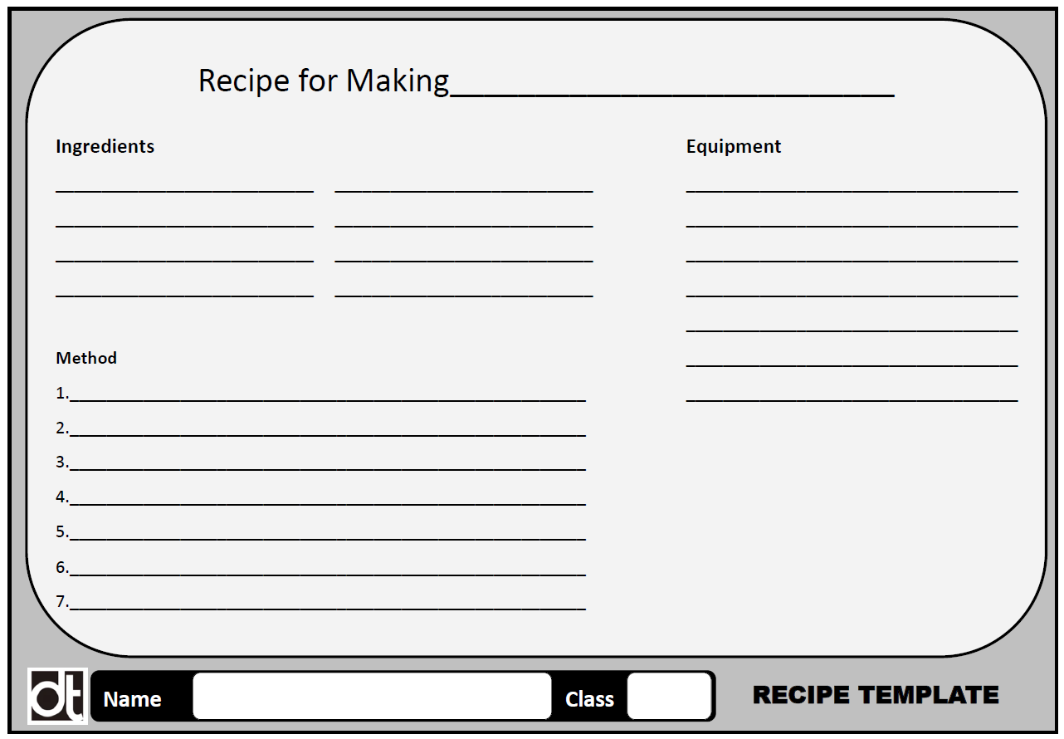

WRITING A RECIPE
To help when writing a recipe, use a template that has space for the four parts of the recipe
Title
Ingredients
Equipment
Method
If there is space, you could draw or add a photo of the food dish
KNOWLEDGE

Slide 13
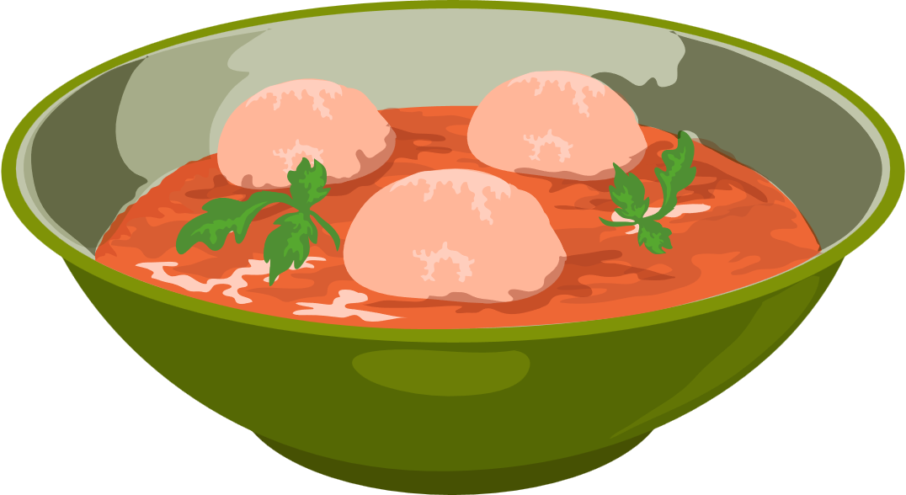
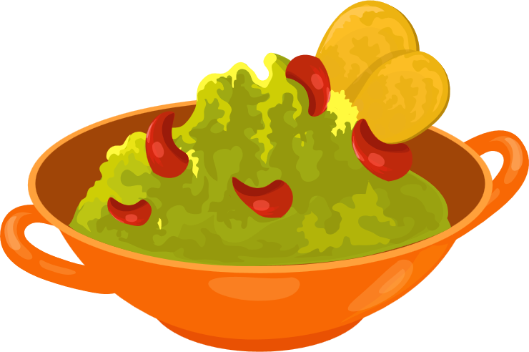
ADAPTING A RECIPE
Adapting a recipe is when we add or remove ingredients from a recipe to create a new recipe.
Adapting a recipe will change either the taste, texture or appearance of the food dish.
We can adapt a recipe to make it healthier by adding ingredients that promote healthy eating and a balanced diet.
KNOWLEDGE

Slide 14
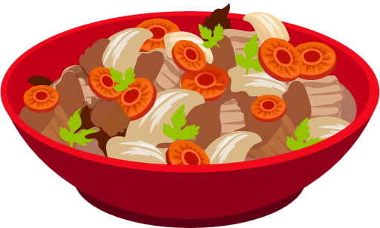
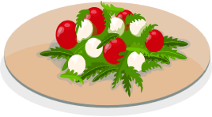
ADAPTING A RECIPE
Sometimes we might adapt a recipe to meet the design brief or the design specifications.
Other times we might adapt a recipe to make a food product that is original and unique.
Sometimes one of the ingredients might not be available and we need to substitute in a different ingredient to complete the recipe.
KNOWLEDGE

Slide 15
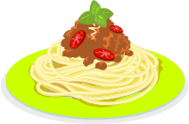
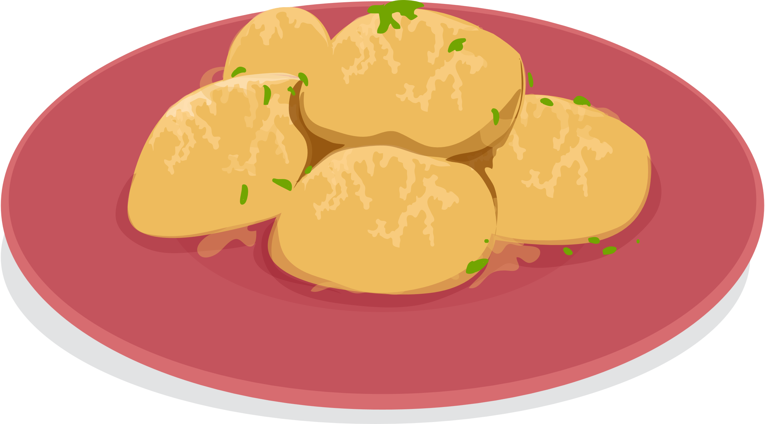
ADAPTING A RECIPE
Recipes might need adapting because of dietary choices (religious, cultural, vegetarian or vegan diets)
Recipes might need adapting due to allergies or simply somebody not liking one of the ingredients.
KNOWLEDGE

Slide 16


ADAPTING A RECIPE
When adapting a recipe, you will know the base recipe for making the product and then add some additional ingredients.
KNOWLEDGE
A plain pizza (bread dough, tomato sauce and cheese) is the base recipe. Adding toppings creates a new pizza recipe.

Slide 17
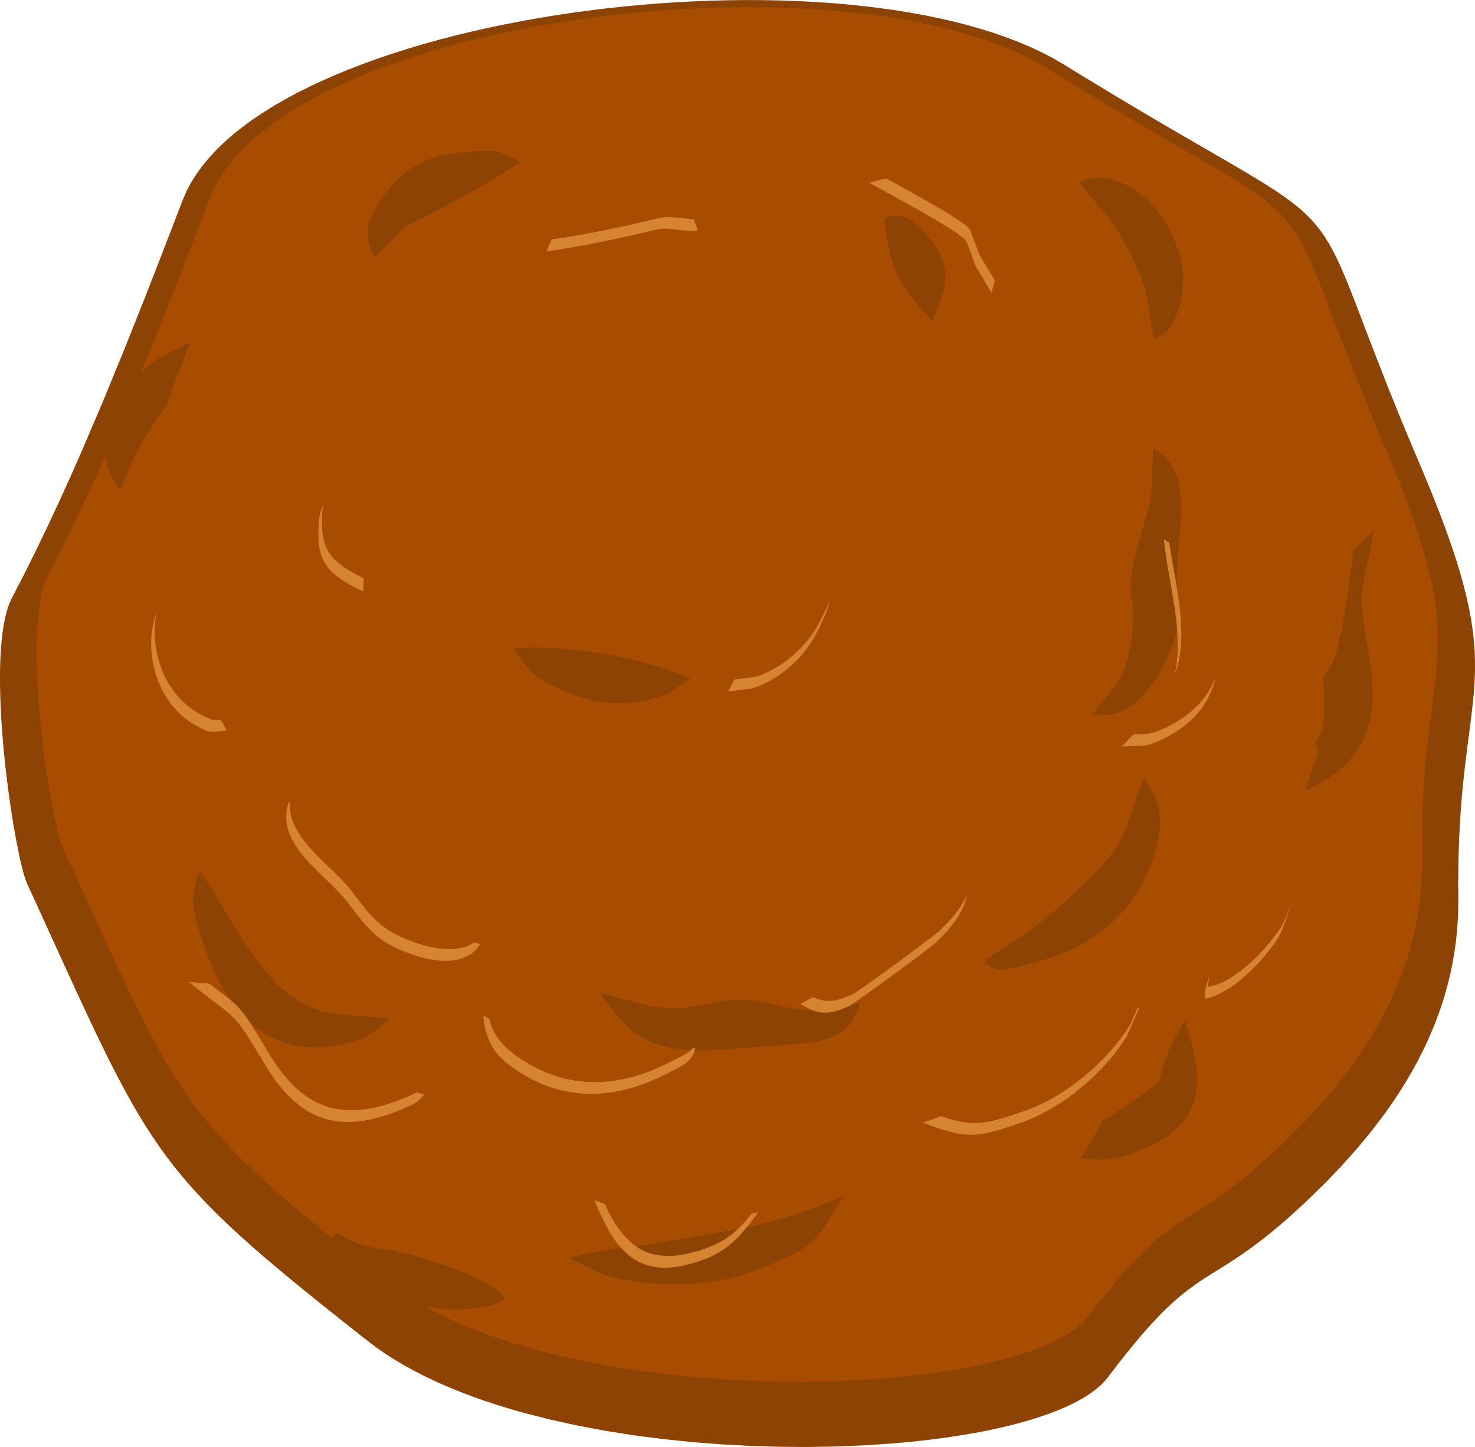

ADAPTING A RECIPE
When adapting a recipe, you will know the base recipe for making the product and then add some additional ingredients.
KNOWLEDGE
A plain biscuit is the base recipe to which ingredients such as spices, fruit, nuts or chocolate can be added to create a new biscuit recipe.

Slide 18
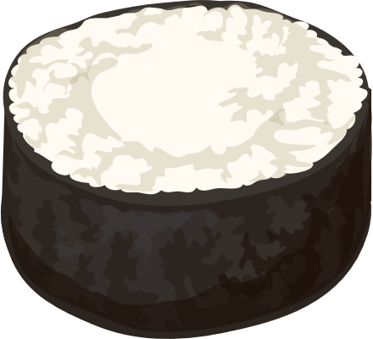
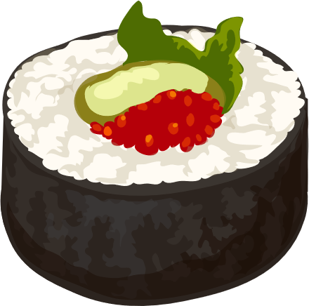
ADAPTING A RECIPE
When adapting a recipe, you will know the base recipe for making the product and then add some additional ingredients.
KNOWLEDGE
A sushi roll (maki) is a sushi rice and a filling wrapped in nori (seaweed). Different maki are created by changing the filling ingredients.

