Slide 1
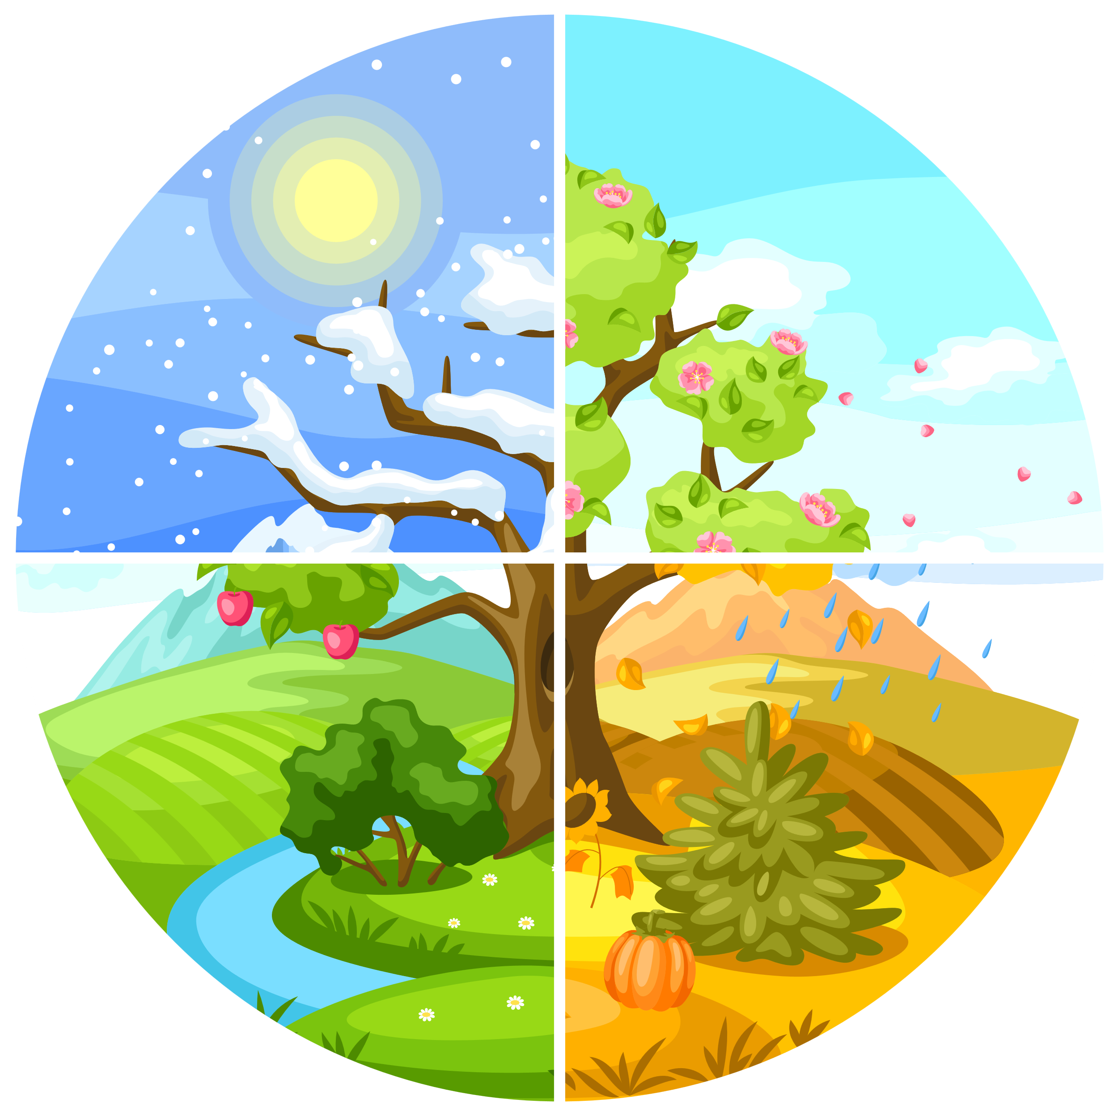
UNDERSTANDING
SEASONALITY

Slide 2
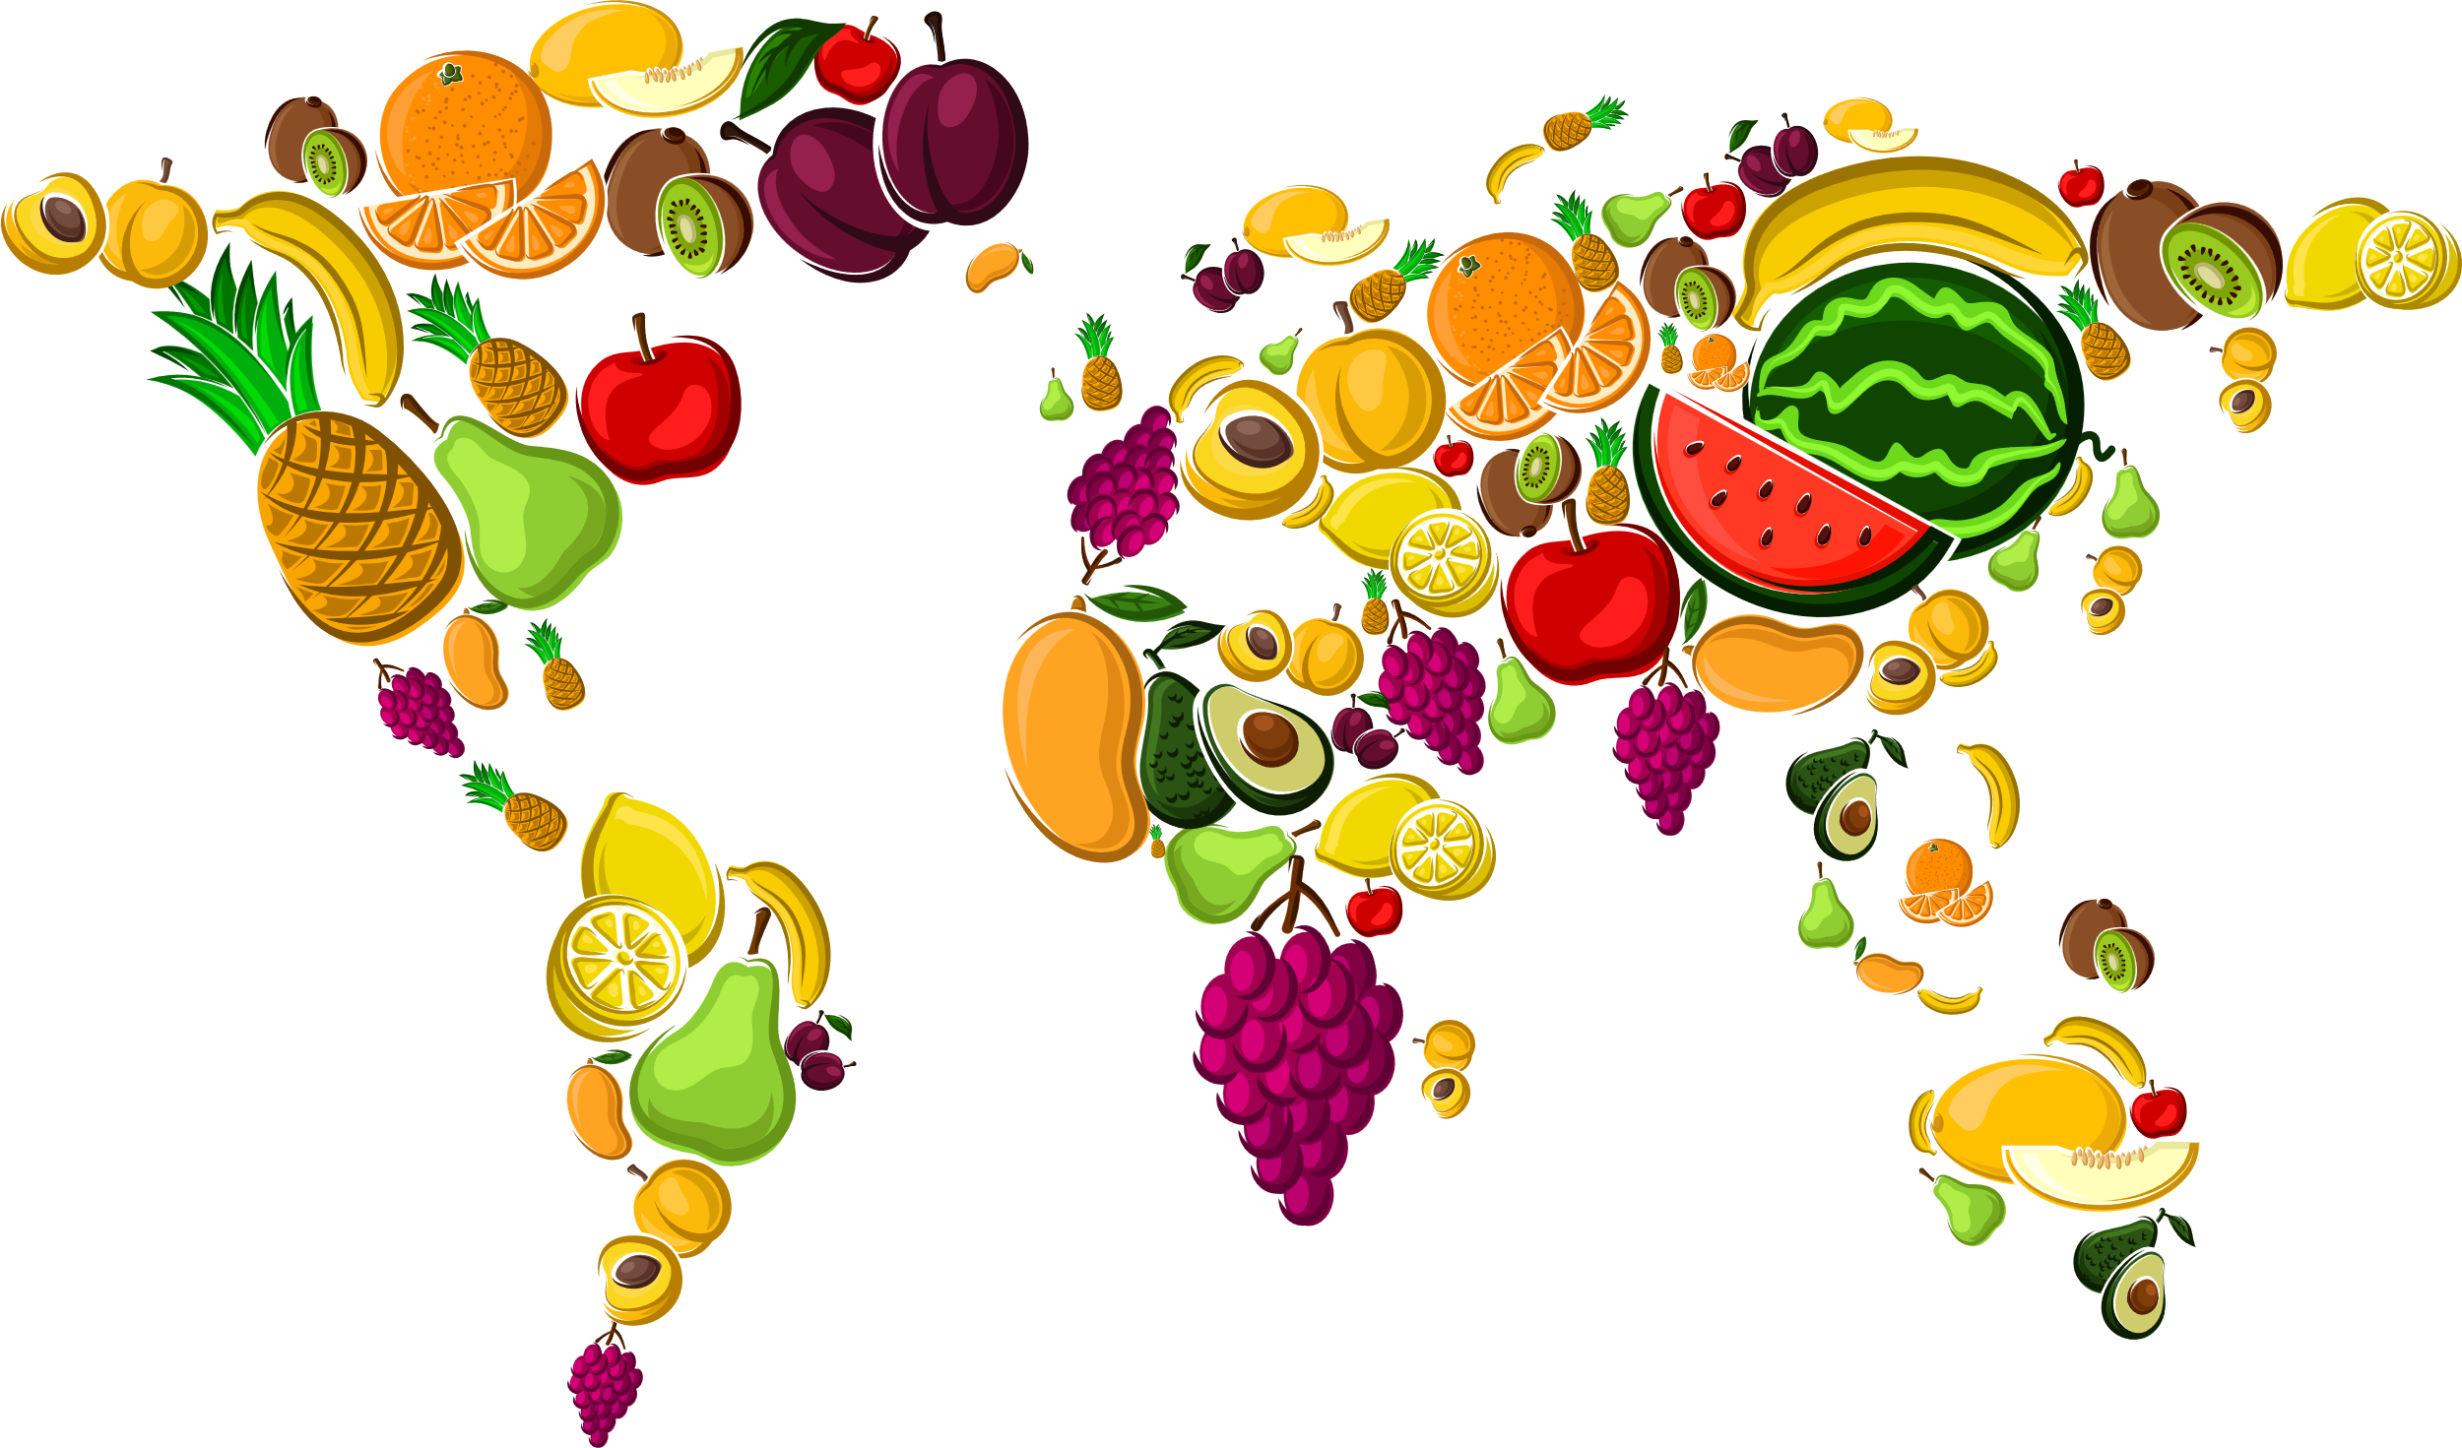
UNDERSTANDING SEASONALITY
Fruit and Vegetables are grown all over the world. Some fruit and vegetables need lots of sunshine or hot weather to grow. Some fruit and vegetables need cool and wet weather to grow.
Most vegetables and some fruits can be grown in the UK.
KNOWLEDGE

Slide 3

UNDERSTANDING SEASONALITY
In different parts of the world the weather and climate is different at different times of the year.
When it is summer in the United Kingdom it is winter in places like South Africa and Australia.
KNOWLEDGE

Slide 4
UNDERSTANDING SEASONALITY
As seasons and the weather change, so do the conditions needed for plats to grow well.
WINTER
SPRING
KNOWLEDGE
SUMMER
AUTUMN

Slide 5
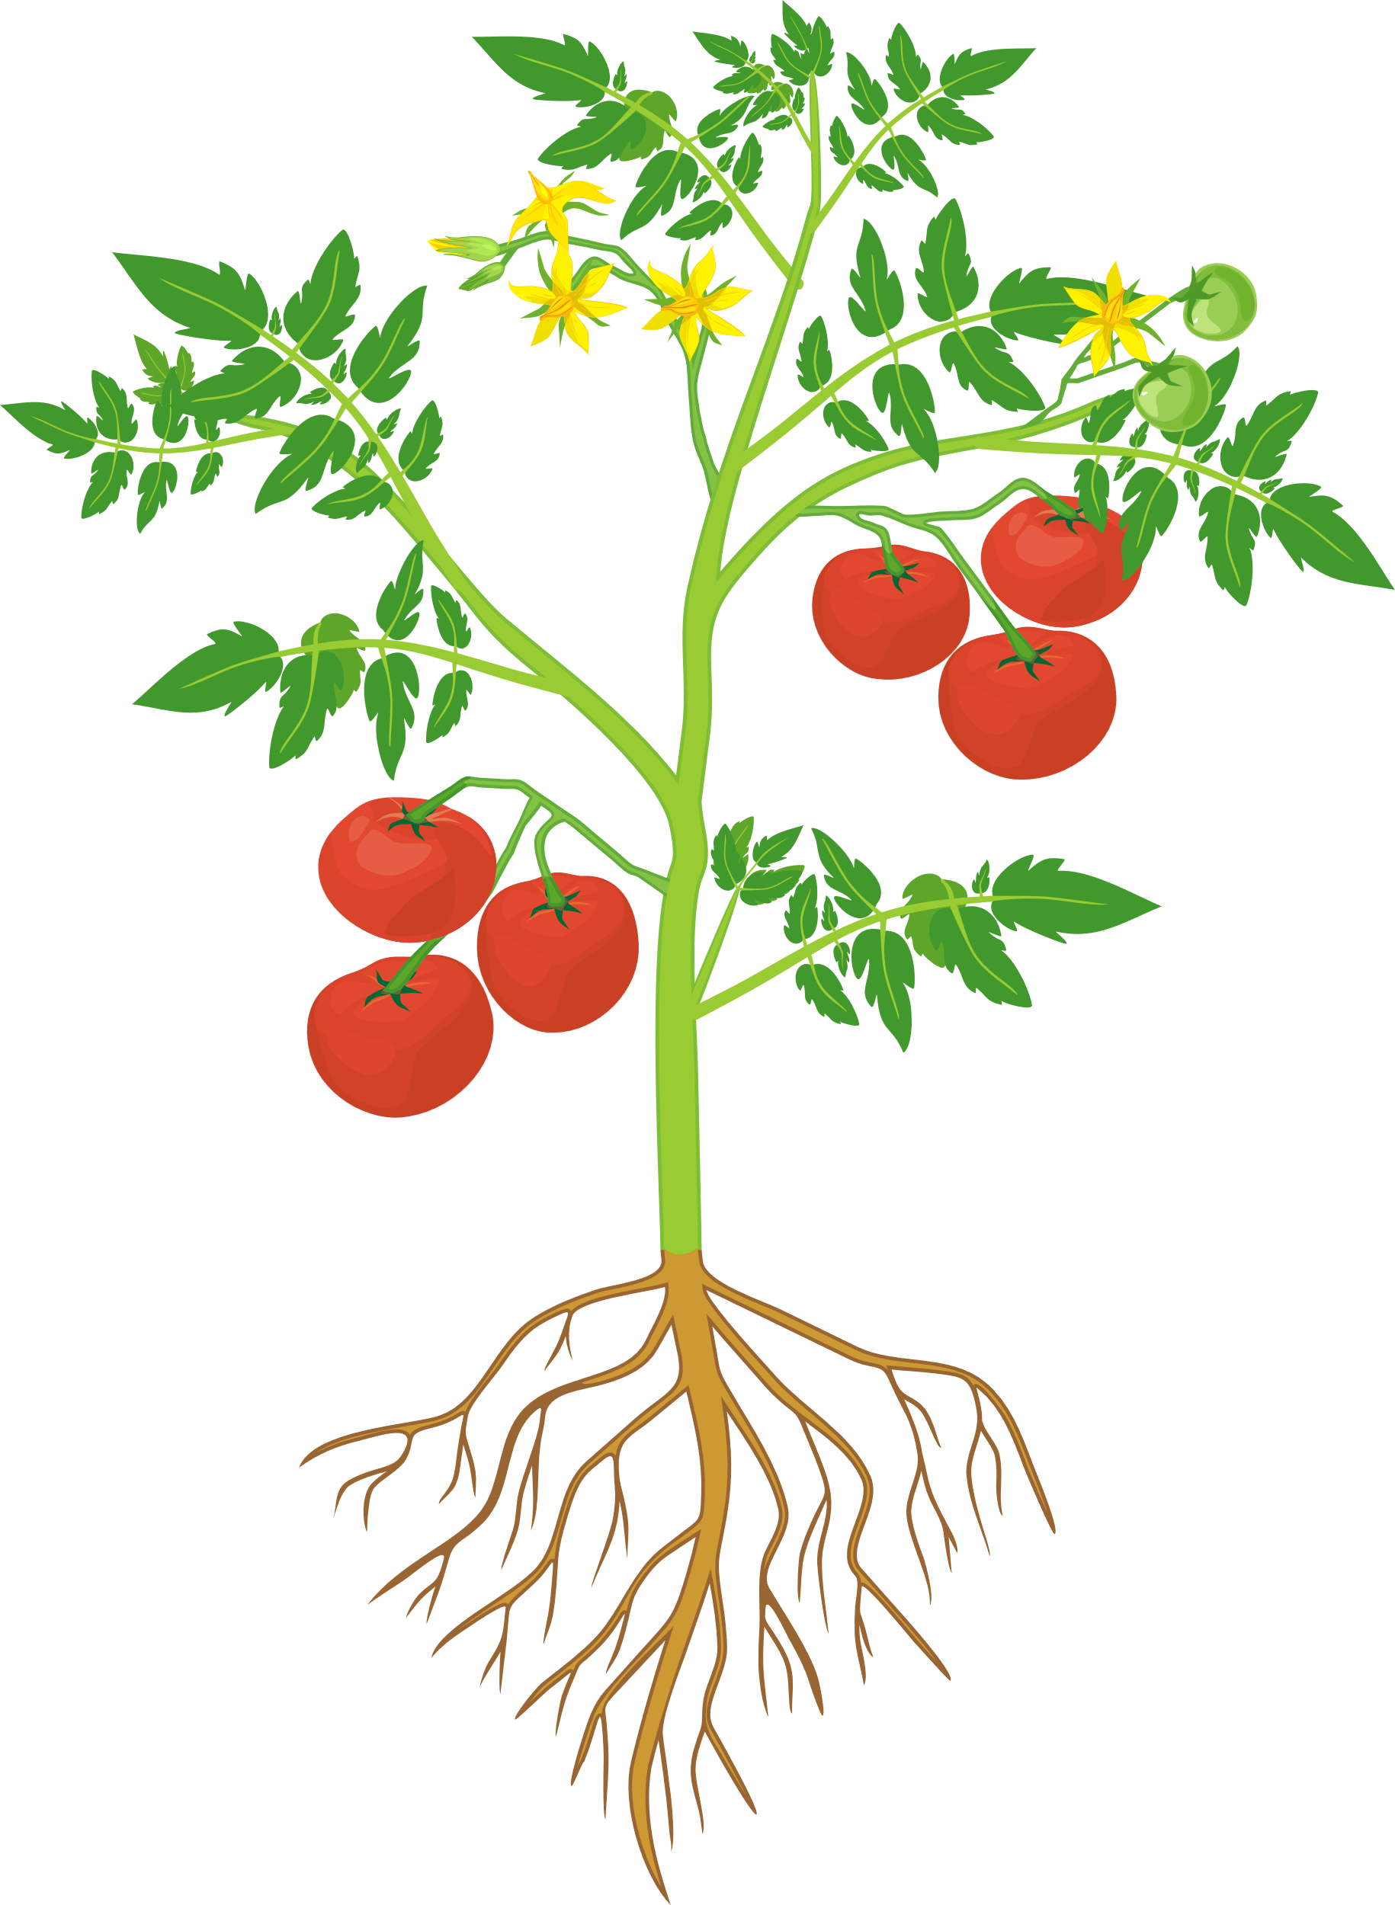
UNDERSTANDING SEASONALITY
Growing Plants
To grow, plants need:
Water
Sunlight
Warmth
These are the conditions that plants need to grow well.
KNOWLEDGE

Slide 6
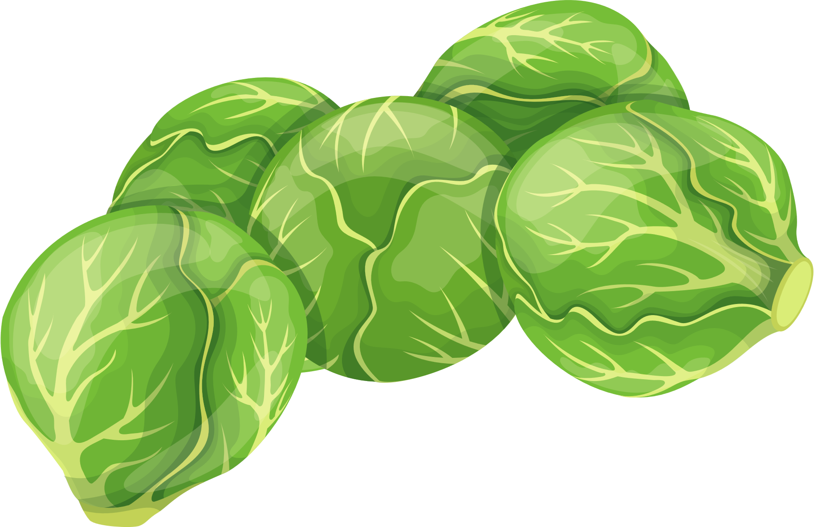
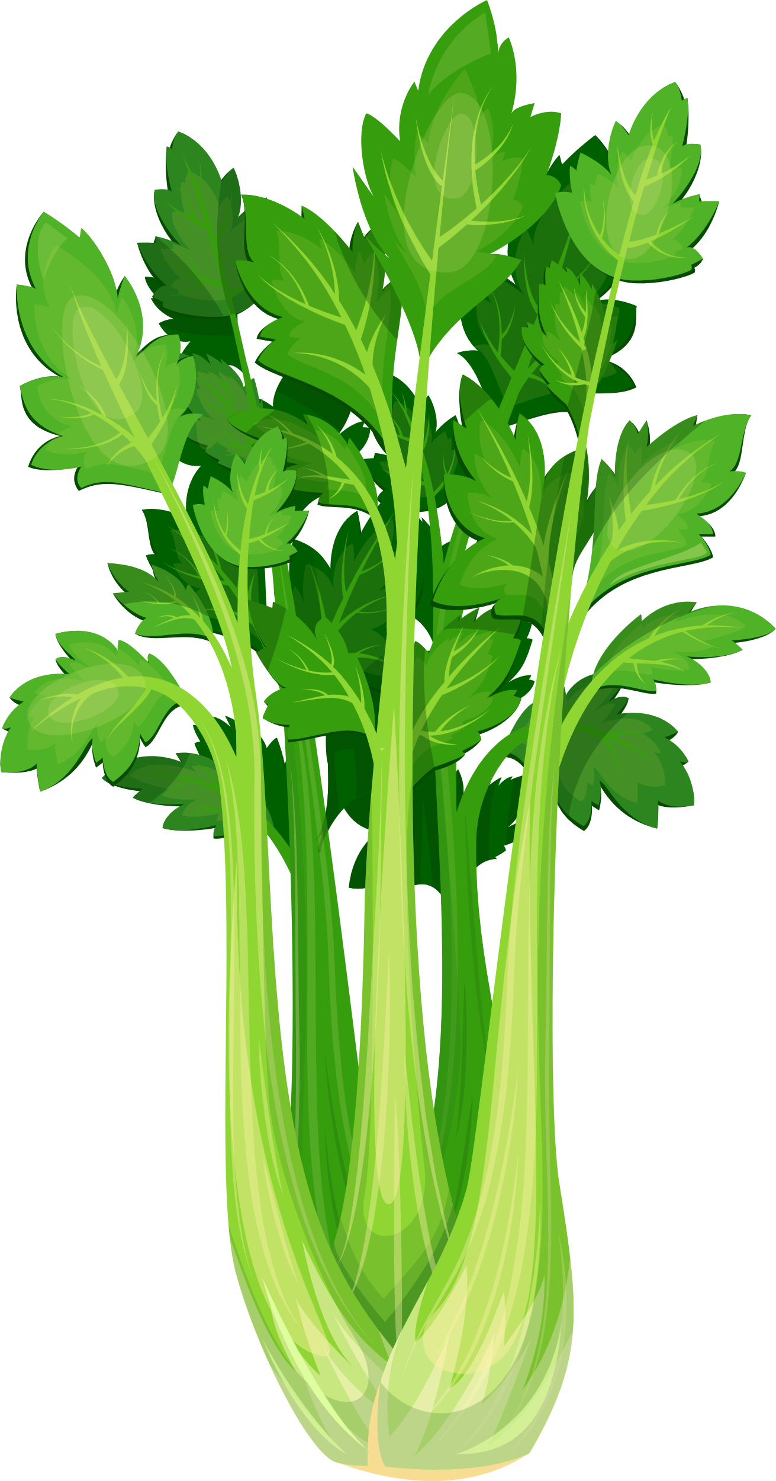

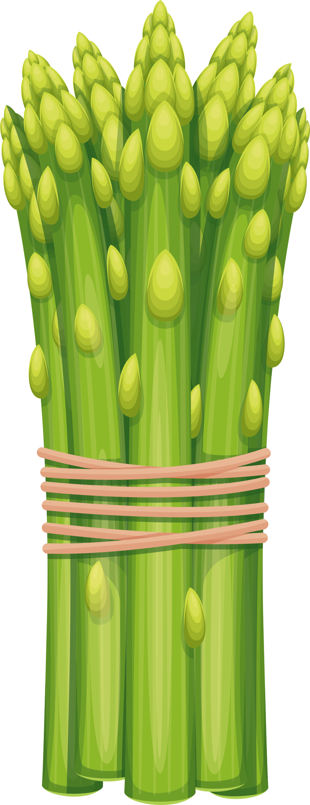

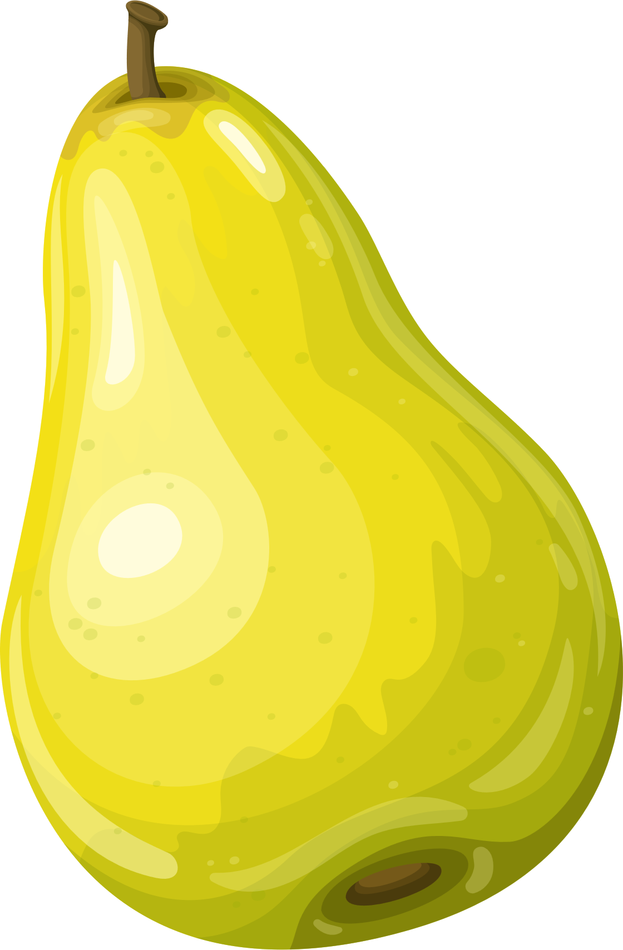

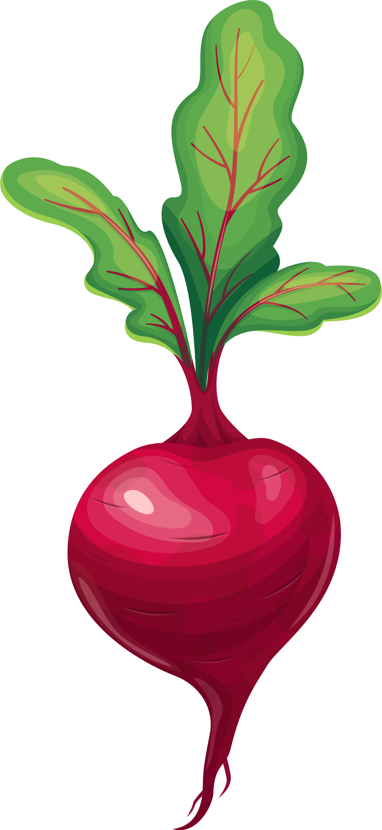



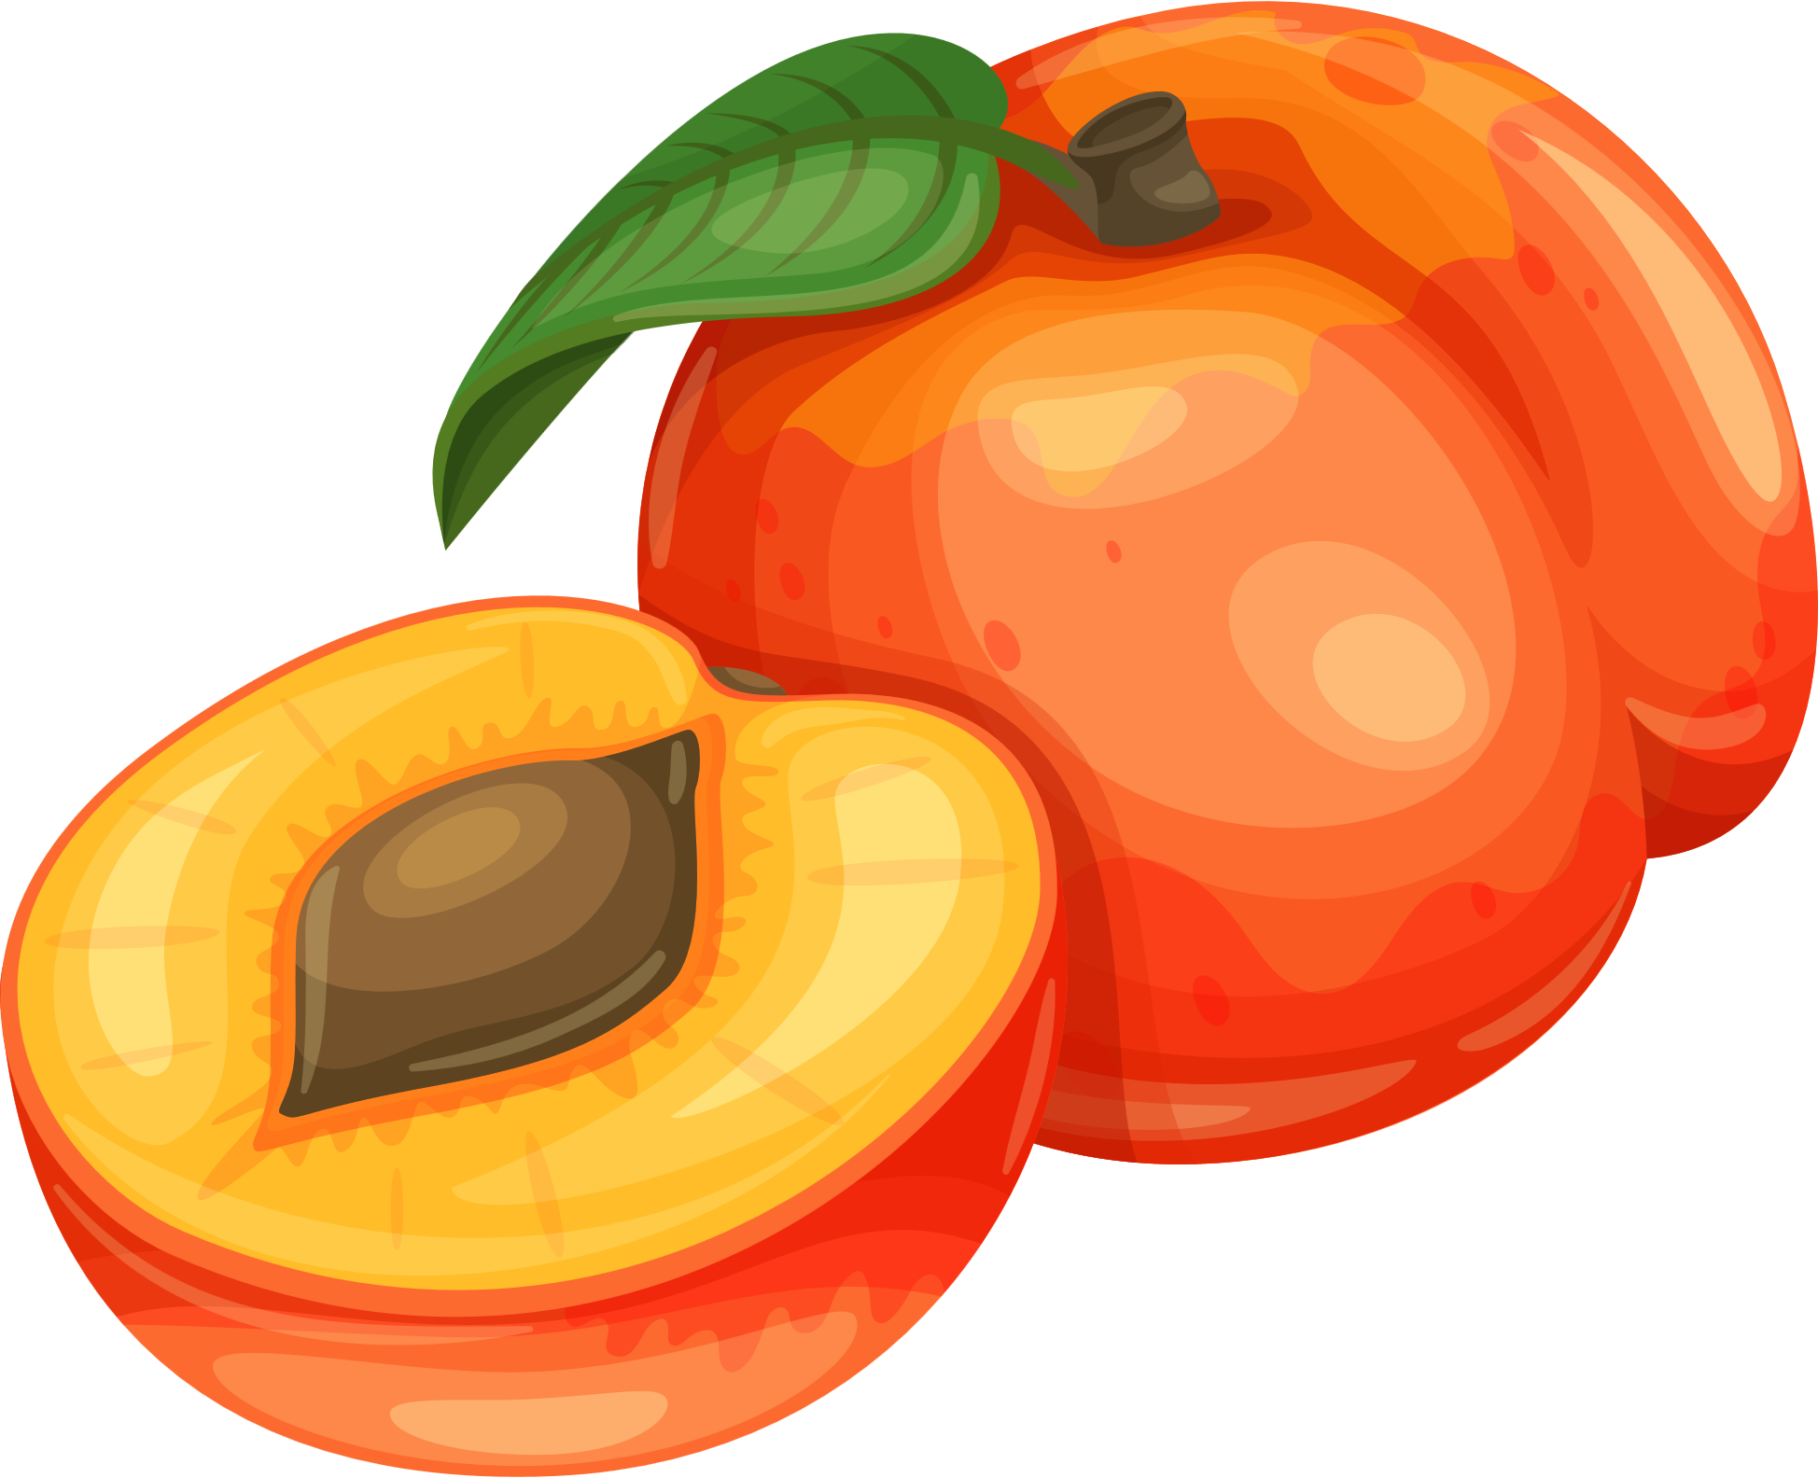

UNDERSTANDING SEASONALITY
In the UK, different fruit and vegetables finish growing at different times of the year.
WINTER
SPRING
KNOWLEDGE
SUMMER
AUTUMN

Slide 7

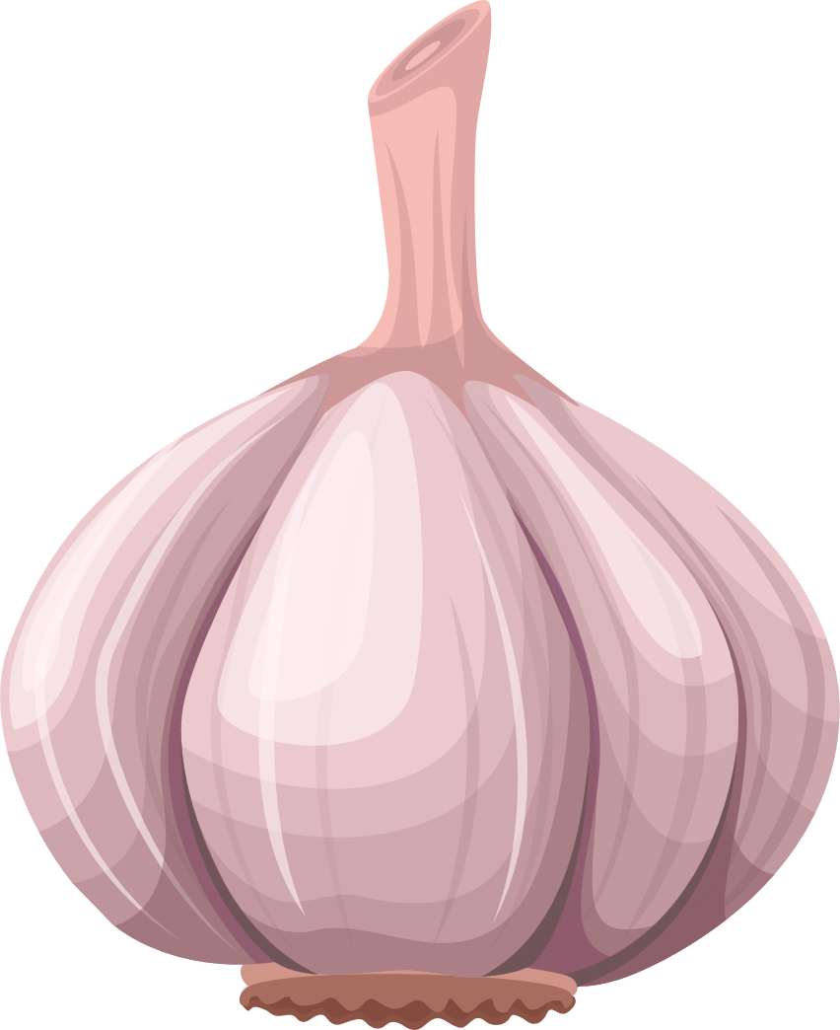
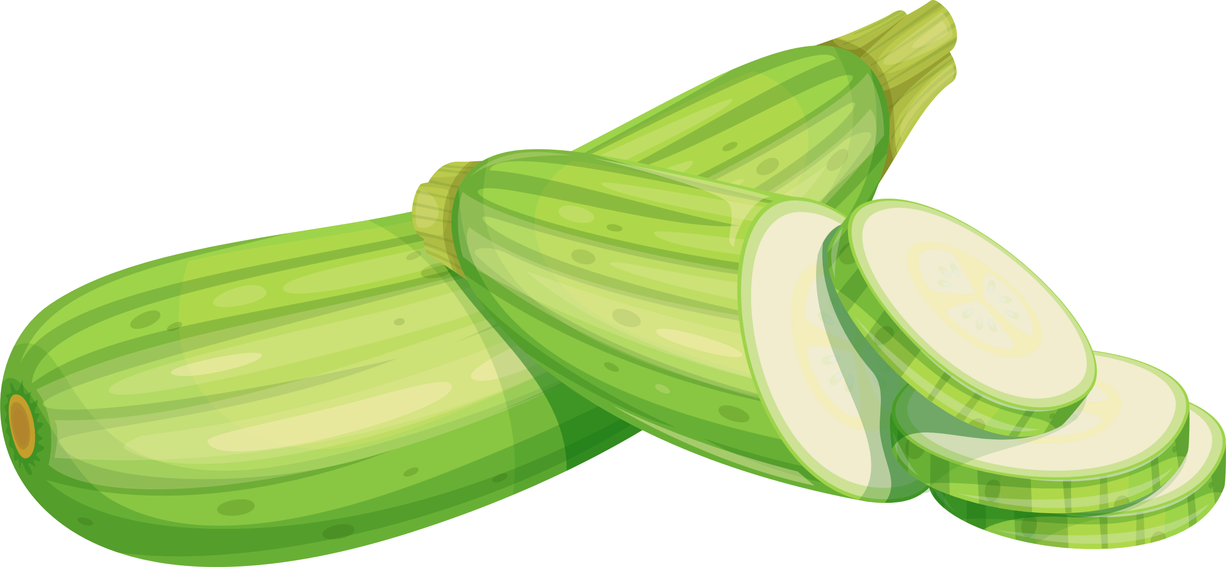

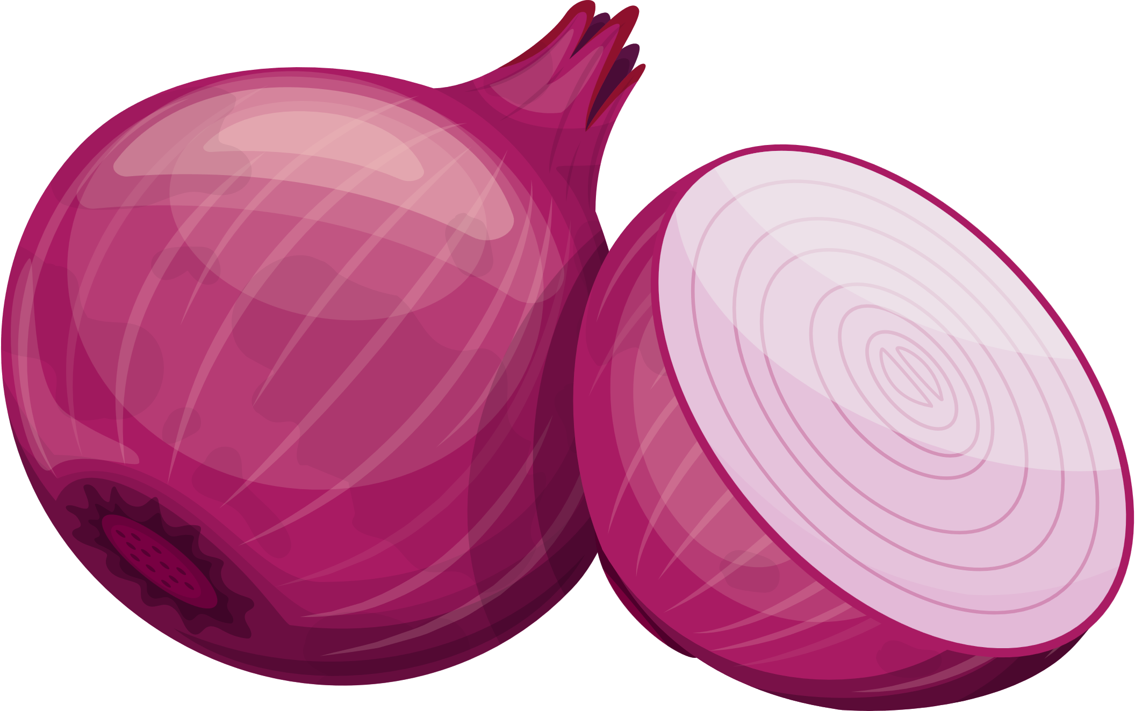
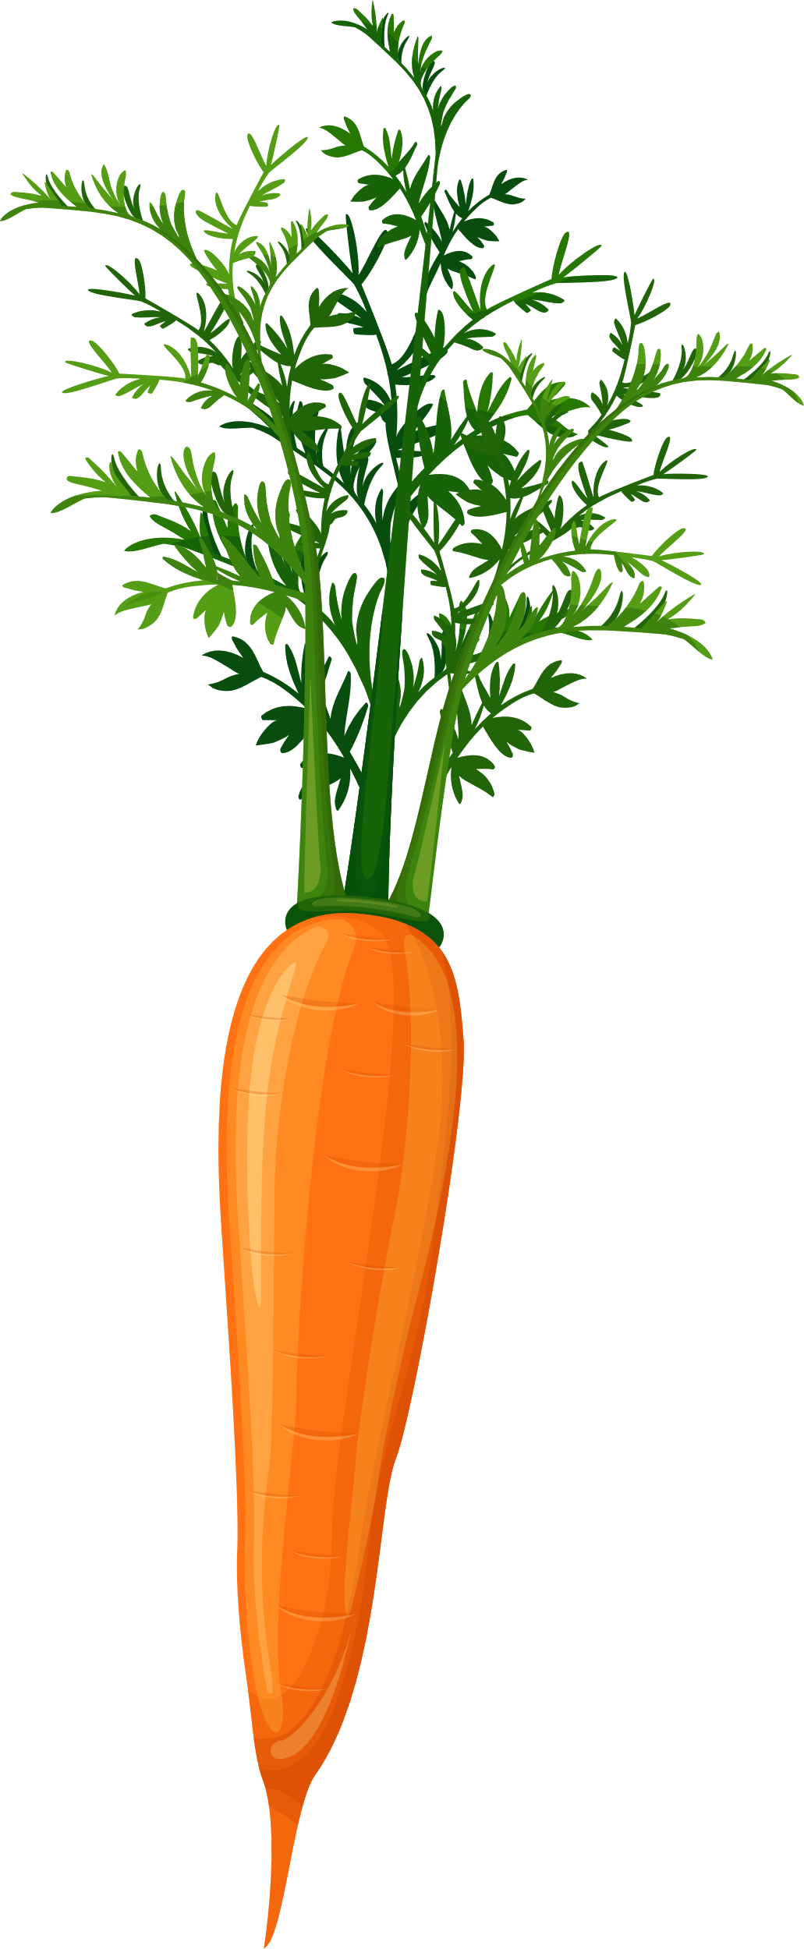



UNDERSTANDING SEASONALITY
garlic
courgettes
onions
spring onions
KNOWLEDGE
beetroot
aubergine
carrots
May
June
tomatoes
broccoli
April
July
asparagus
peppers

Slide 8
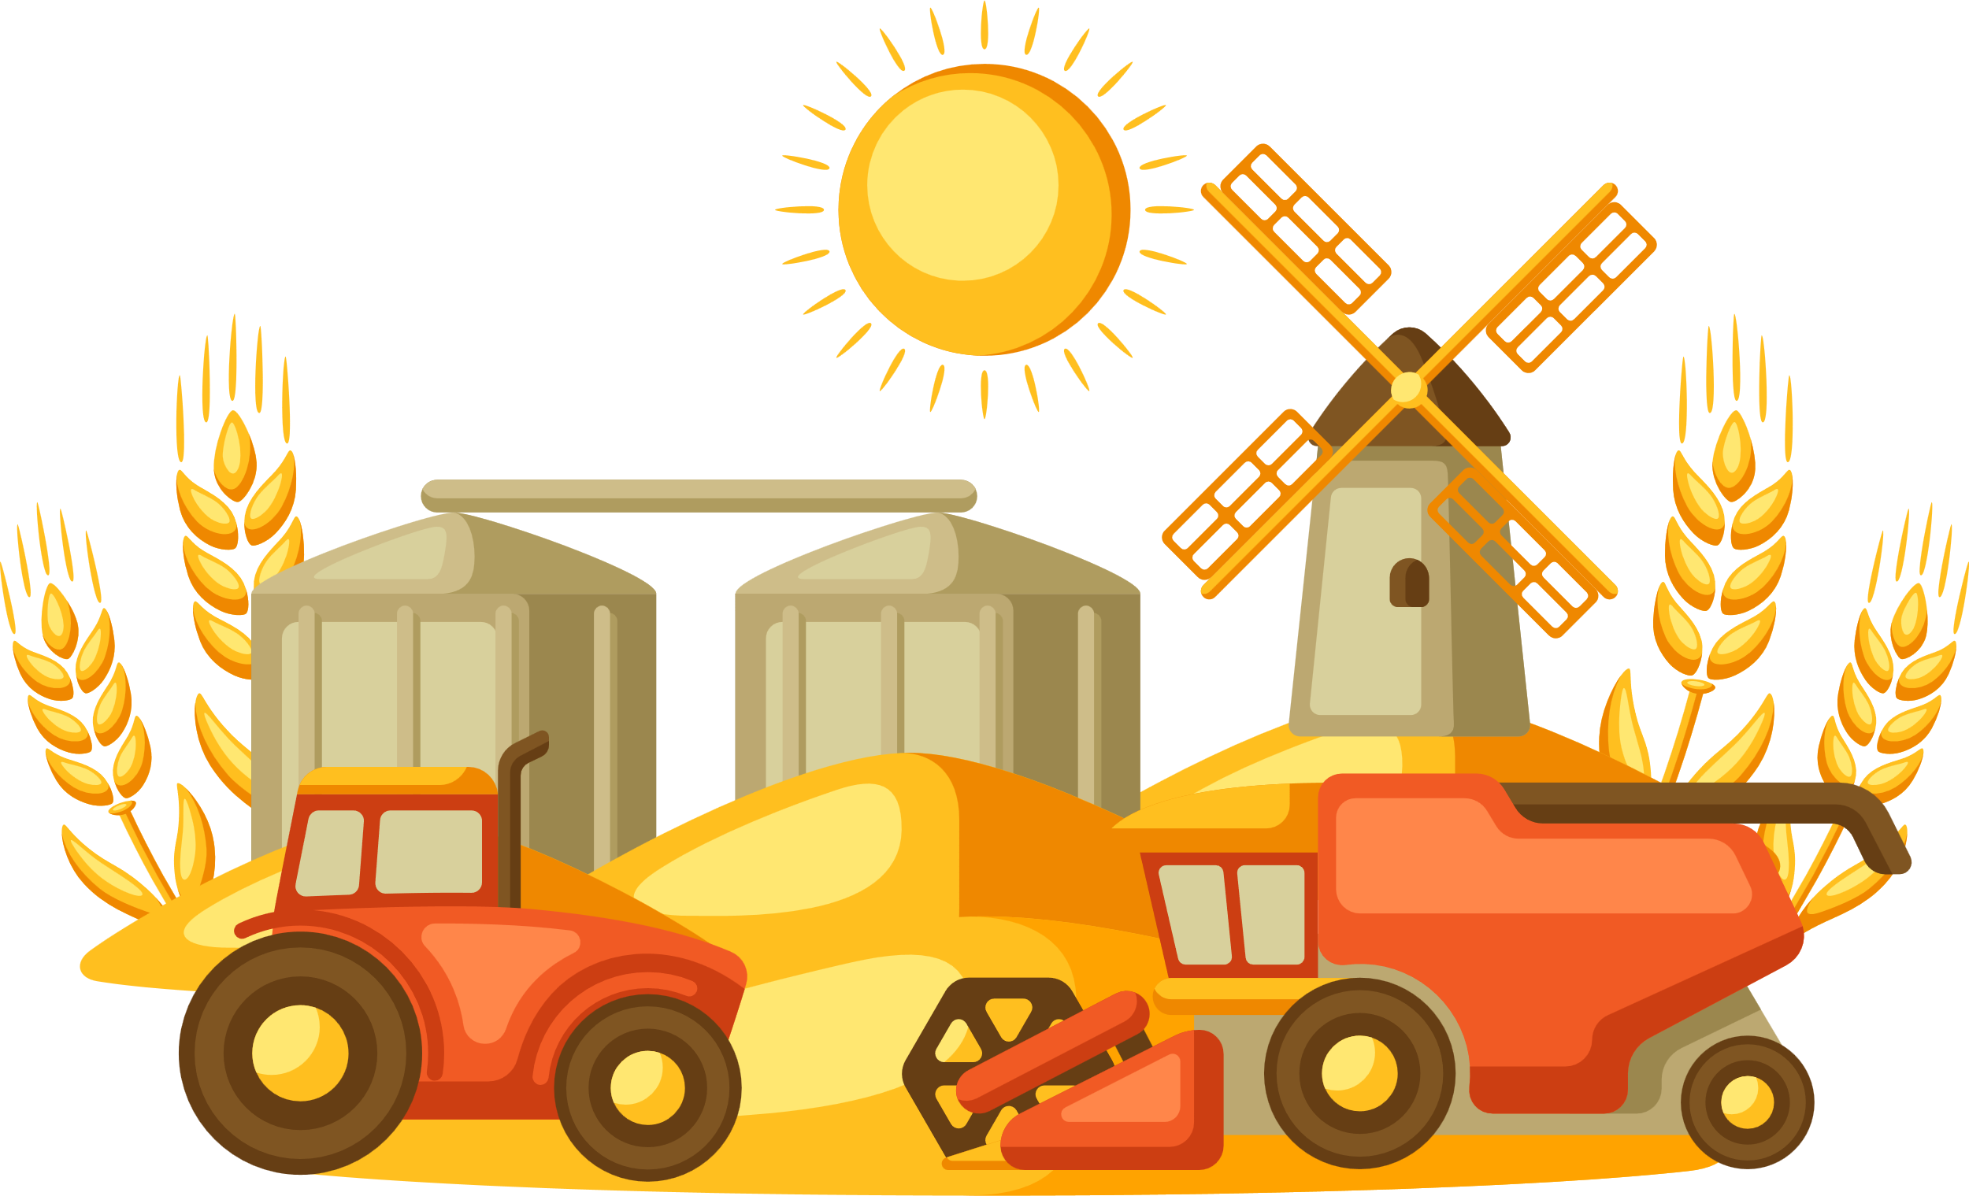
UNDERSTANDING SEASONALITY
Eating Seasonal Foods
When fruit and vegetables finish growing and are ready to eat, they are collected from the fields. This is called harvesting.
KNOWLEDGE
Eating food that is seasonal supports UK farmers and is good for the environment. Eating food that is not in season means energy is used to store the food or it has to be imported from other countries. The further food has to travel, the more energy is used, and this has a negative impact on the environment.

Slide 9
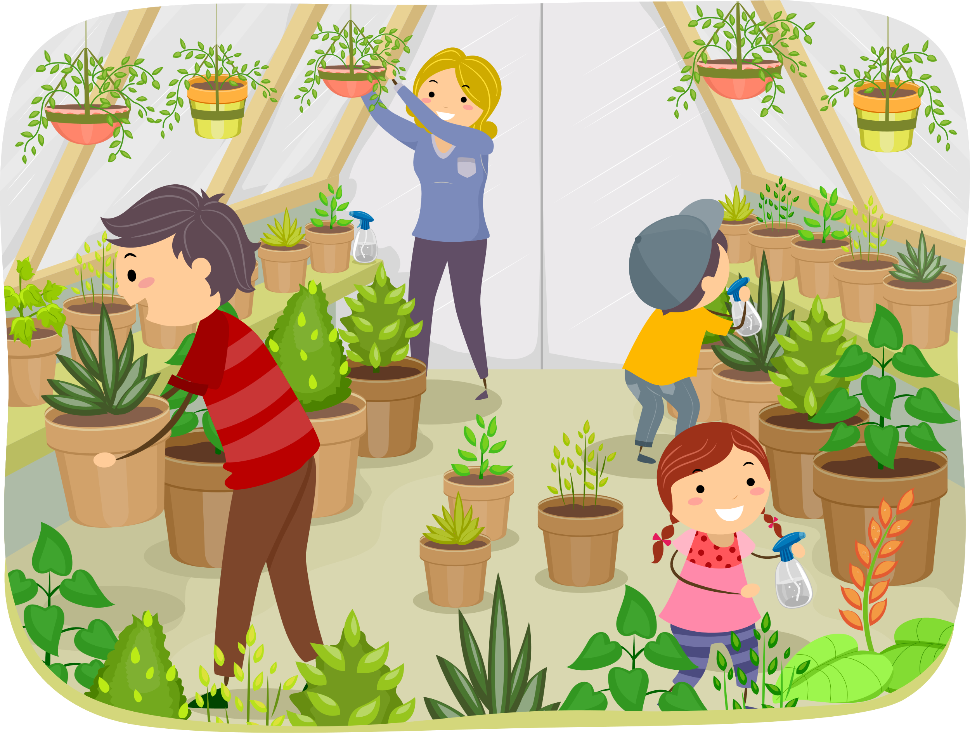
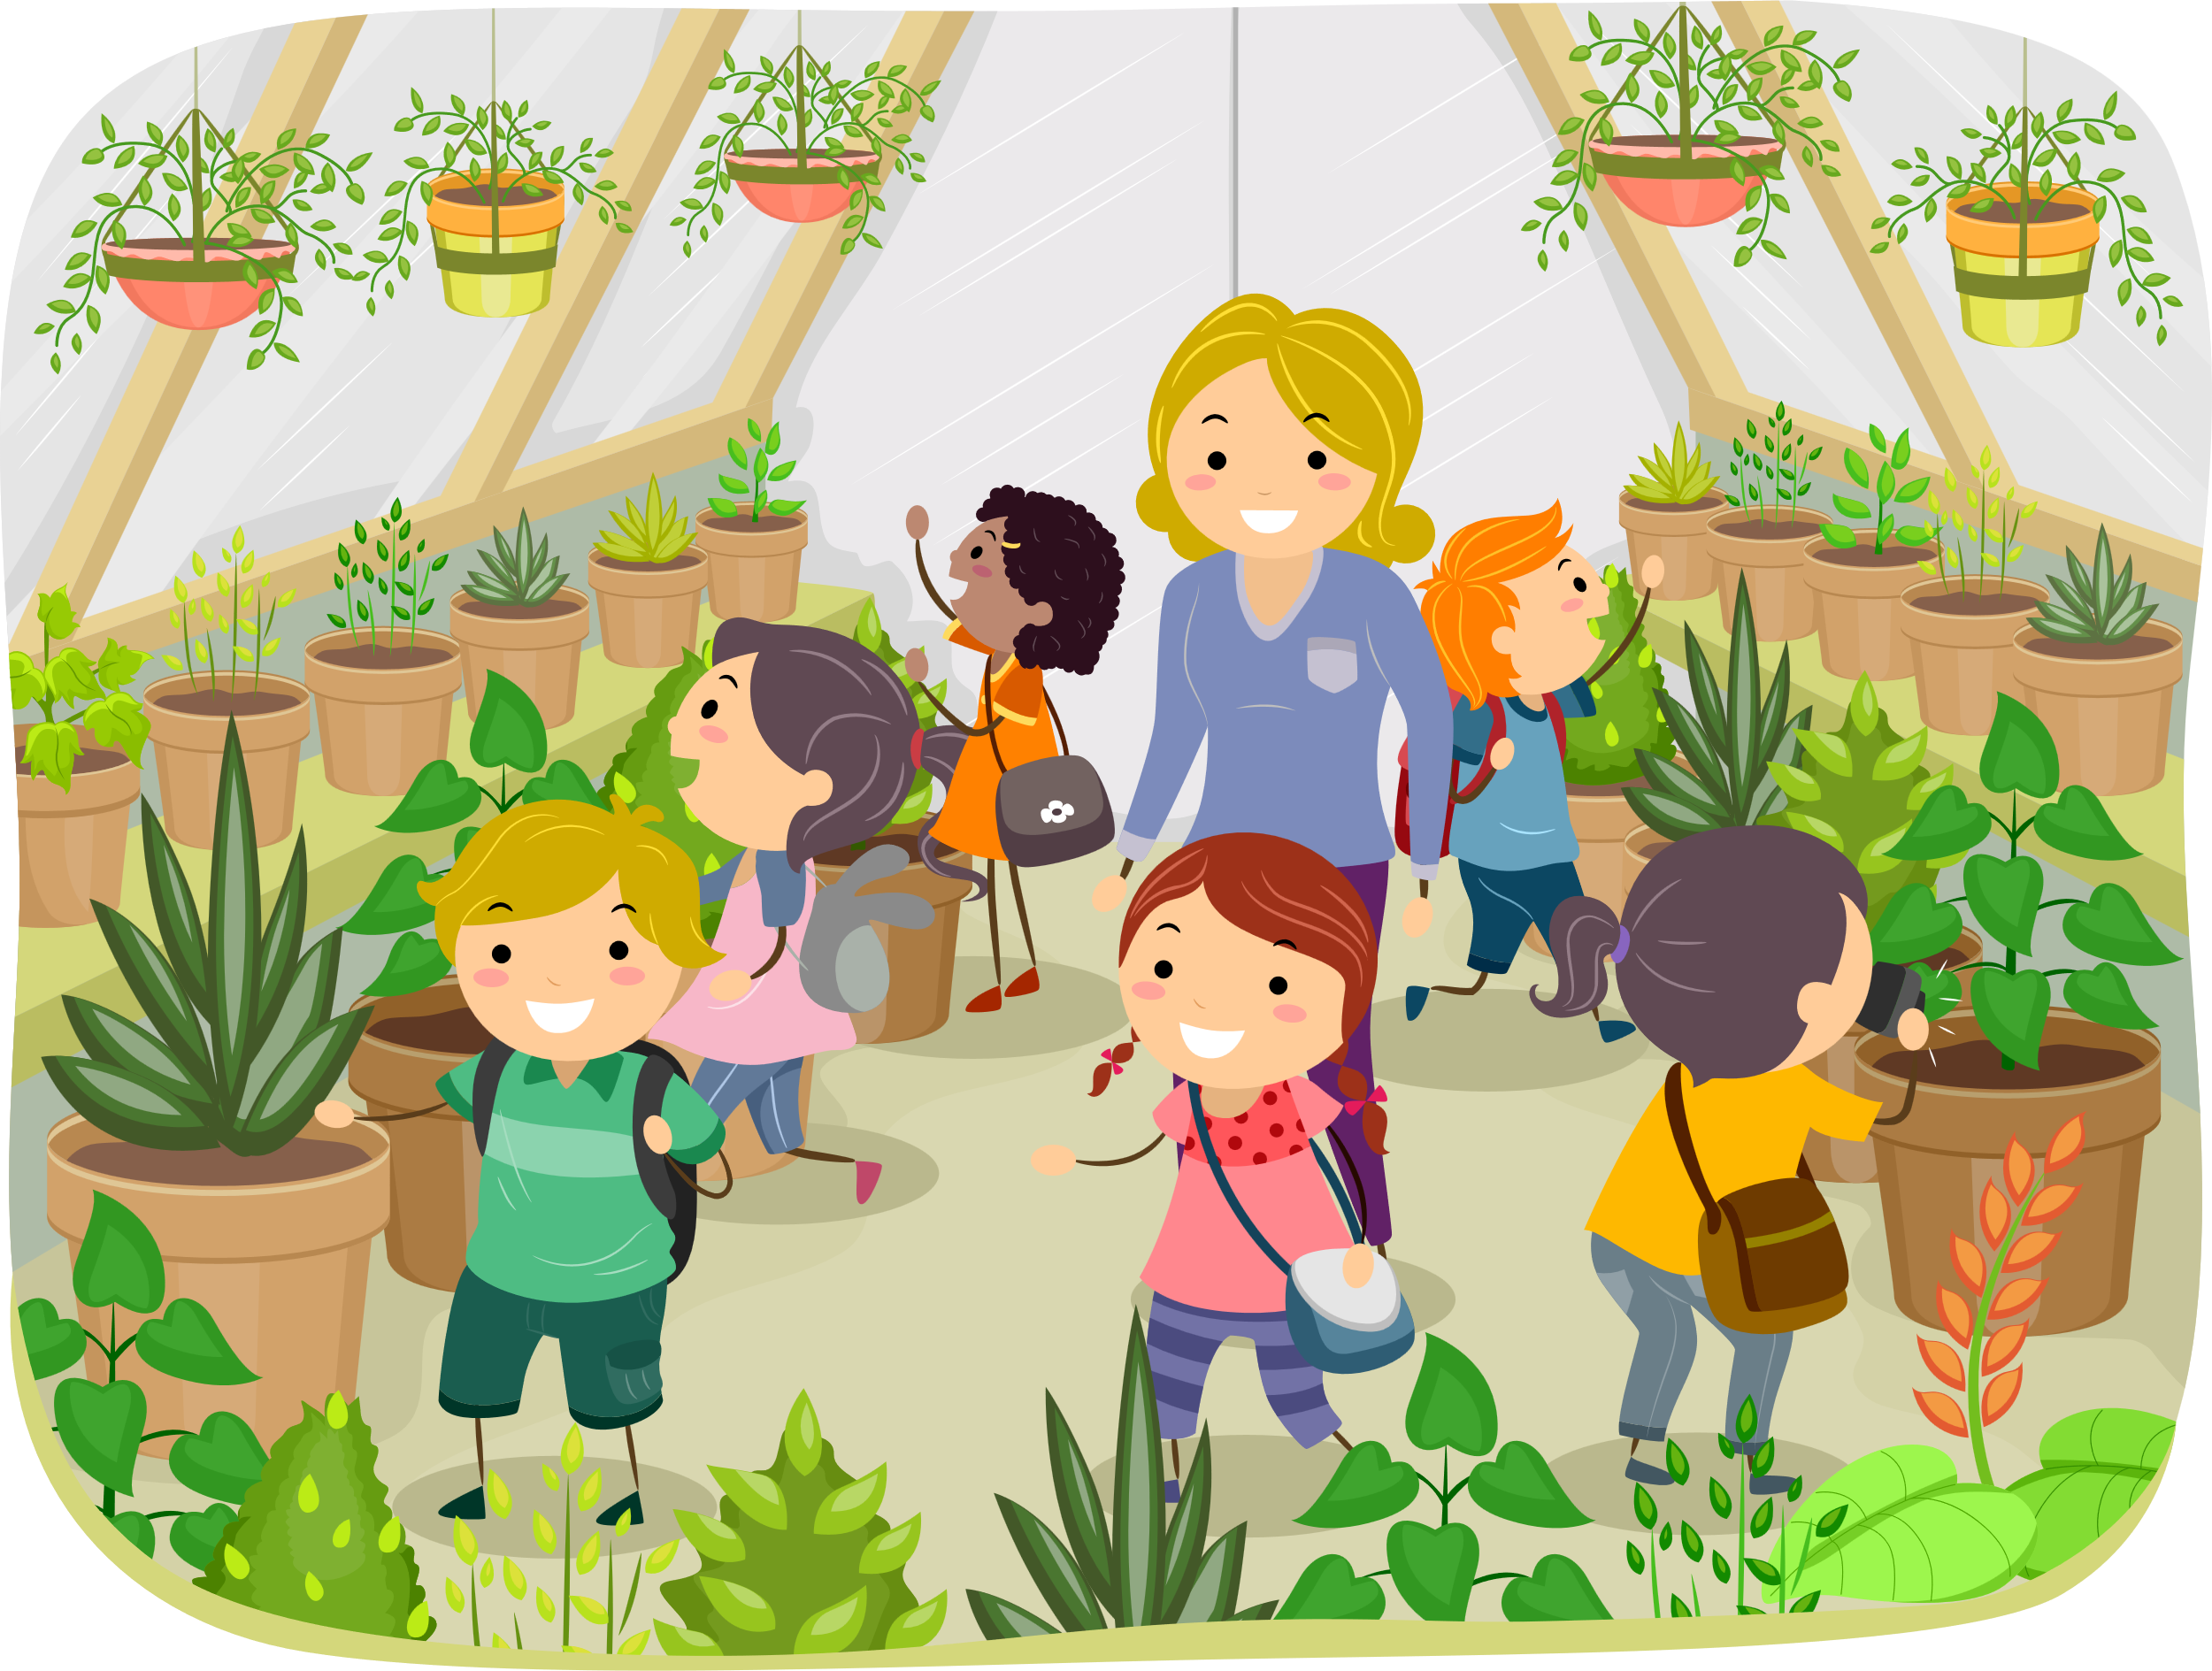
UNDERSTANDING SEASONALITY
WHAT IS A GREENHOUSE?
All products have a purpose. The purpose of a greenhouse is to:
Protect plants from too much cold.
Protect plants from bugs and slugs that might eat them.
Greenhouses make it possible to grow vegetables, fruits and flowers all the year round.
KNOWLEDGE

Slide 10
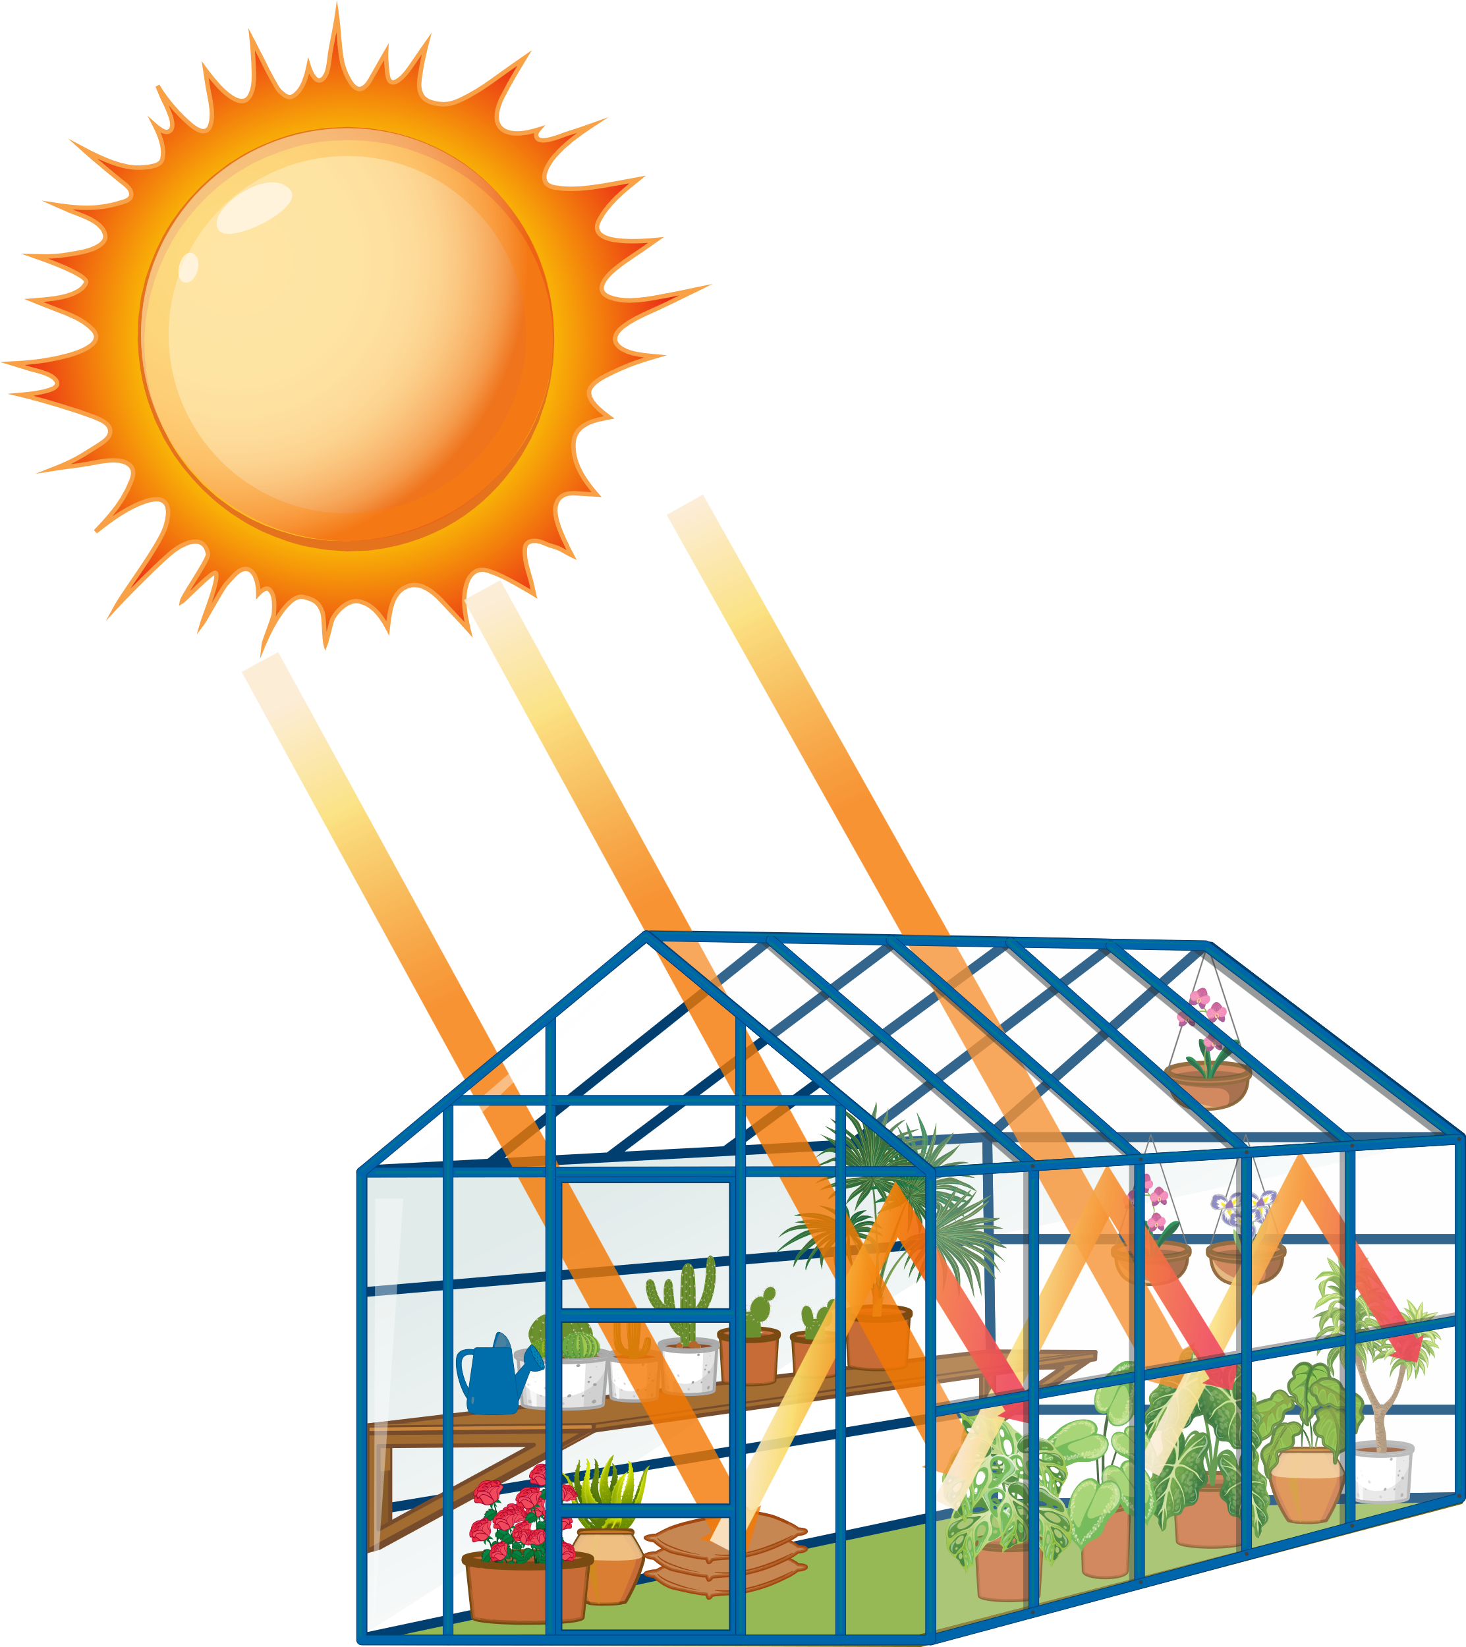
UNDERSTANDING SEASONALITY
HOW DO GREENHOUSES WORK?
Greenhouses work by allowing the sunlight to shine through the glass. The sunlight warms the air inside the greenhouse. At night, when it is colder outside, the greenhouse traps the air inside keeping it warm.
Greenhouses control the conditions that plants need to grow well.
KNOWLEDGE

