Slide 1
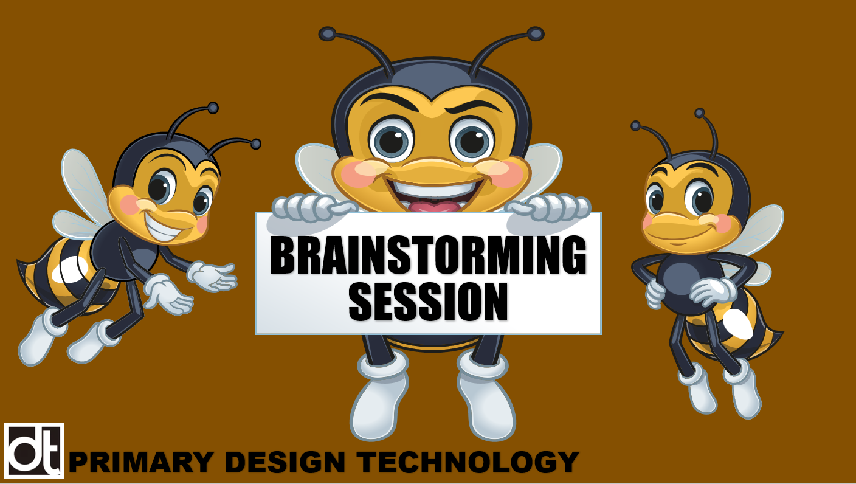

Slide 2
WHAT IS BRAINSTORMING?
Brainstorming is an activity used by designers to:
Generate ideas
Solve a problem
Answer a question
You can brainstorm on your own, but it most often done in small groups where everyone contributes their ideas and thoughts.
BRAINSTORM
BRAINSTORM

Slide 3
RULES OF BRAINSTORMING
Everyone contributes, everything is allowed.
Encourage wild ideas.
Create as many ideas as possible .
​Build on the ideas of others​
Postpone your judgement ​
​One speaker at a time- take turns
Keep focused
Ideas are owned by everyone!
BRAINSTORM
BRAINSTORM

Slide 4
MAKING DESIGN DECISIONS
What are some good ideas for designing and making puppets in key stage 1?
How can the choice of what puppet to design and make the subject real life and relevant to the children?
How can we give the product a purpose?
BRAINSTORM
5 minutes
BRAINSTORM

Slide 5
MAKING DESIGN DECISIONS
Once your group has agreed on your design, write a short paragraph to explain your product.
What is the theme for the puppet?
How will it be real-life and relevant?
What is the purpose of the puppet?
BRAINSTORM
BRAINSTORM

Slide 6
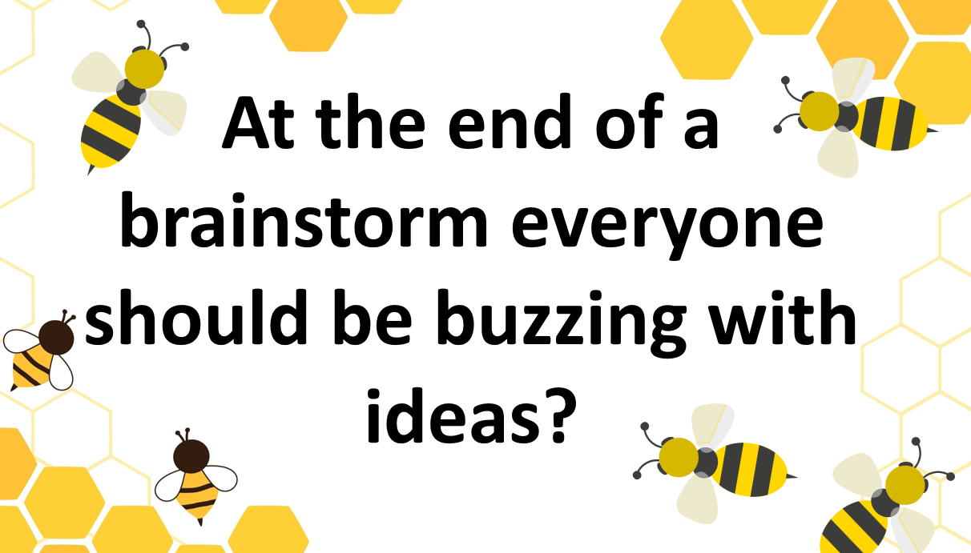
BRAINSTORM
BRAINSTORM

