Slide 1

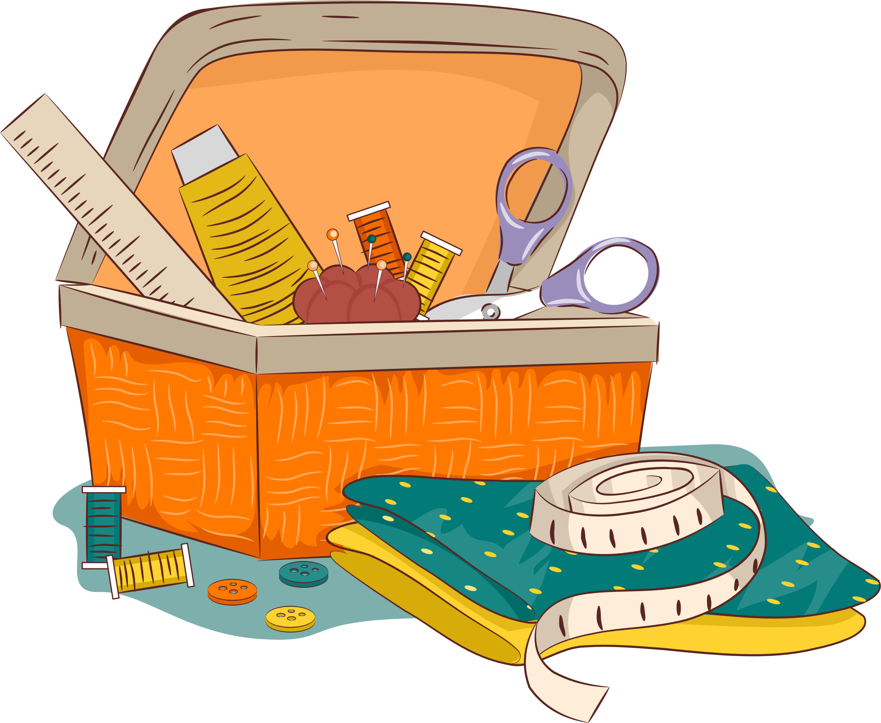
SEWING TECHNIQUES

Slide 2
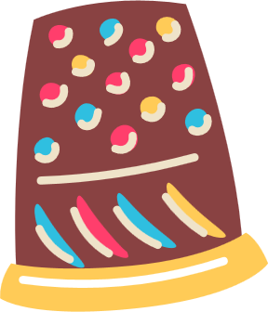
USING A THIMBLE
A thimble is a small cover that goes on the end of your finger to protect that finger when you are hand sewing.
They can be used on your sewing hand to help you push through the needle or on your other hand to protect your finger from the needle as it passes through the fabric.
TECHNIQUE

Slide 3

THREADING A NEEDLE
USING A NEEDLE THREADER
Push the needle threader through the eye of the needle.
Loop the thread through the needle threader.
Withdraw the needle threader from the eye of the needle.
TECHNIQUE

Slide 4
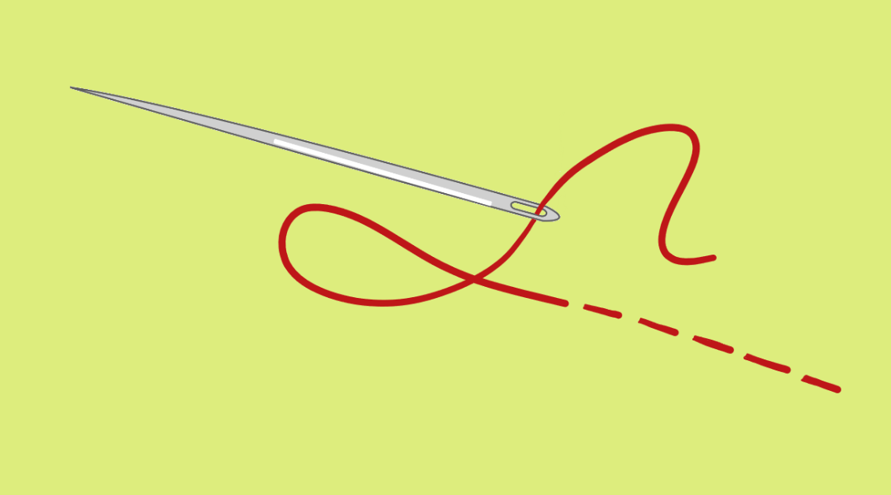
RUNNING STITCH
In a running stitch the needle is pushed from the back of the fabric to the front of the fabric and the thread is pulled all the way through.
The needle is placed a small distance away to make the stitch and is pushed through the front of the fabric to the back of the fabric and the thread is pulled all the way through to complete the stitch.
TECHNIQUE

Slide 5
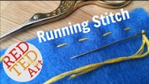

TECHNIQUE
www.redtedart.com

Slide 6
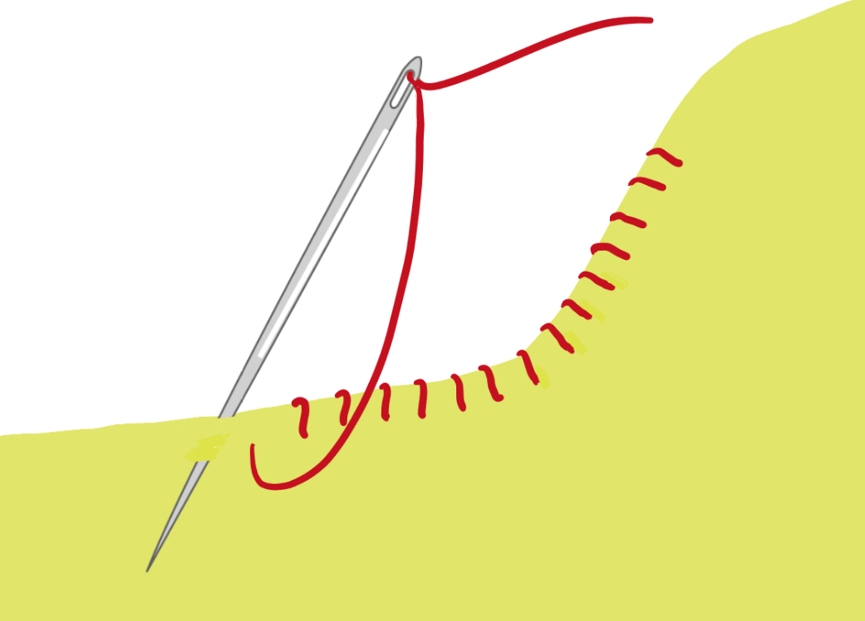
OVERSTITCH
The overstitch is used to join two pieces of fabric together.
To create the overstitch, a loop is sewn around the two edges of the fabric to be joined together.
The overstitch can also be used to prevent fabrics from fraying and when creating buttonholes.
TECHNIQUE

Slide 7

TECHNIQUE
www.redtedart.com

Slide 8
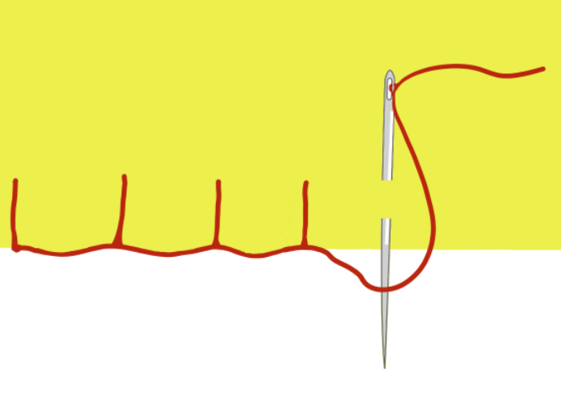
BLANKET STITCH
The blanket stitch is used to stitch the edges of materials together and to prevent them from fraying and/or to decorate the edges.
Like an overstitch, a loop is sewn around the two edges, but the needle and thread pass through the loop to complete the stitch.
TECHNIQUE

Slide 9

TECHNIQUE
www.redtedart.com

Slide 10
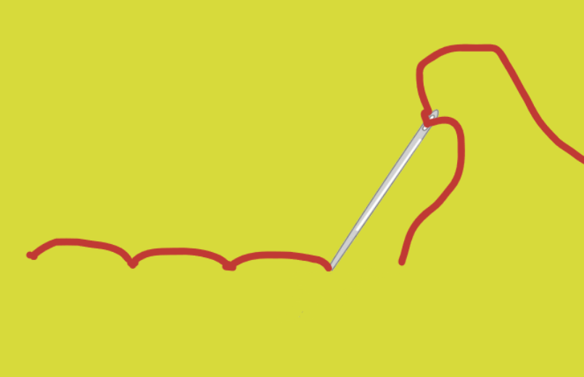
BACK STITCH
The back stitch is the strongest way to join fabric pieces as if a stitch breaks it will not unravel.
The back stitch is like the running stitch but instead of sewing forwards, the stitch is made in a backward direction.
TECHNIQUE

Slide 11
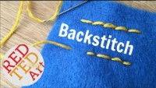
TECHNIQUE
www.redtedart.com

Slide 12
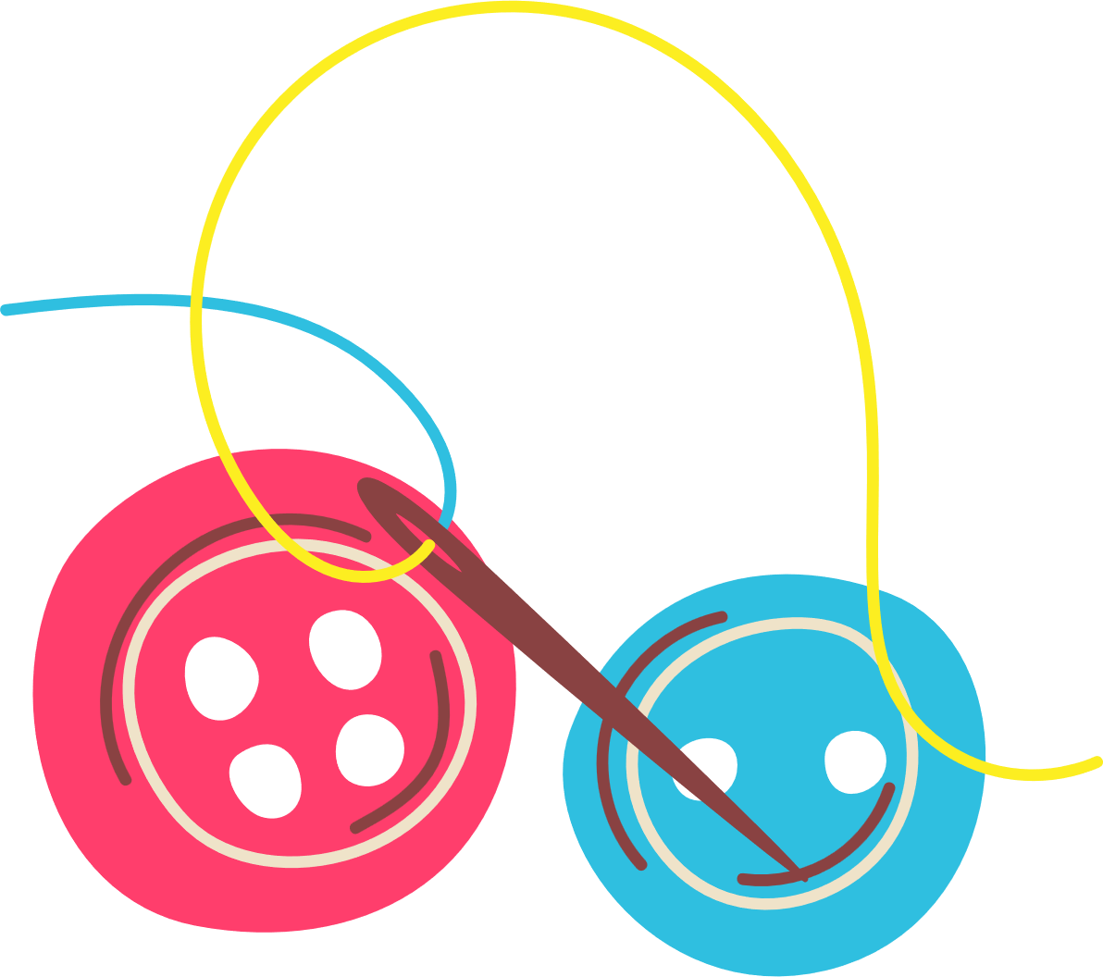
SEWING A BUTTON
Sewing techniques such as the running stitch and overstitching can be used to permanently join fabrics and other materials together.
TECHNIQUE
Fastenings are used to create temporary joins. There are many different types of fastenings – buttons are the most common form of fastening.

Slide 13
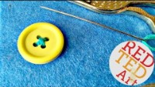
TECHNIQUE
www.redtedart.com

