Slide 1

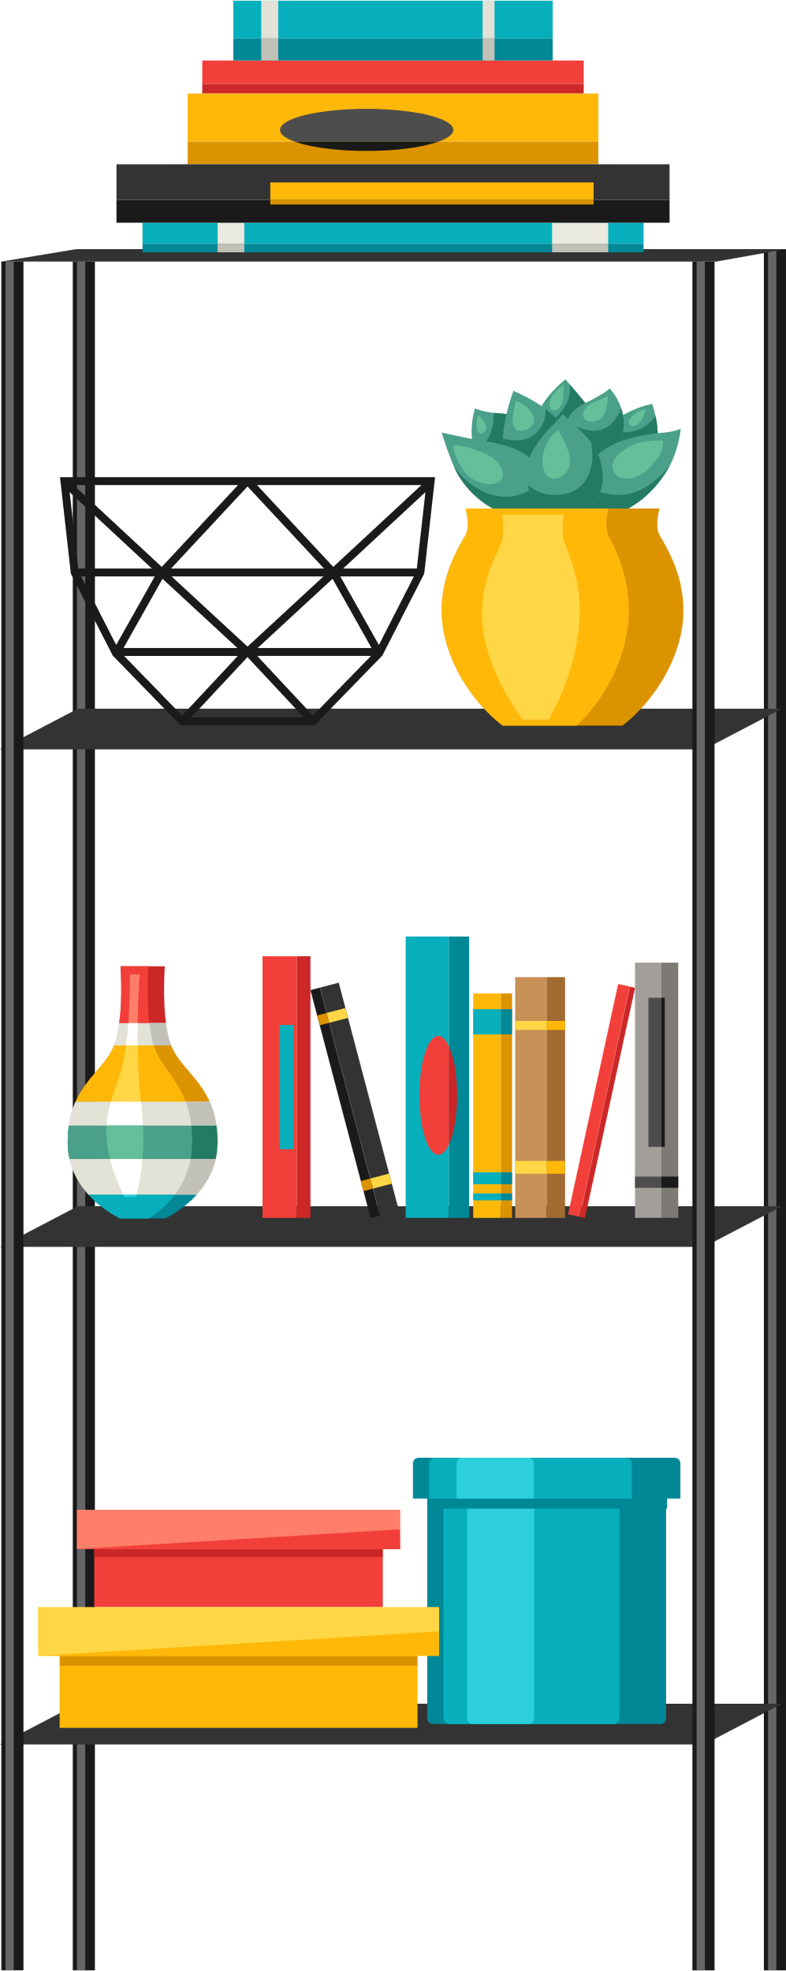
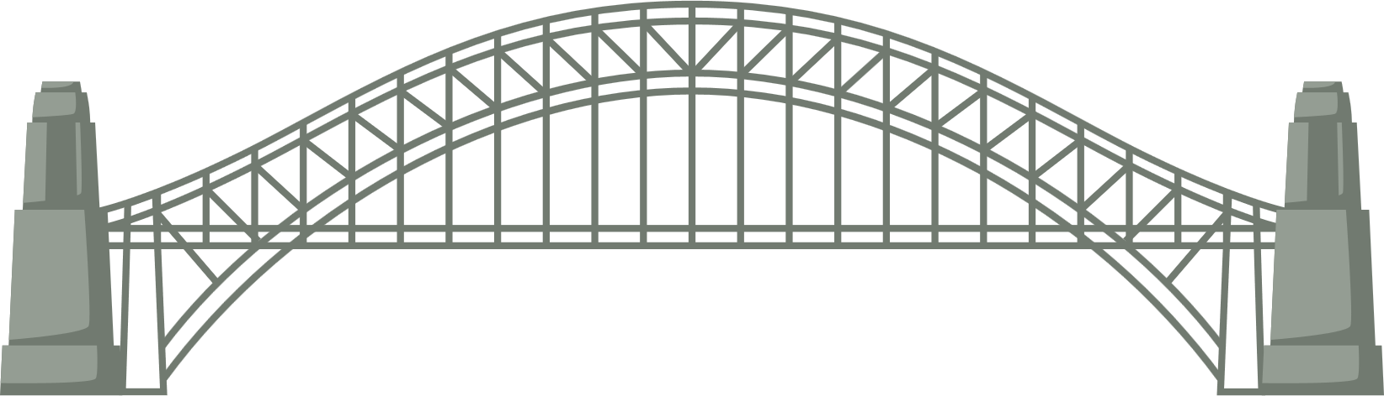
STRUCTURES
Key Stage 2

Slide 2
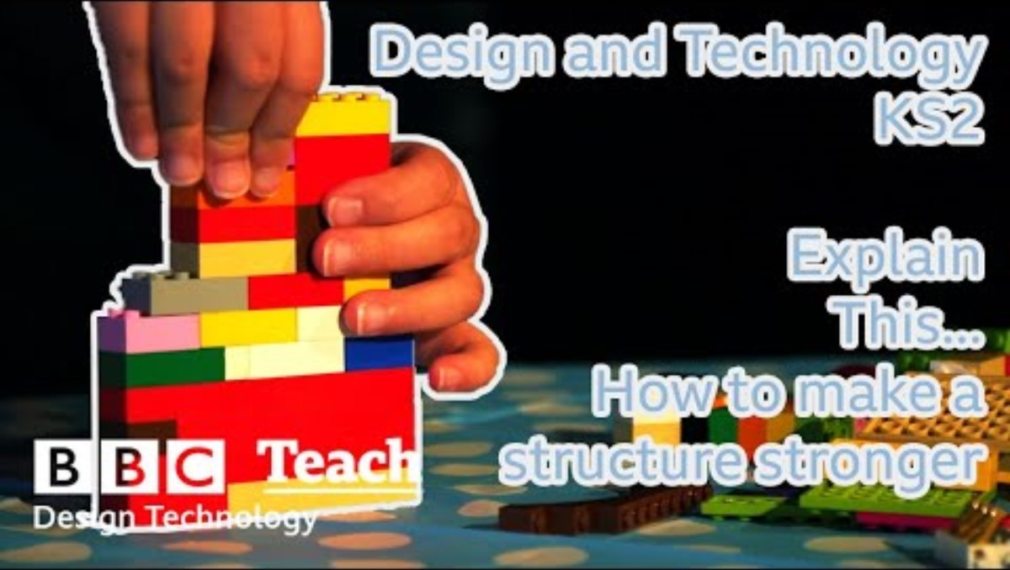

Slide 3
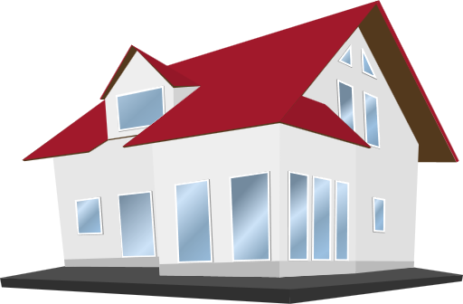
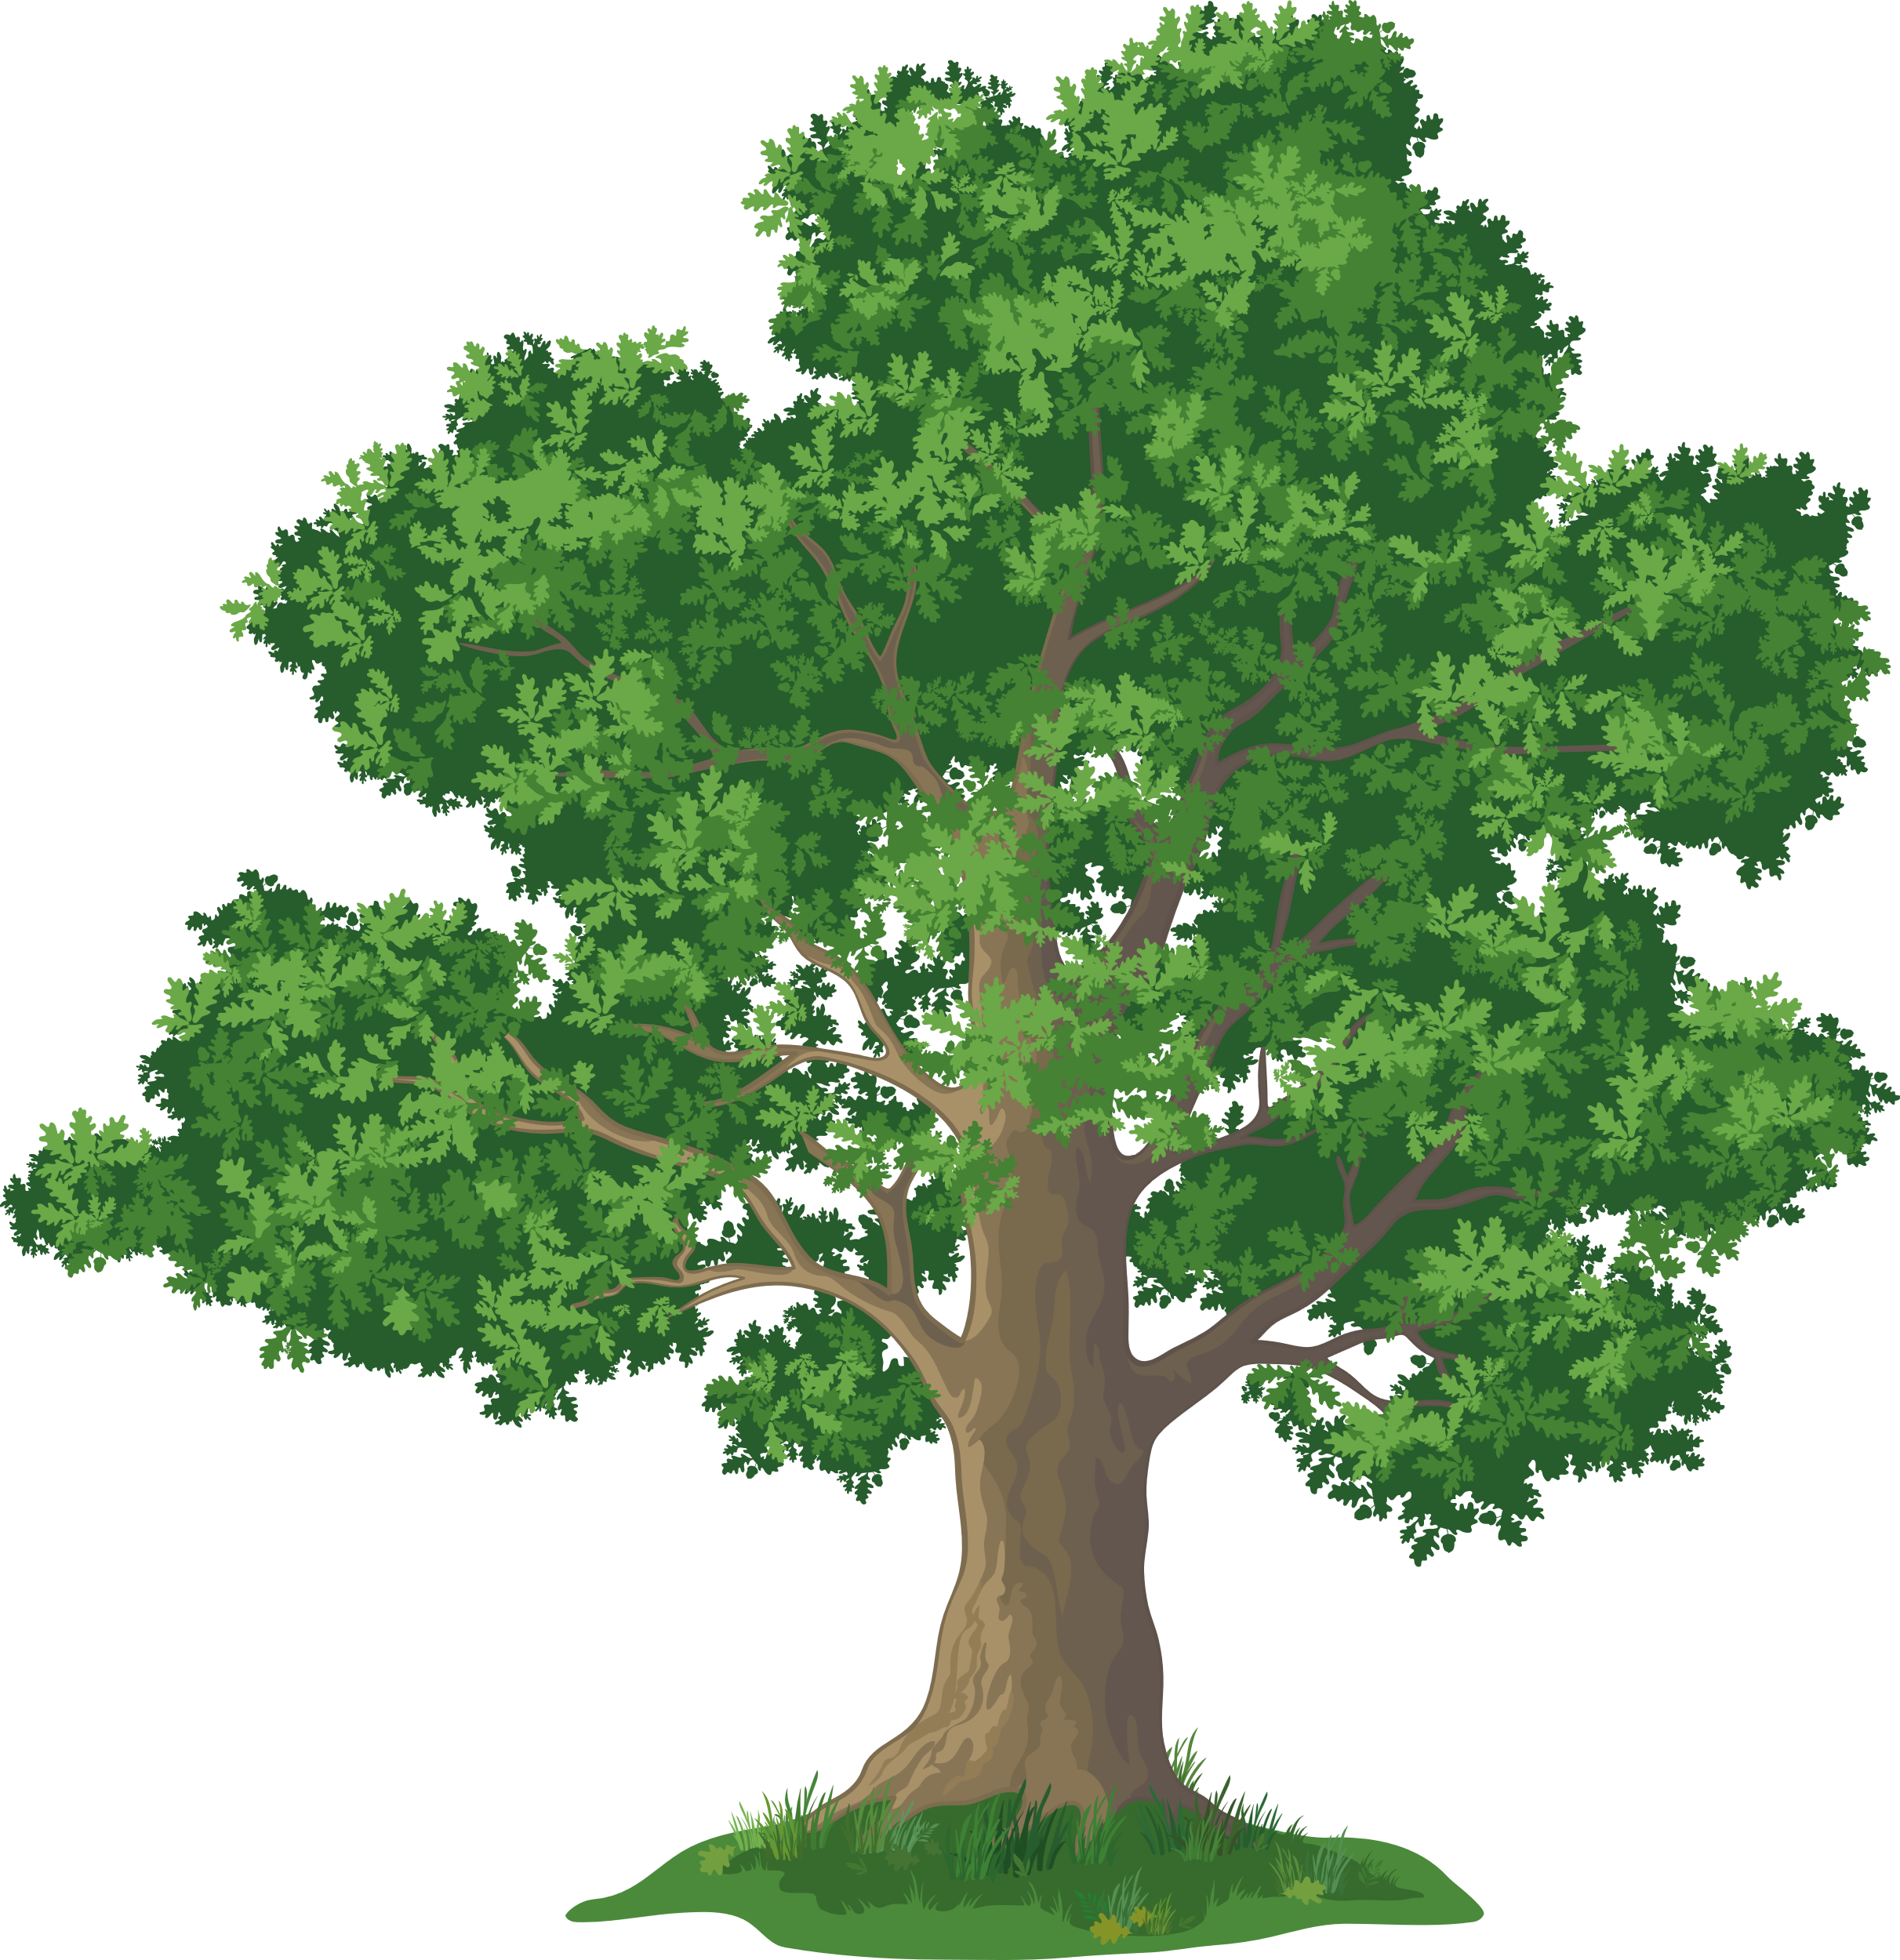

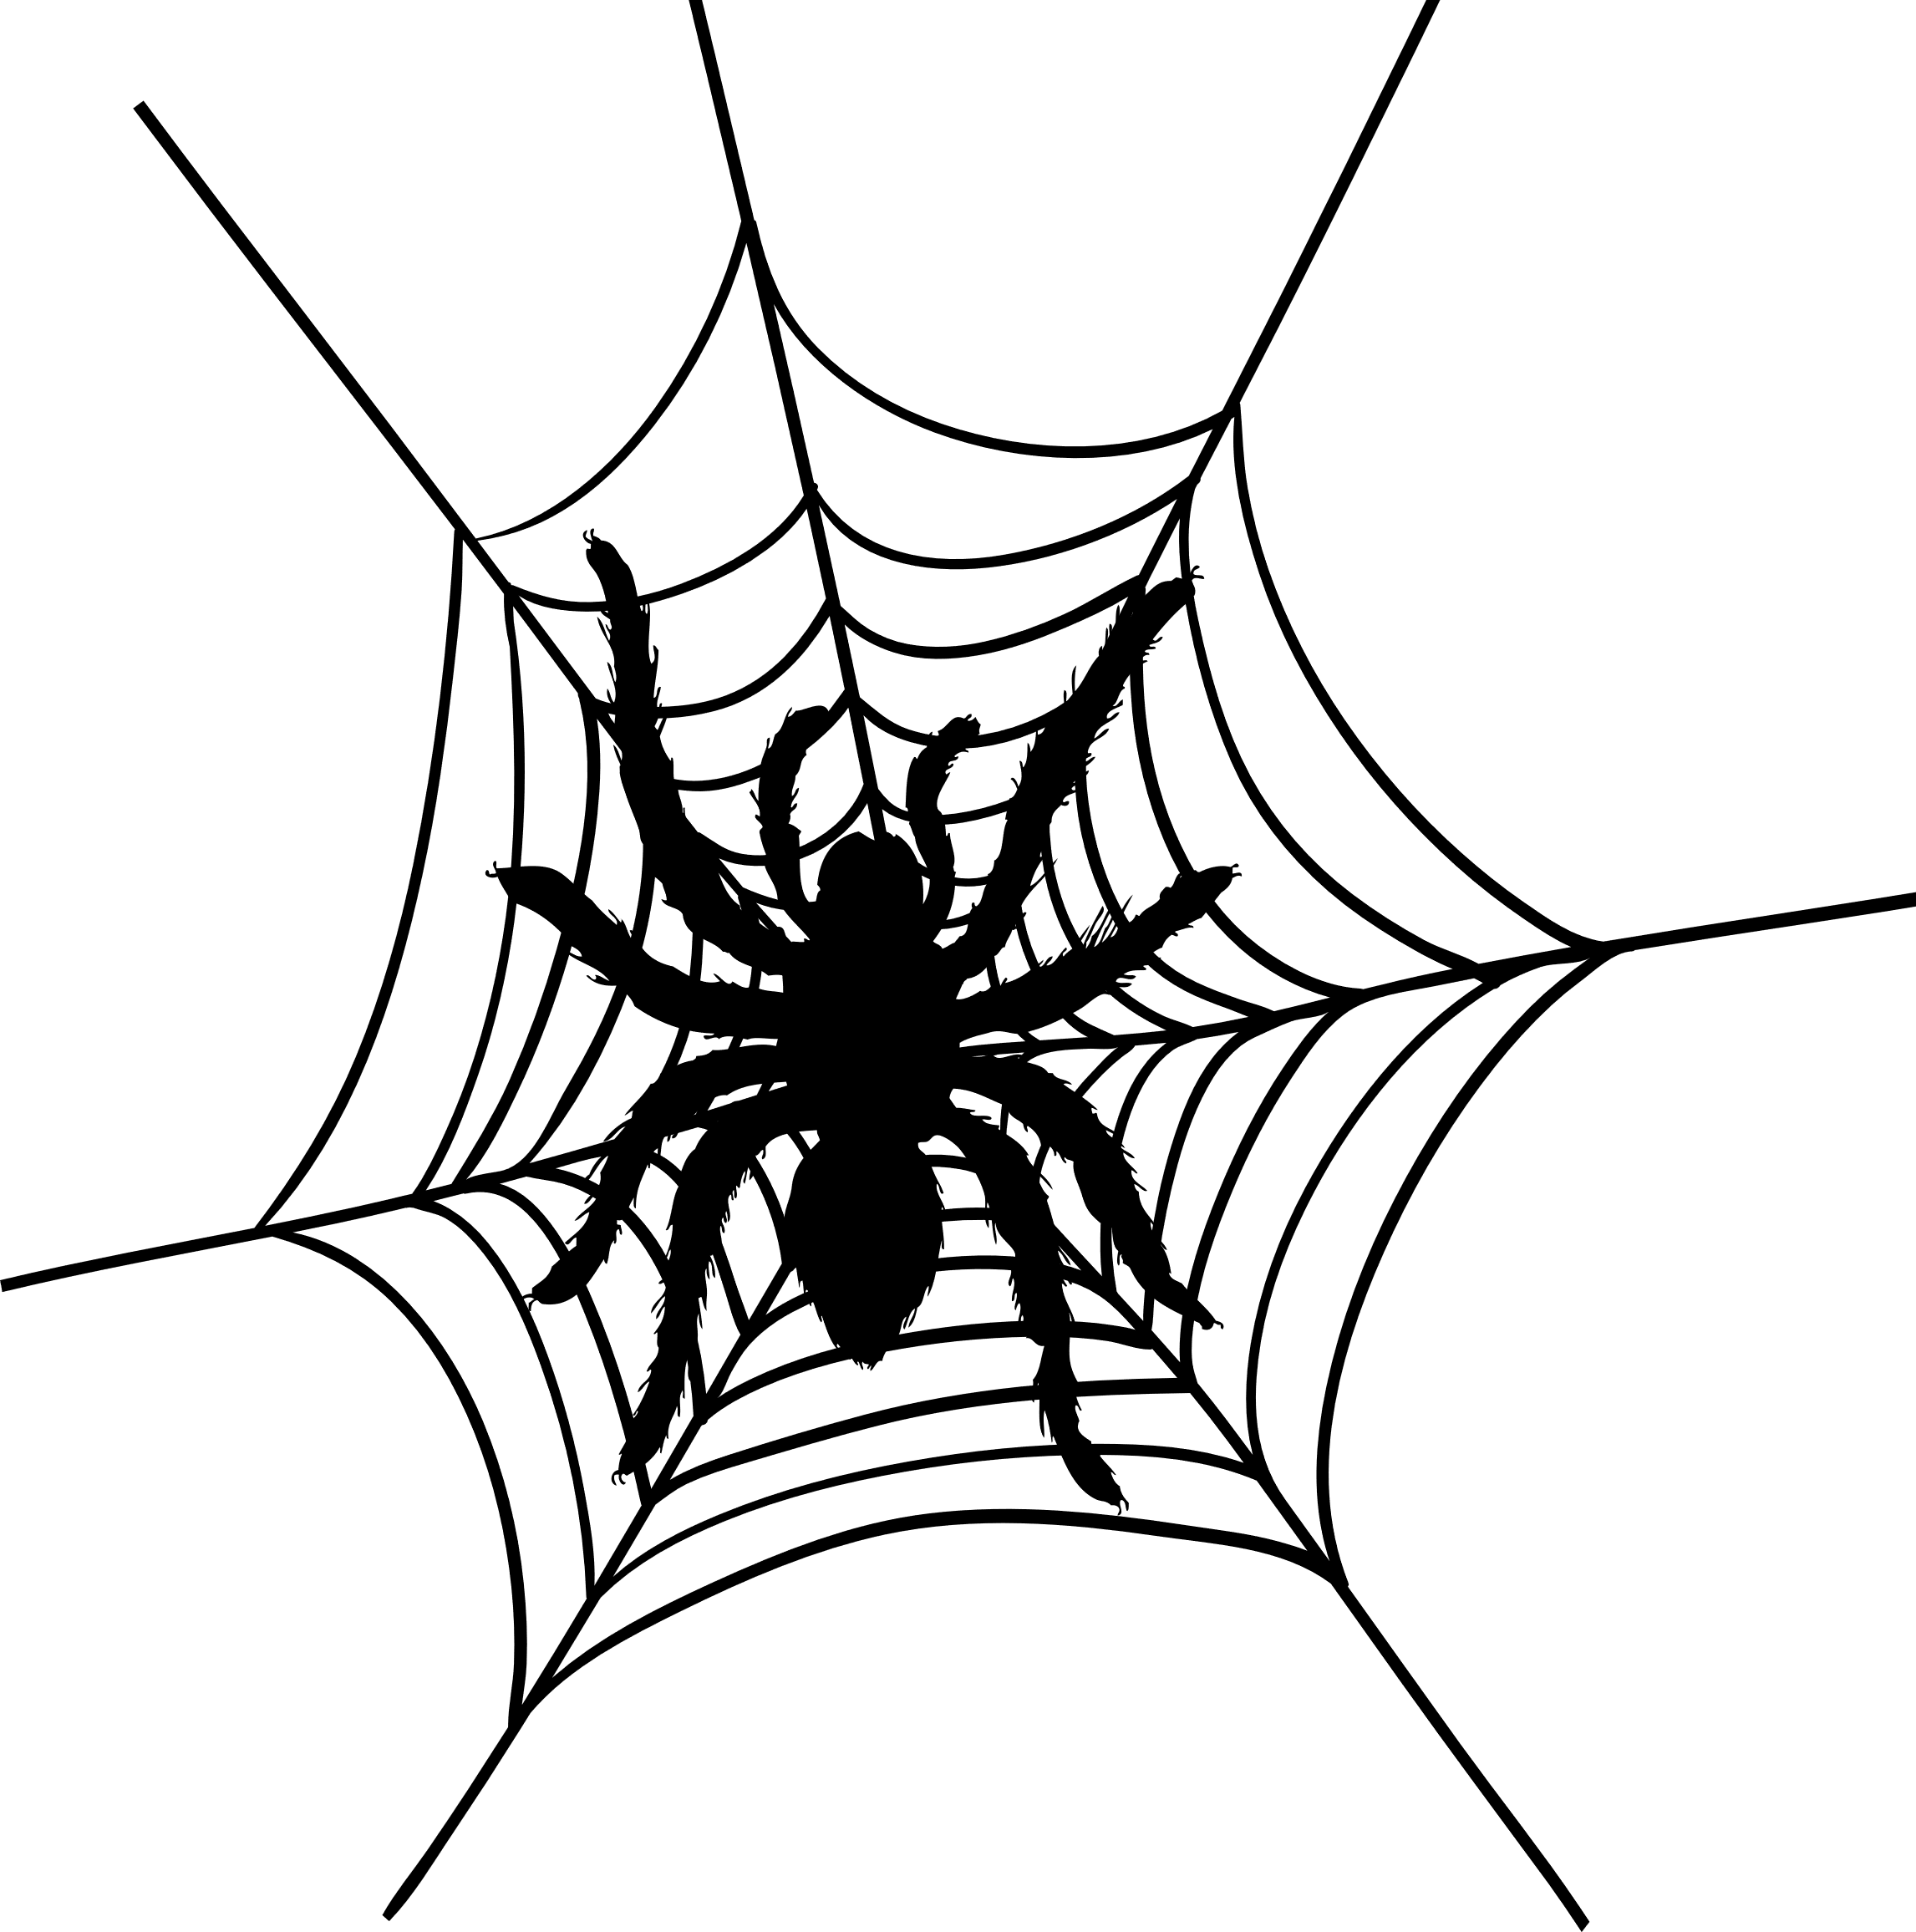

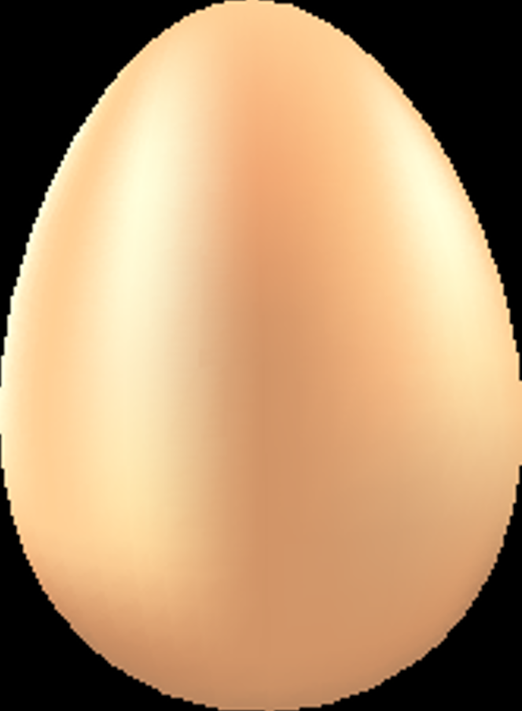

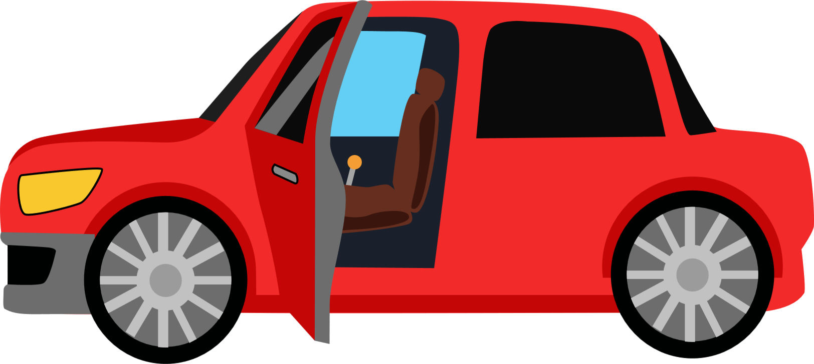
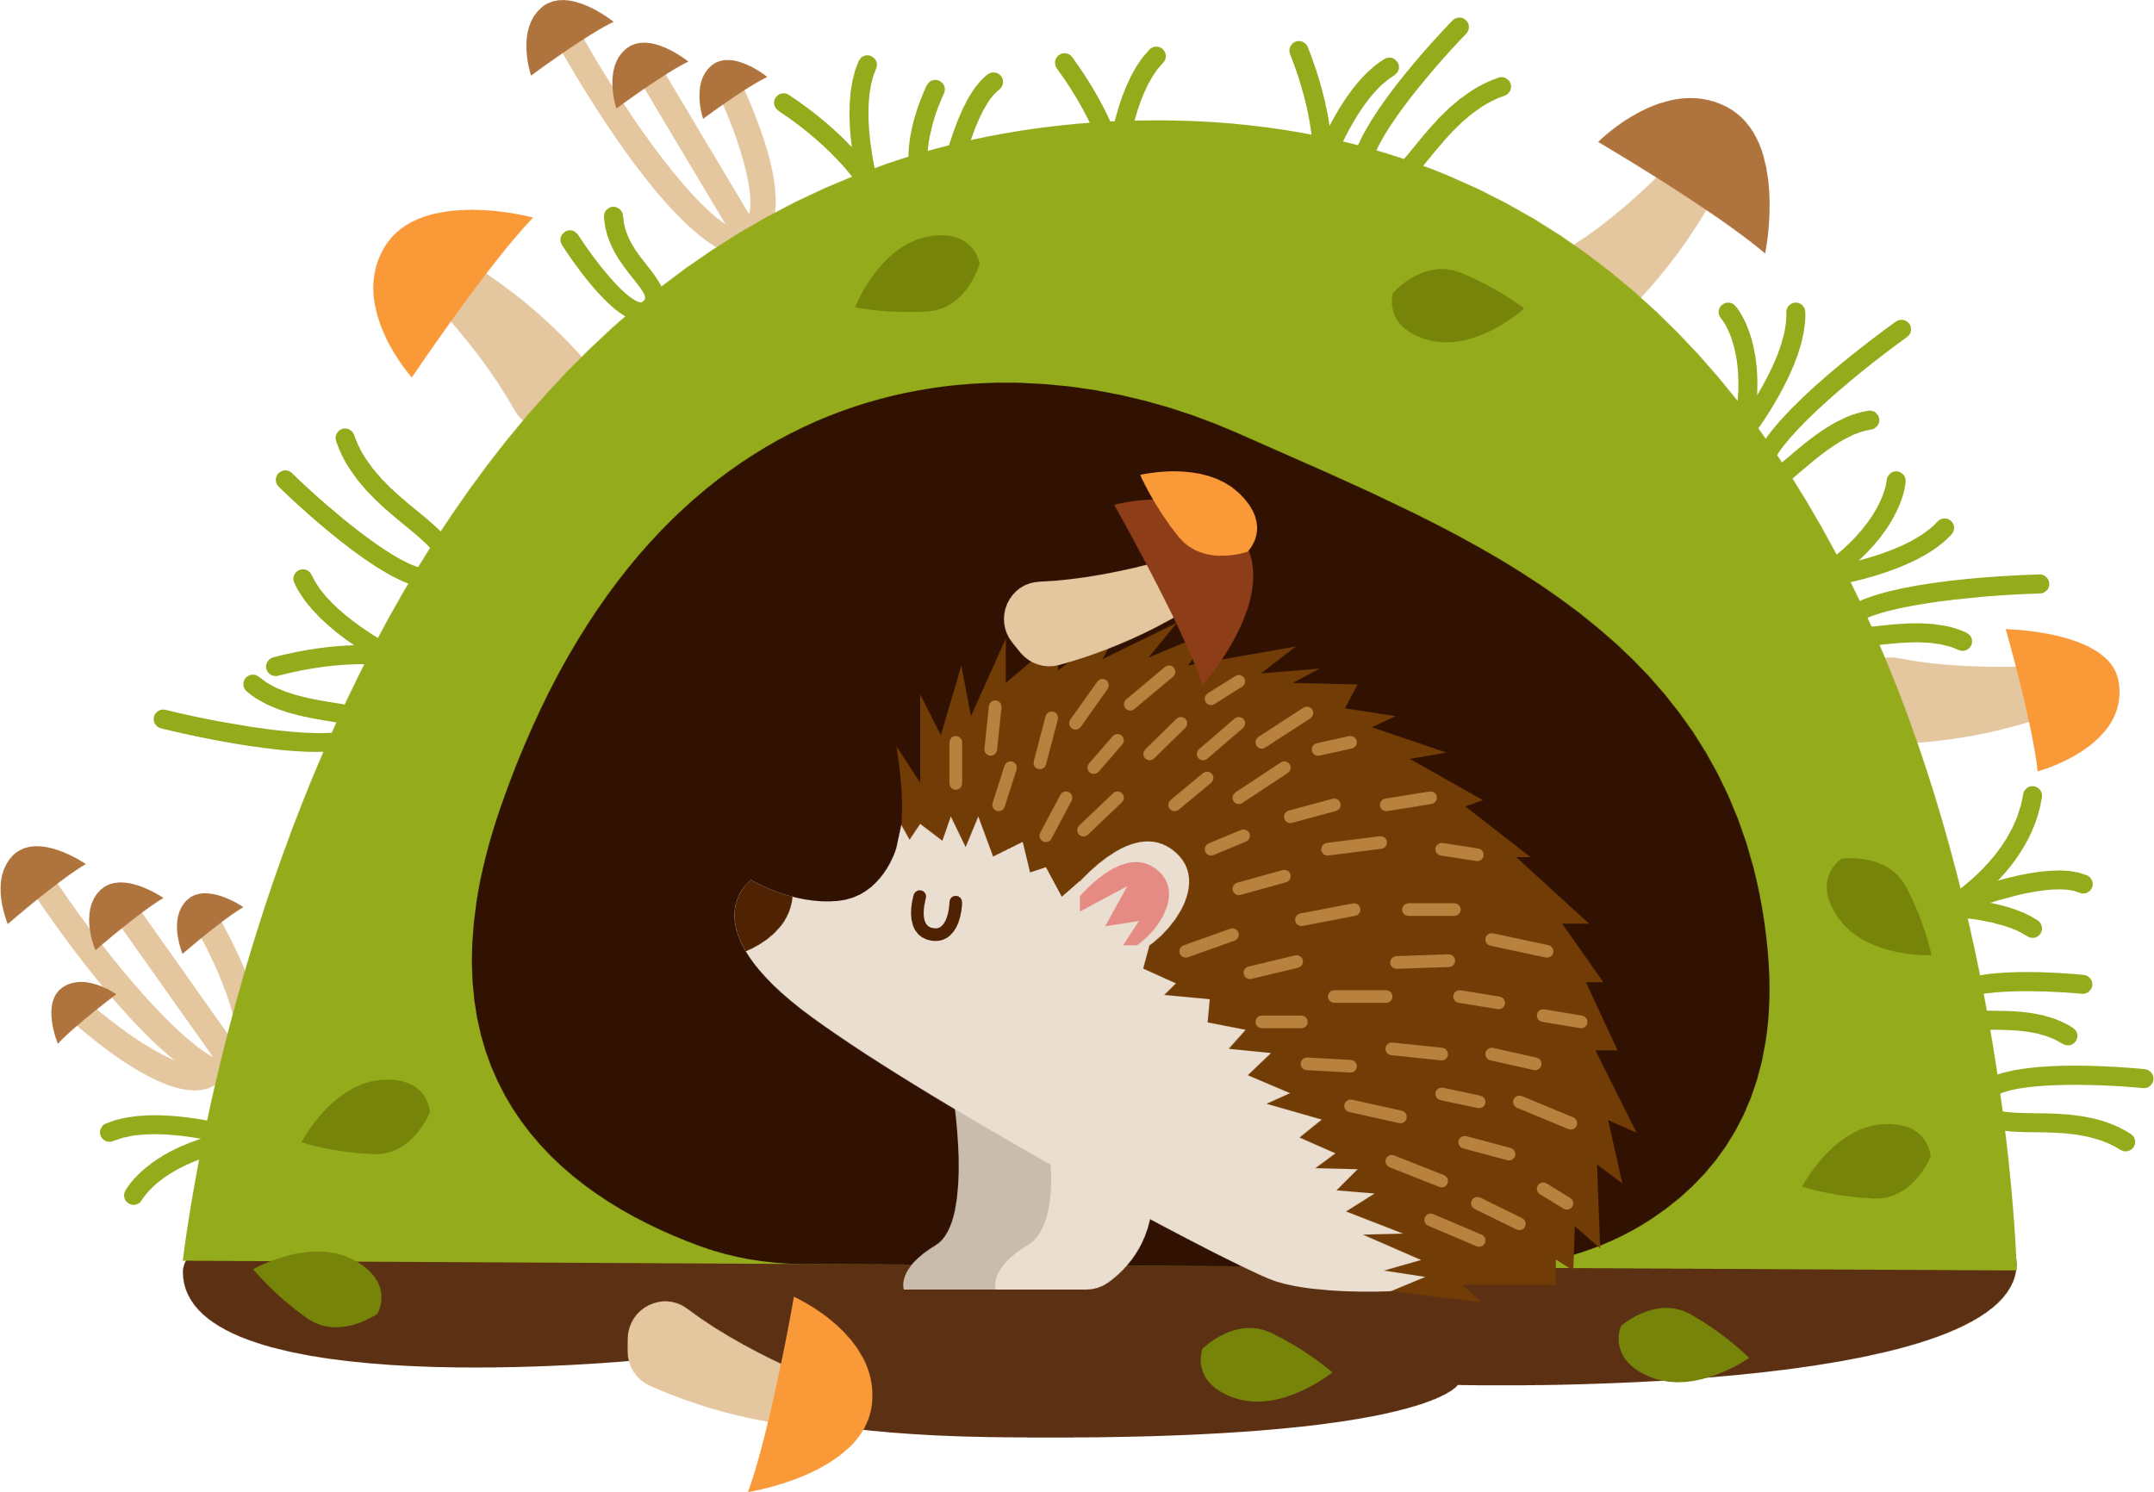
building
tree
human body
spider web
STRUCTURES ARE ALL AROUND US
egg
glasses
furniture
car

Slide 4
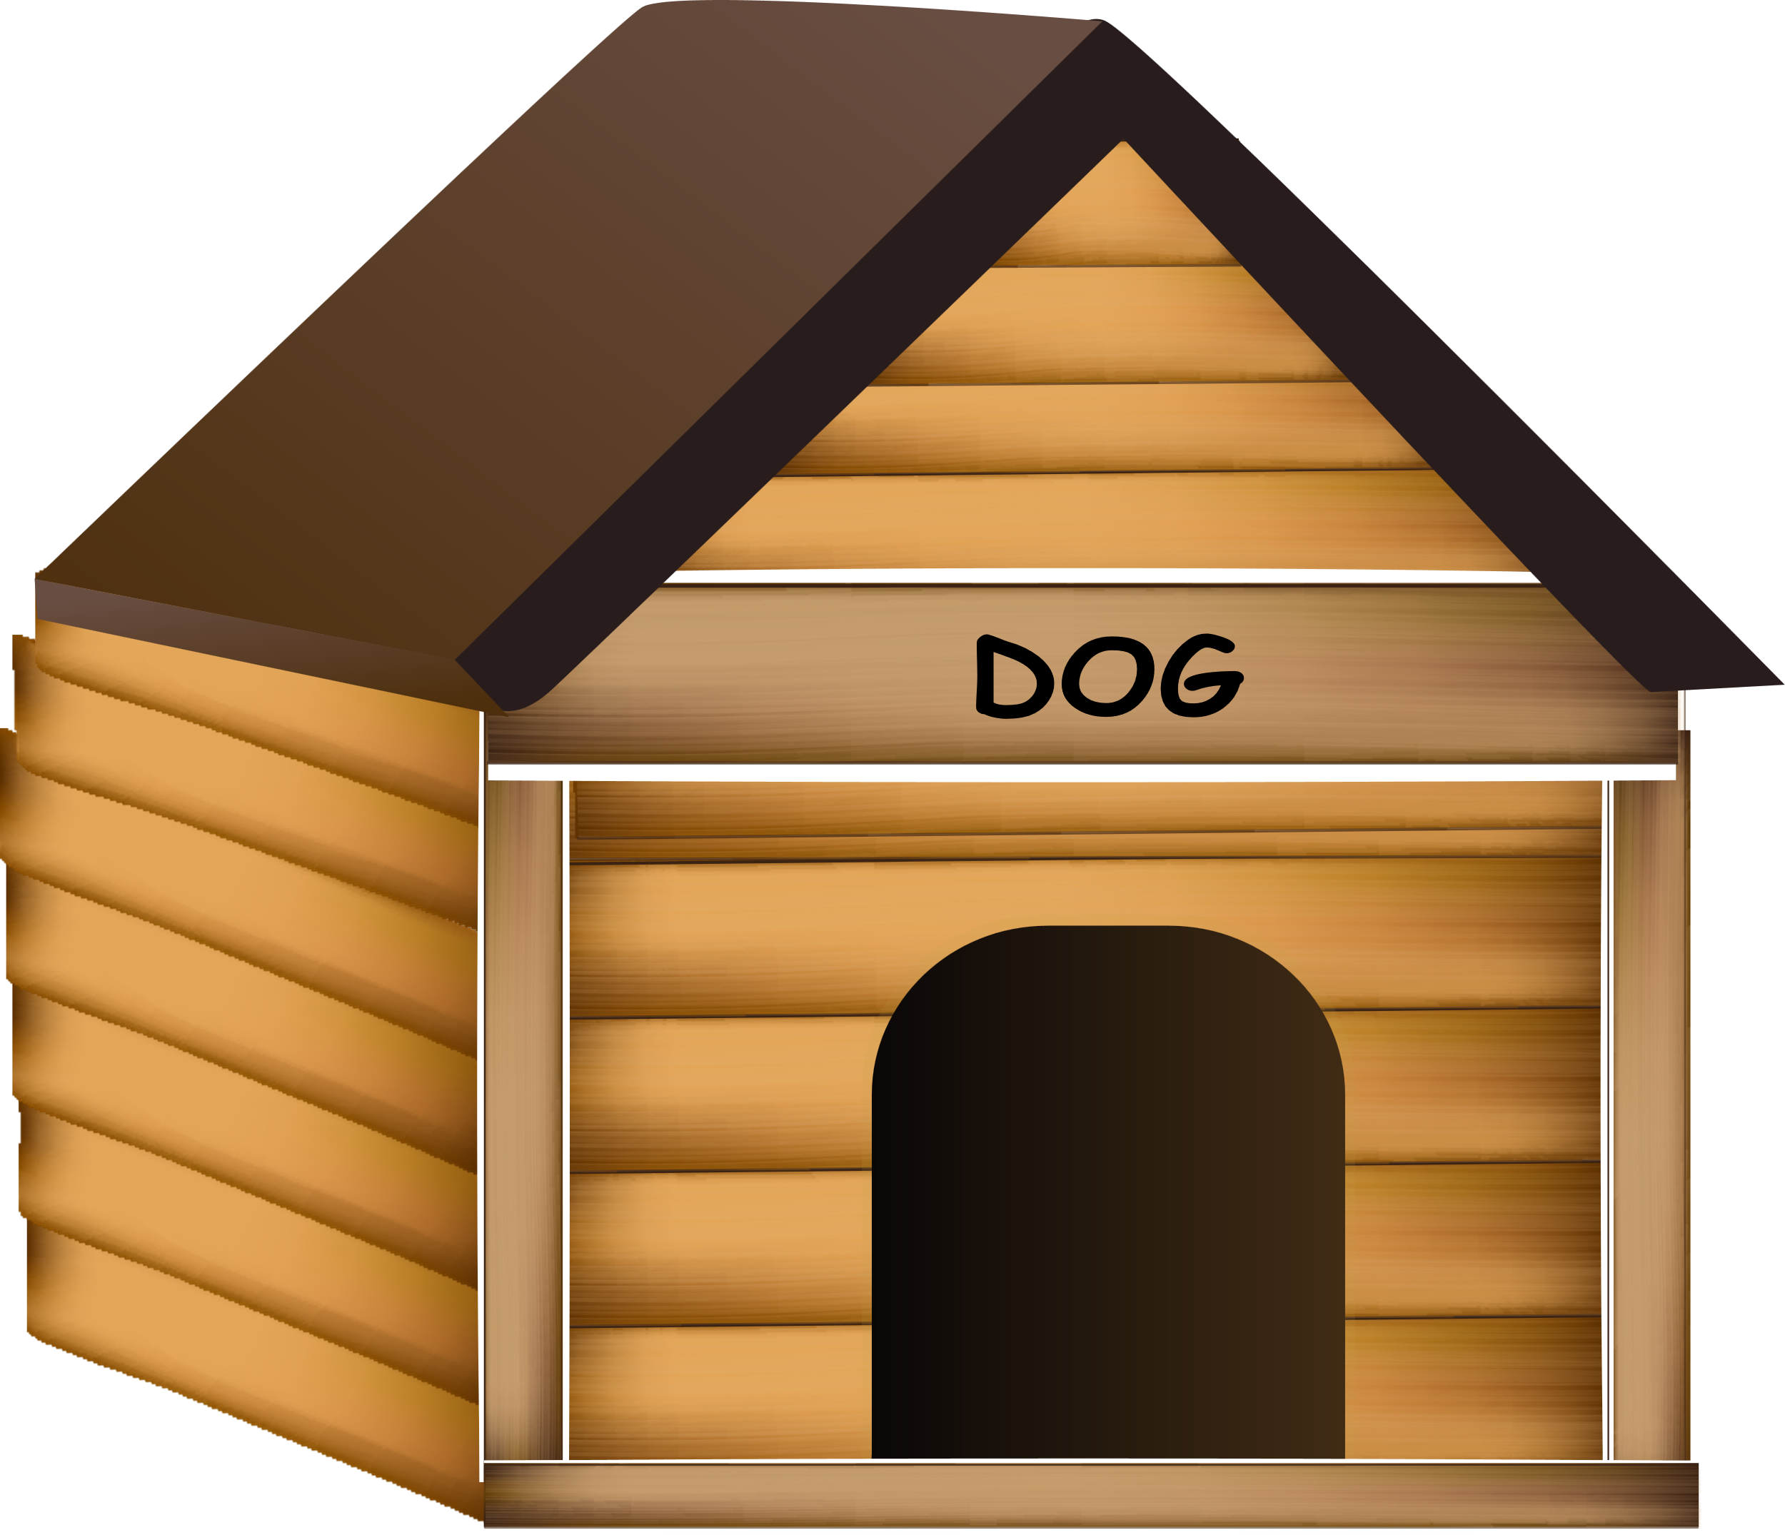
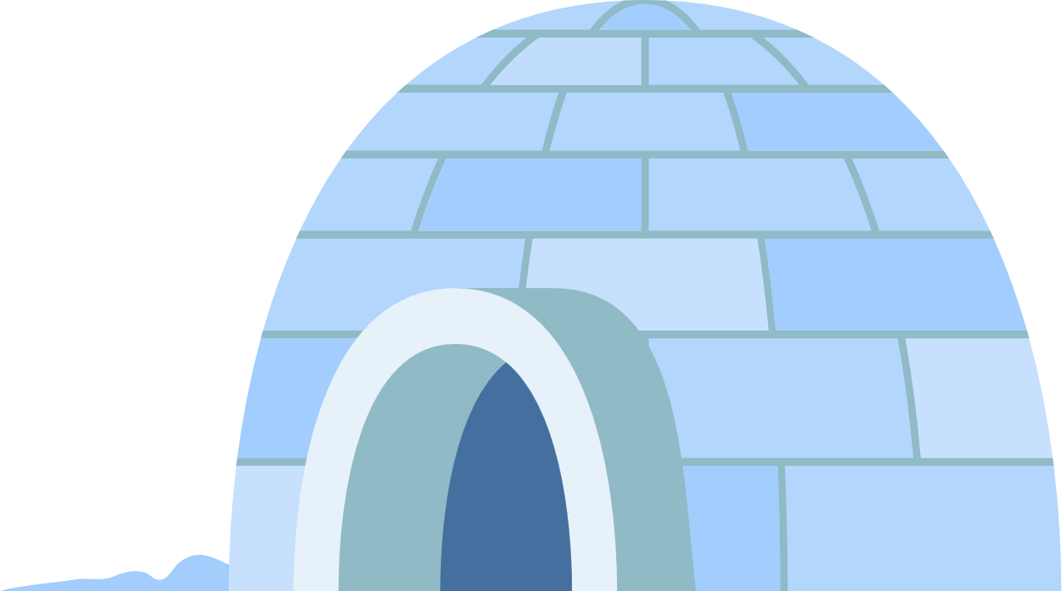
What is a structure?
A structure is made by combining materials or parts to create a three-dimensional shape.
KNOWLEDGE
What material has been used to create the dog kennel?
What materials has been used to create the igloo?

Slide 5
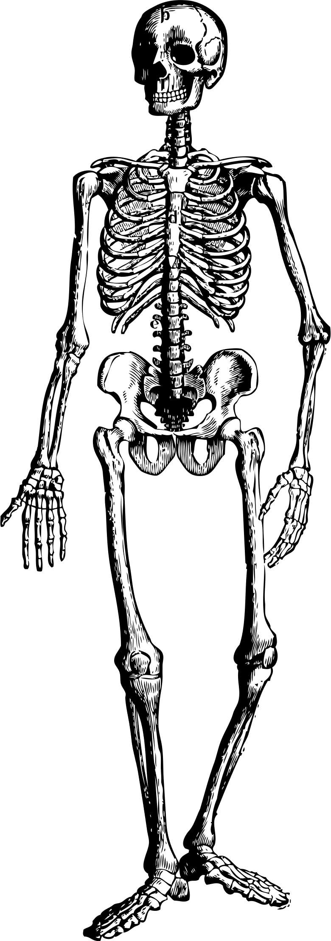
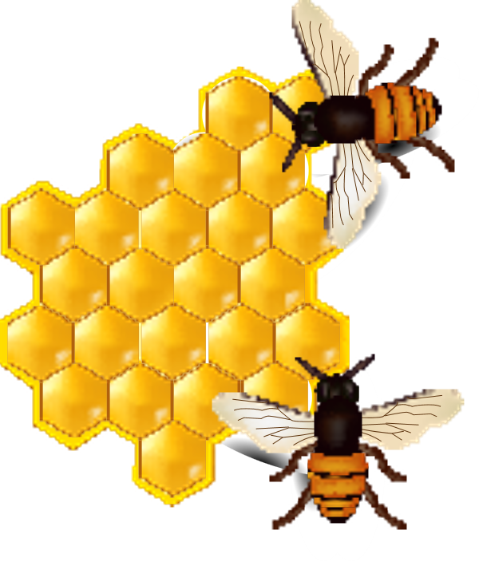
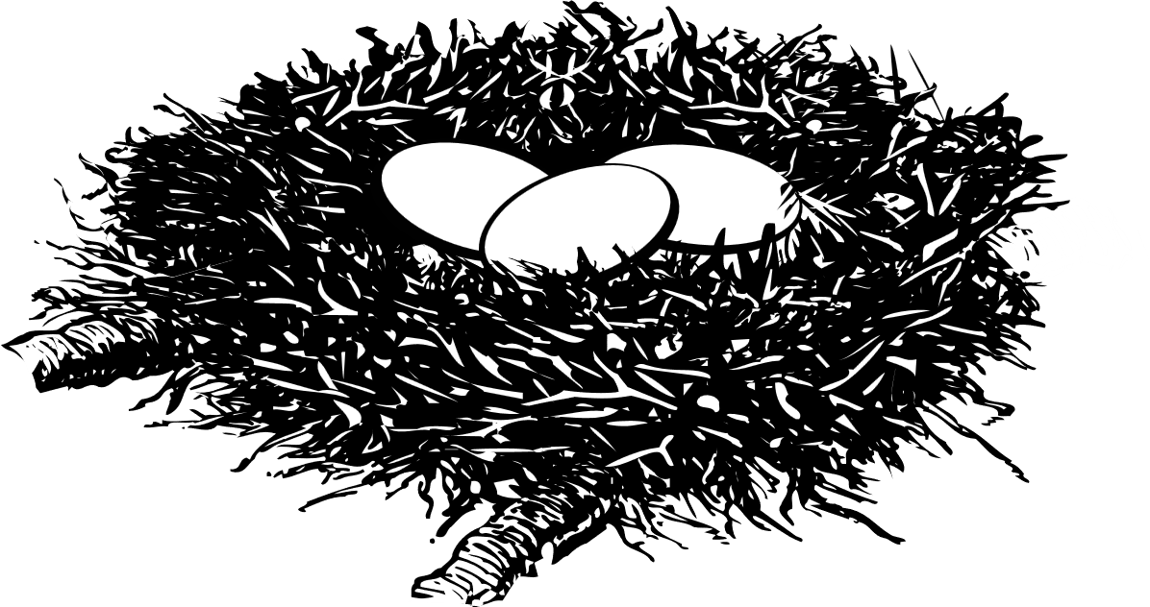
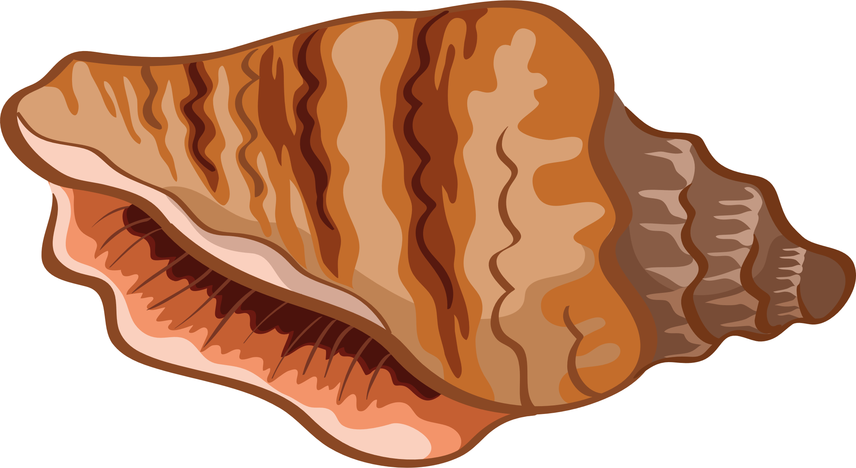
STRUCTURES
The world around us is full of structures.
Some structures are natural.
KNOWLEDGE

Slide 6
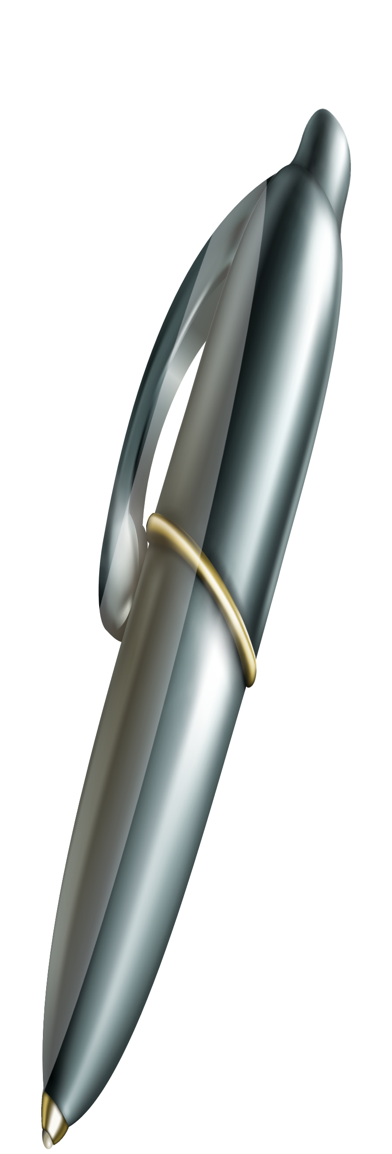
STRUCTURES
The world around us is full of structures.
Some structures are made by humans (man-made).
KNOWLEDGE

Slide 7
STRUCTURES
Structures are things that provide support.
Structures support weight or hold things together
KNOWLEDGE
Our skeleton holds up our body and allows us to move
Our skin is a structure that holds all our organs inside our body

Slide 8
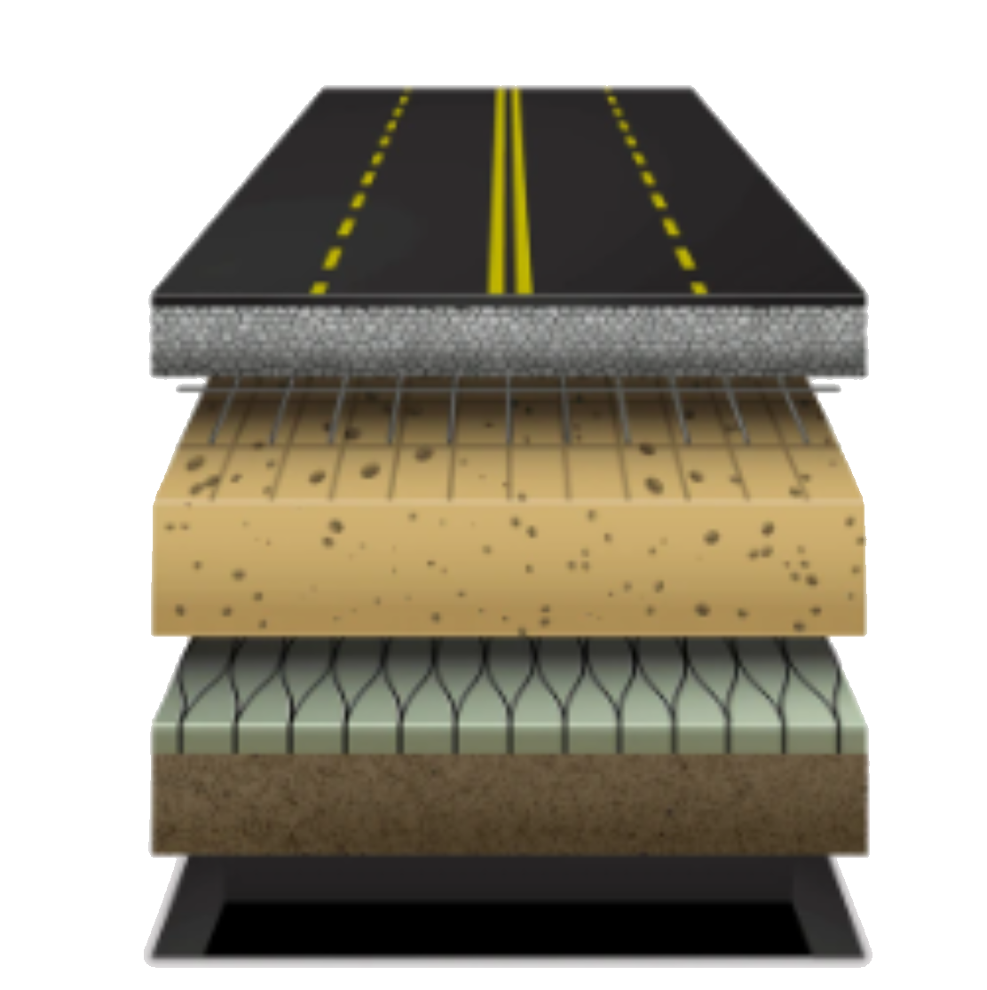
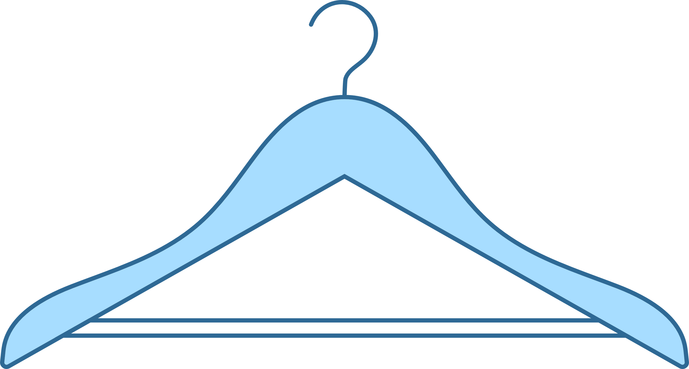
STRUCTURES
Structures are things that provide support.
Structures support weight or hold things together
KNOWLEDGE
A coat hanger supports the weight of clothes
A chair supports the weight of the person sitting in it
The layers of a road support the weight of vehicles and stop them sinking into the mud

Slide 9
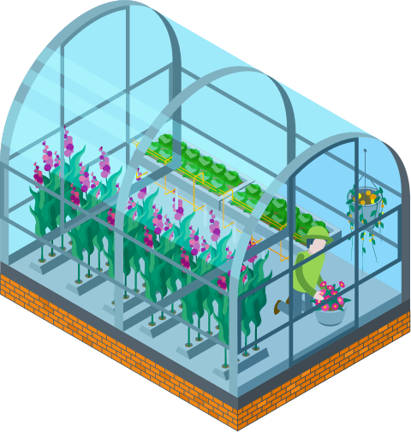
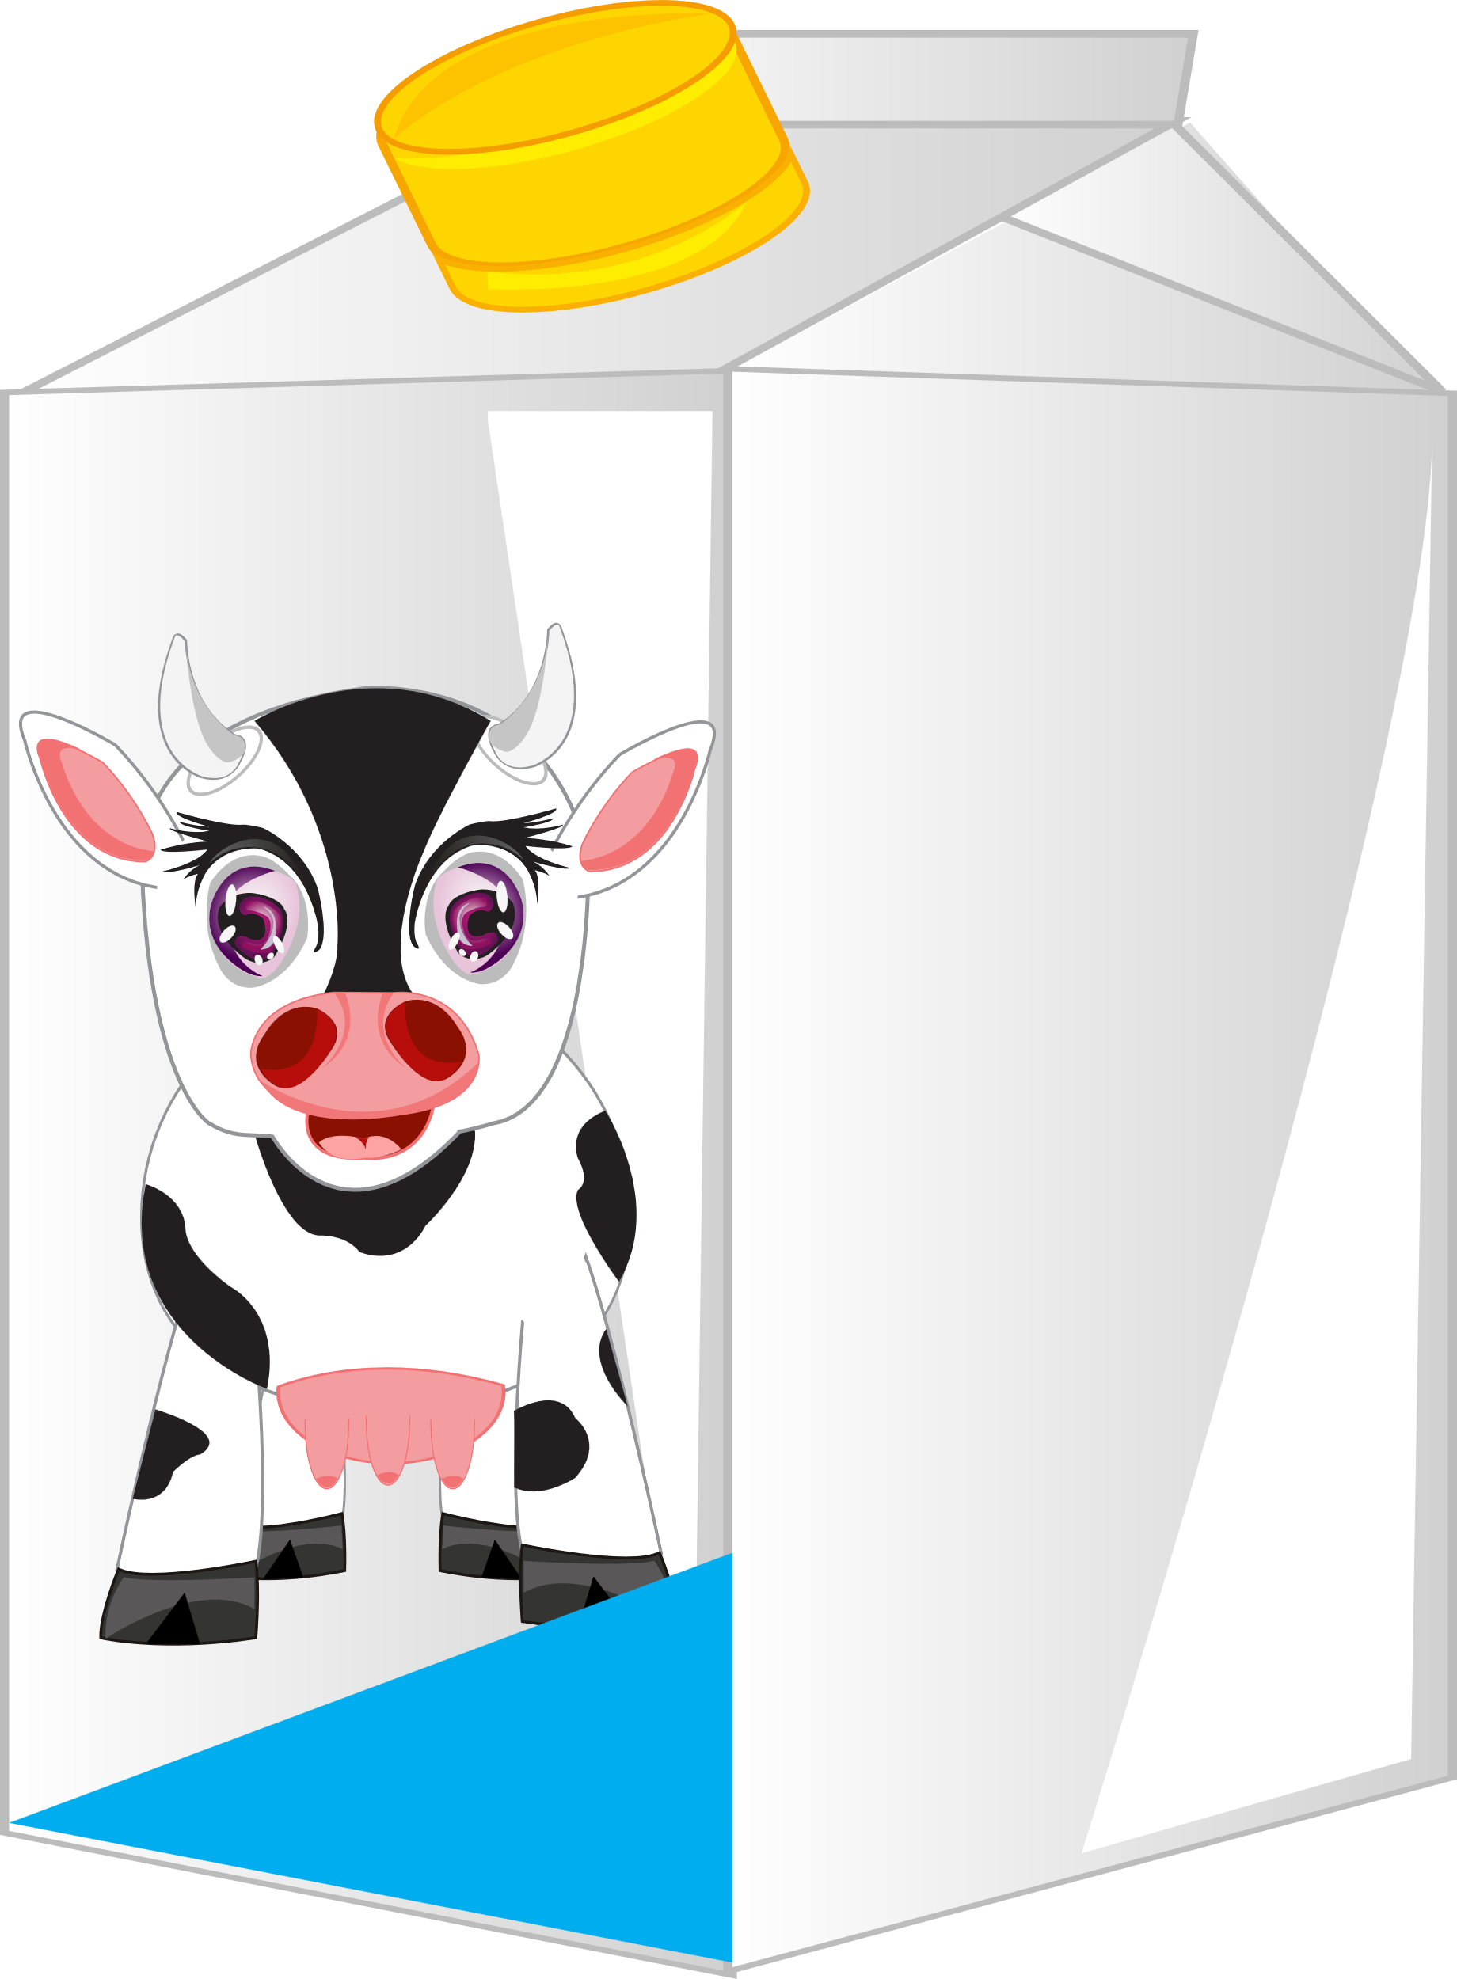
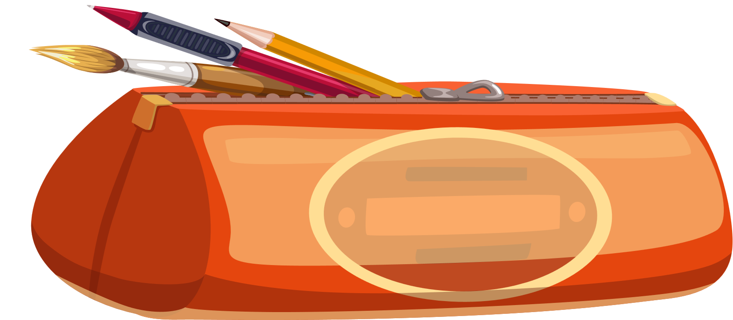
STRUCTURES
Structures are things that provide support.
Structures support weight or hold things together
KNOWLEDGE
A greenhouse supports and holds the glass together
A milk carton holds all the milk inside
A pencil case holds pens and pencils inside

Slide 10
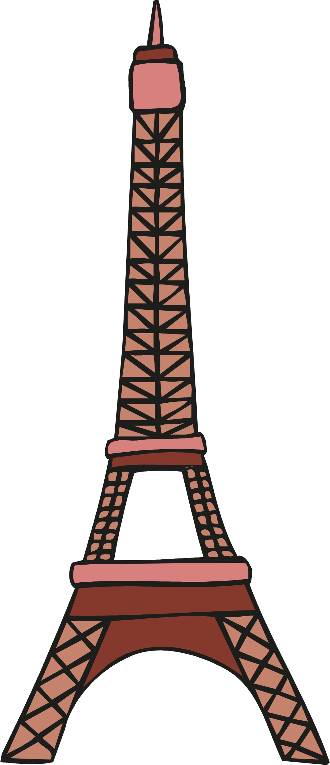
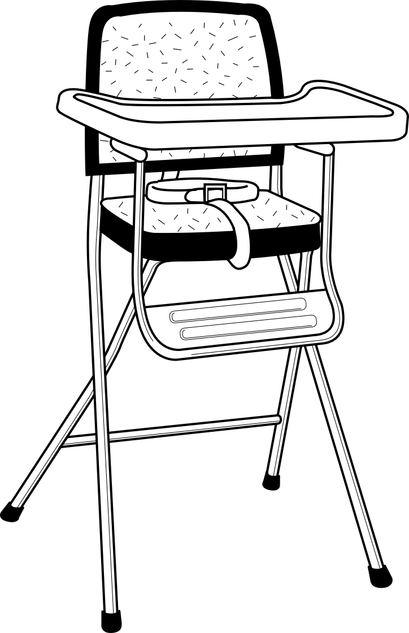
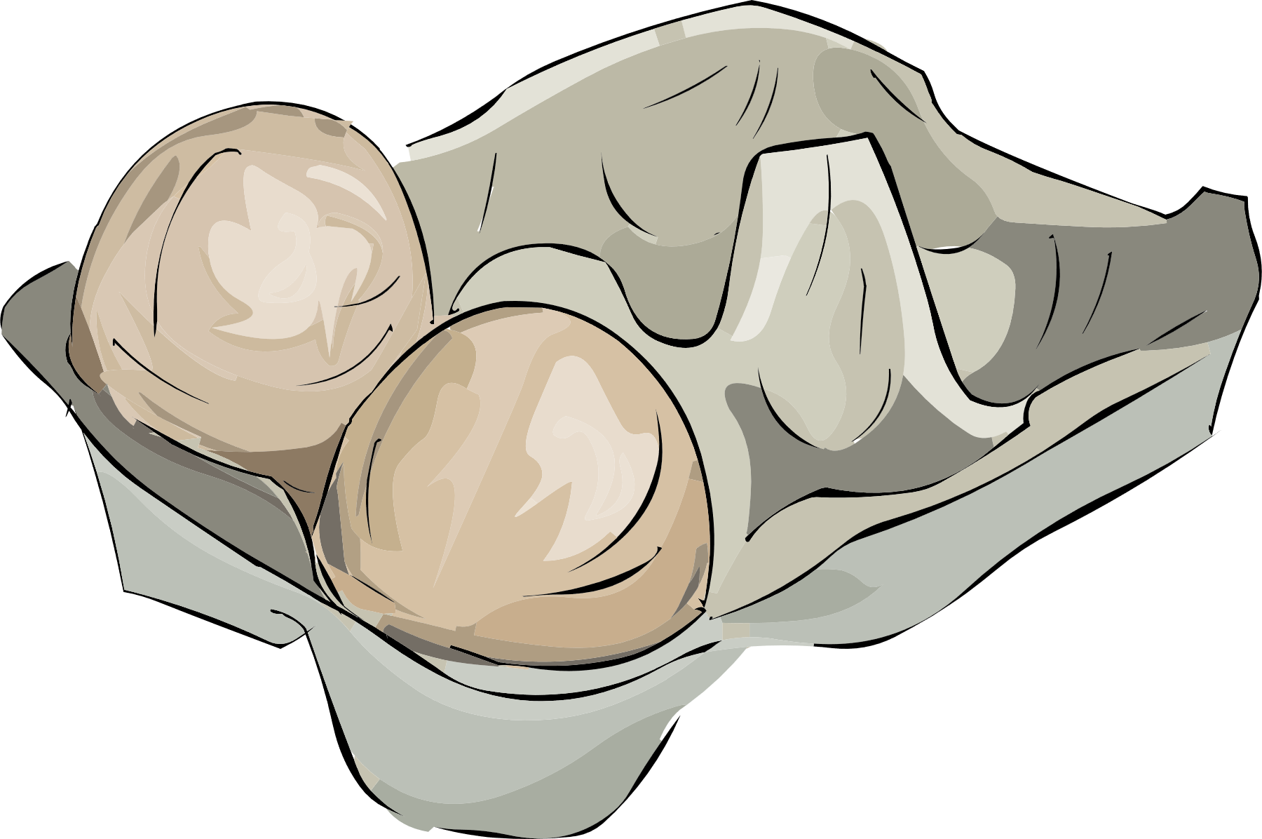
STRUCTURES
Structures are built for a purpose
Structures come in all shapes and sizes
KNOWLEDGE
Some structures are very small
Some structures are small
Some structures are very tall
What is the purpose of these products?

Slide 11
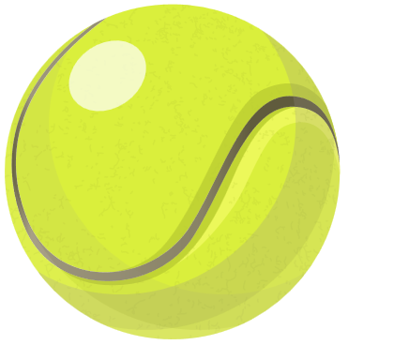
SHELL STRUCTURES
A shell structure is a hollow structure made from a thin outer layer. Shell structures get their strength, stiffness and stability from their shape and the materials that they are made from.
Examples of Shell Structures
KNOWLEDGE

Slide 12
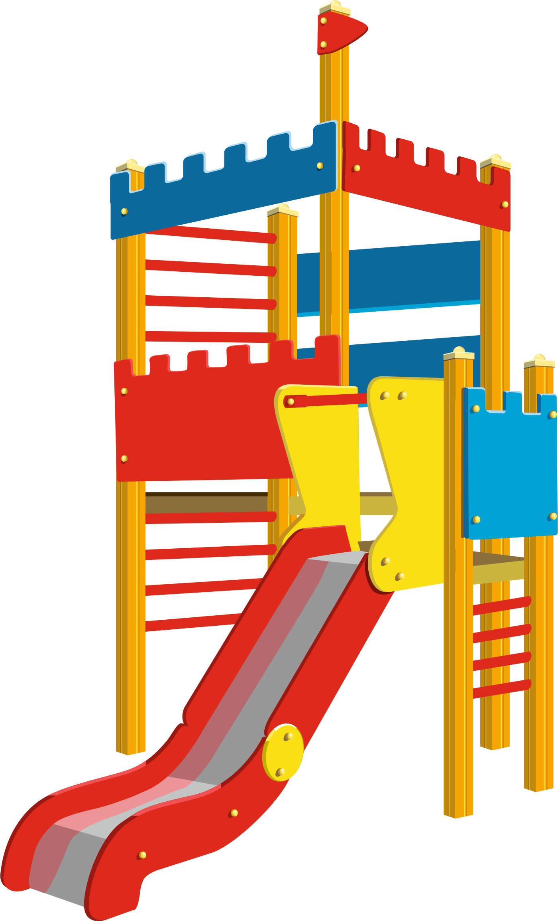
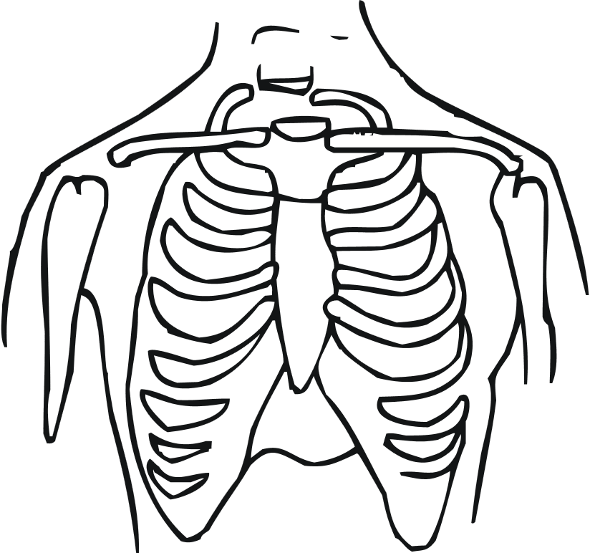
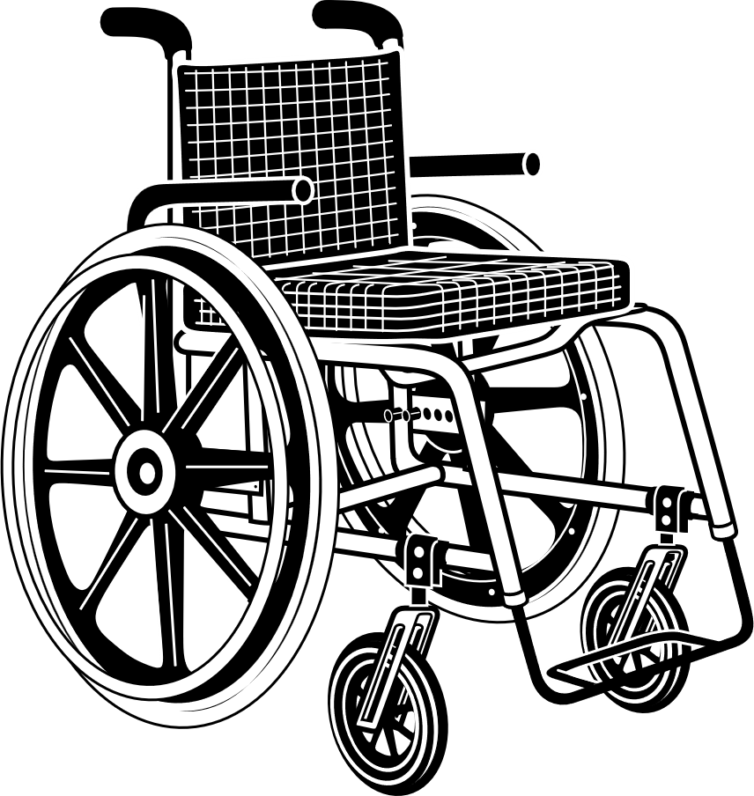
FRAME STRUCTURES
Frame structures are constructed from pieces linked together to create a strong unit.
Examples of Frame Structures
KNOWLEDGE

Slide 13
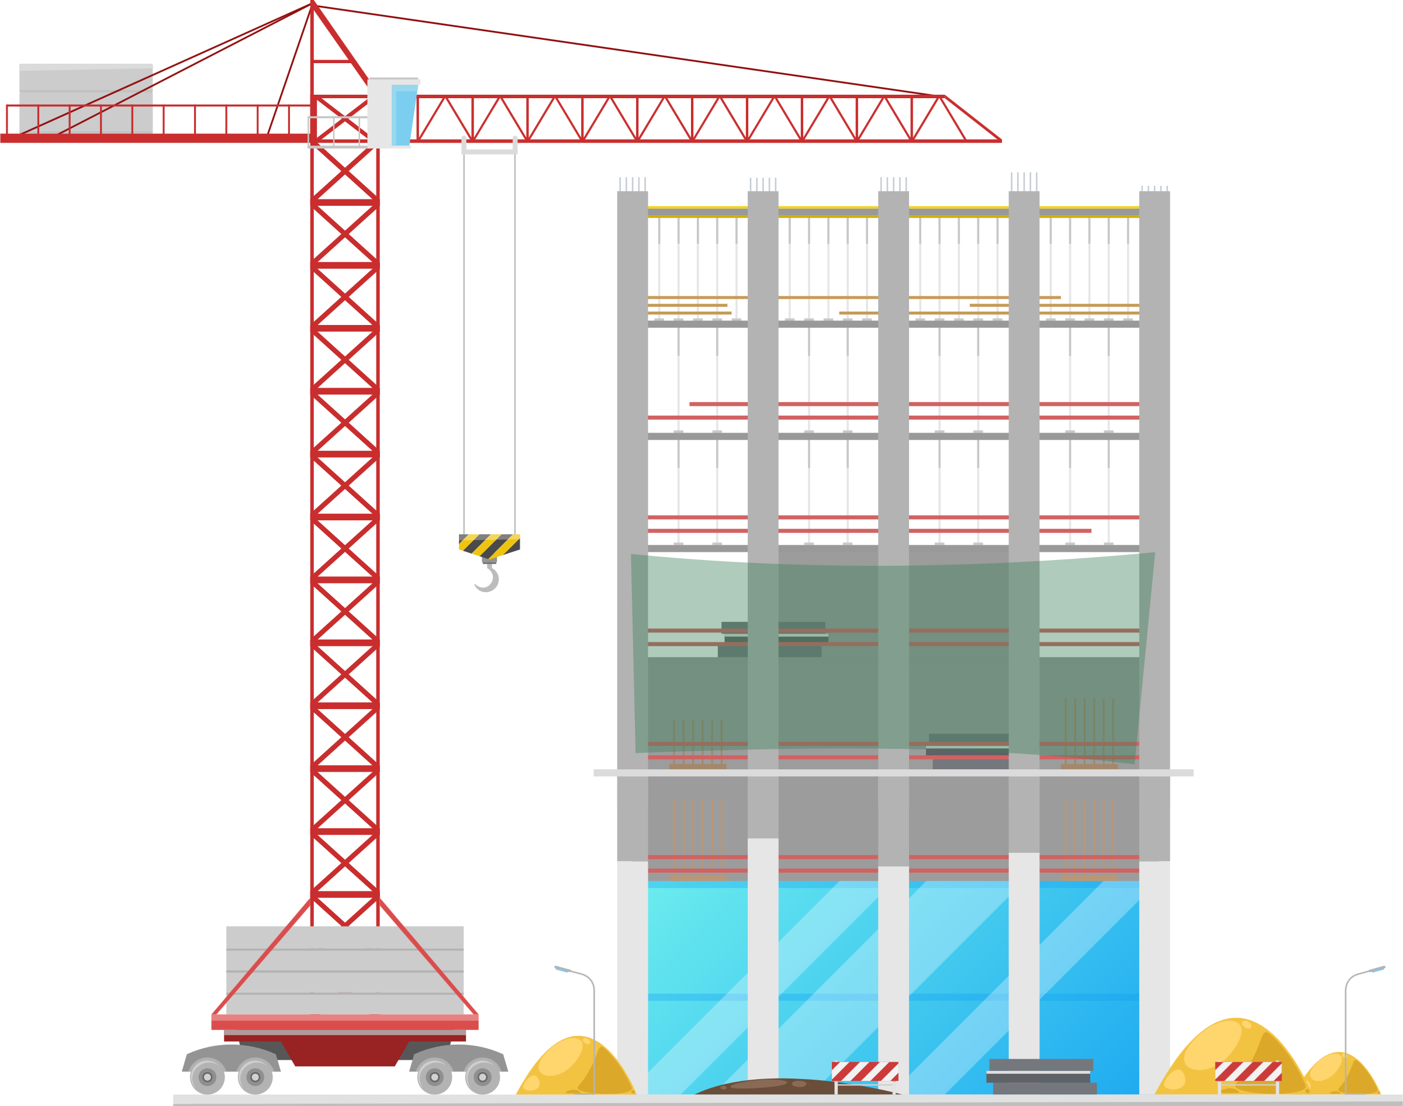
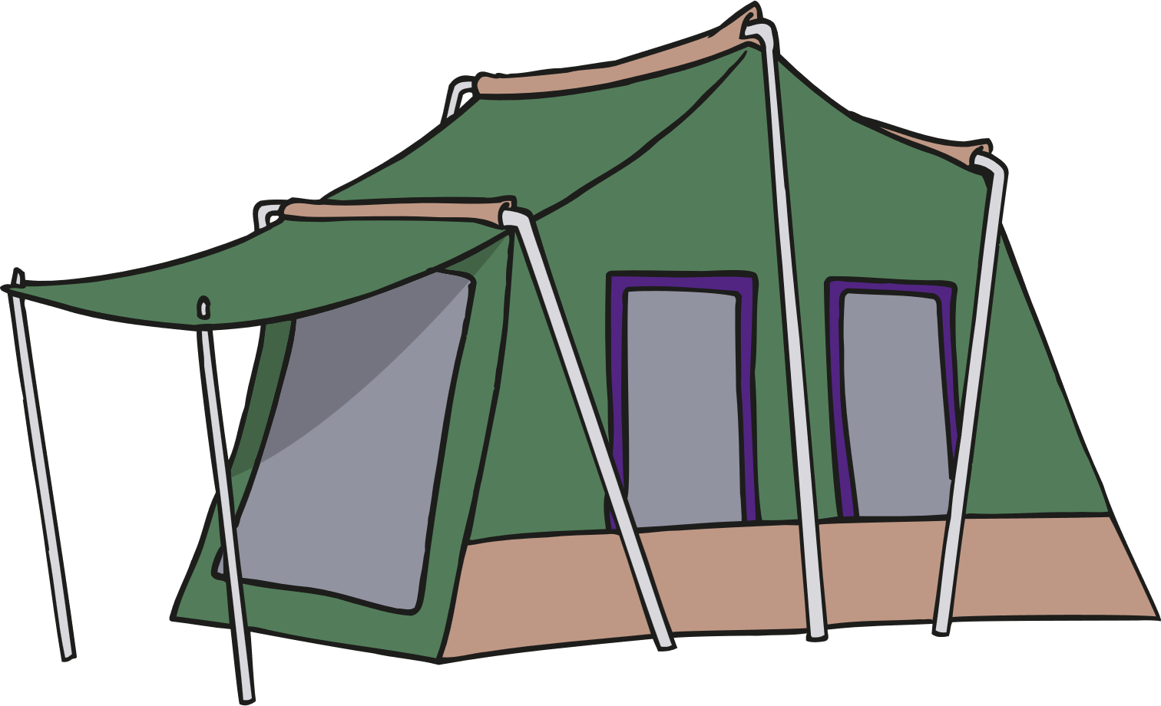
COMBINED STRUCTURES
Many structures are created by combining both frame and shell structures
KNOWLEDGE
Tents are a framework structure covered by sheet material to create a shell structure.
Many tall buildings are made by creating a strong framework then adding an outer shell – this shell is called cladding.

Slide 14
FREE-STANDING STRUCTURES
Freestanding structures stand on their own base without being attached to something else. As the structure gets taller it is more likely to fall over.
KNOWLEDGE
The baby chair needs to be stiff (rigid) and maintain its shape.
This baby chair needs to support the weight of the baby so it must be made of strong material.
The baby chair must also be stable so that it does not topple over.
The baby chair must not be too heavy so that it cannot be moved.
Free-standing structures such as a baby chair need to be well-designed: strong, stiff and stable.

Slide 15
FREE-STANDING STRUCTURES
The Eiffel Tower
The Eiffel tower has 4 legs which gives it a wide base and makes it stable.
The Eiffel tower is made of steel which is a strong metal.
The Eiffel tower is made of a framework of steel which makes it stiff and rigid.
KNOWLEDGE

Slide 16
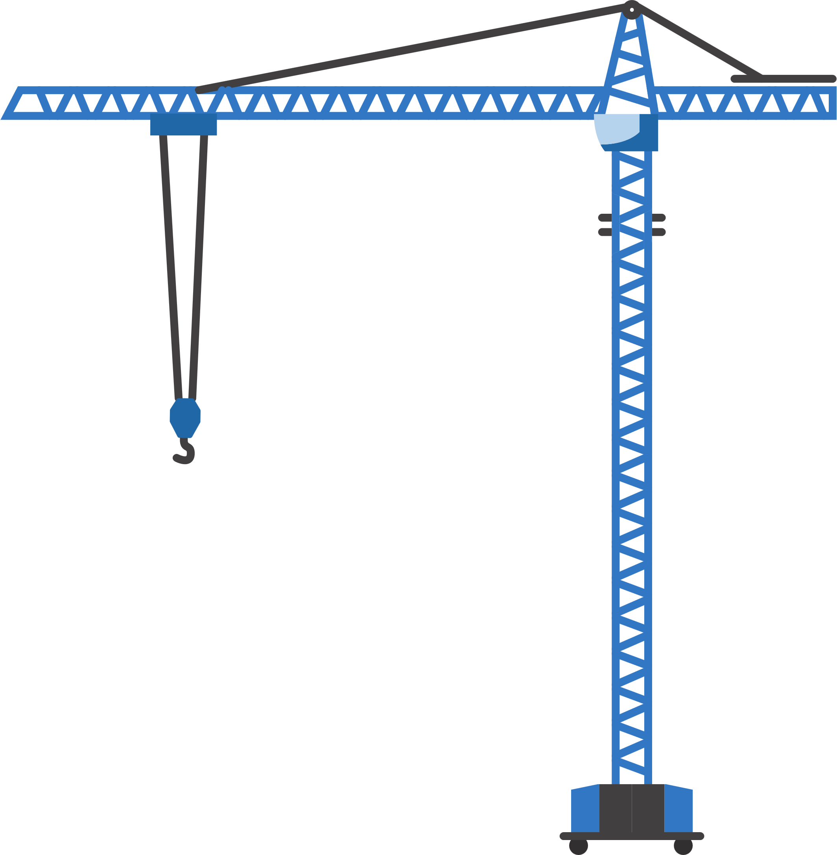
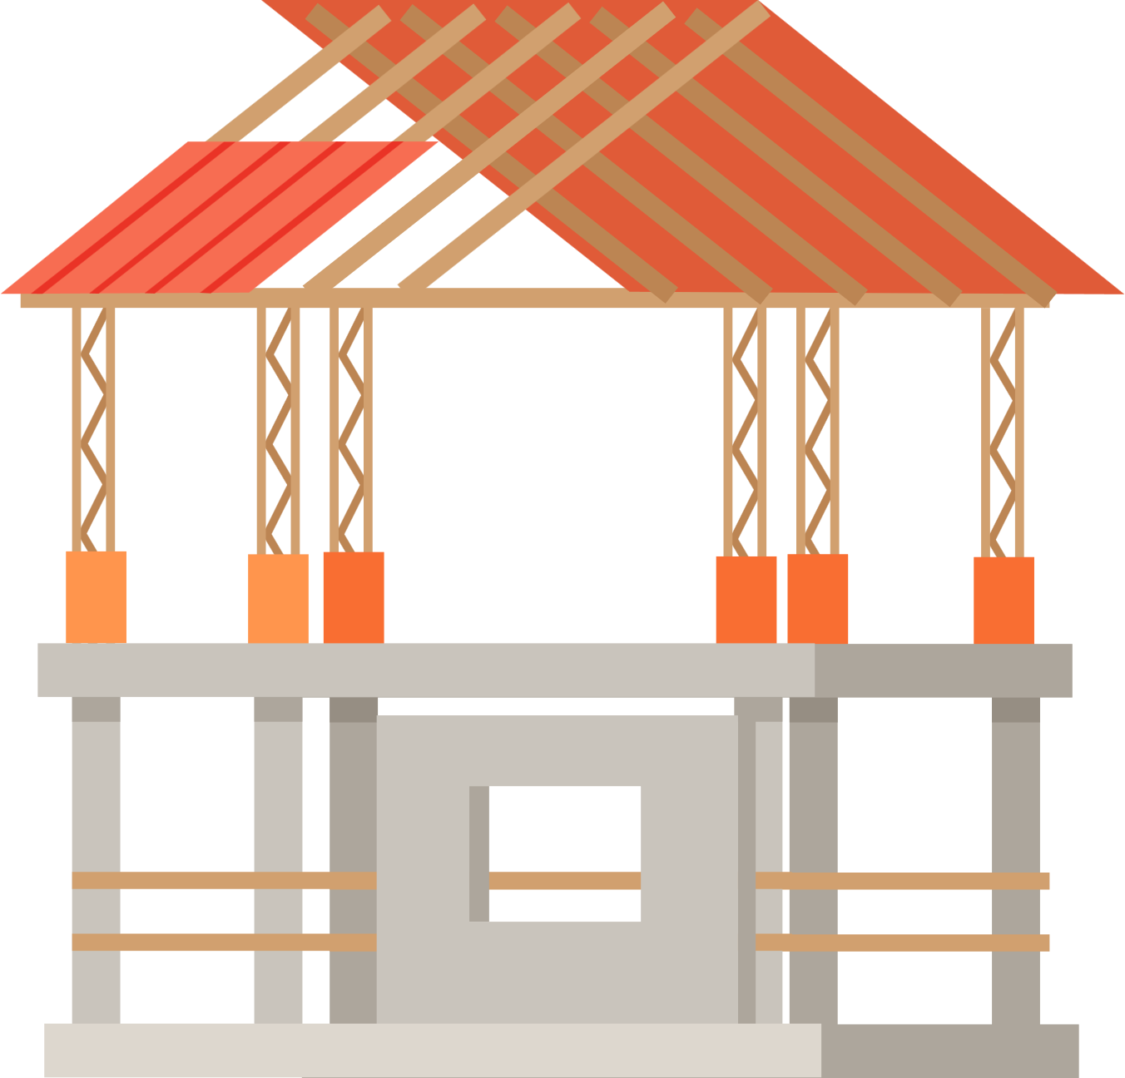
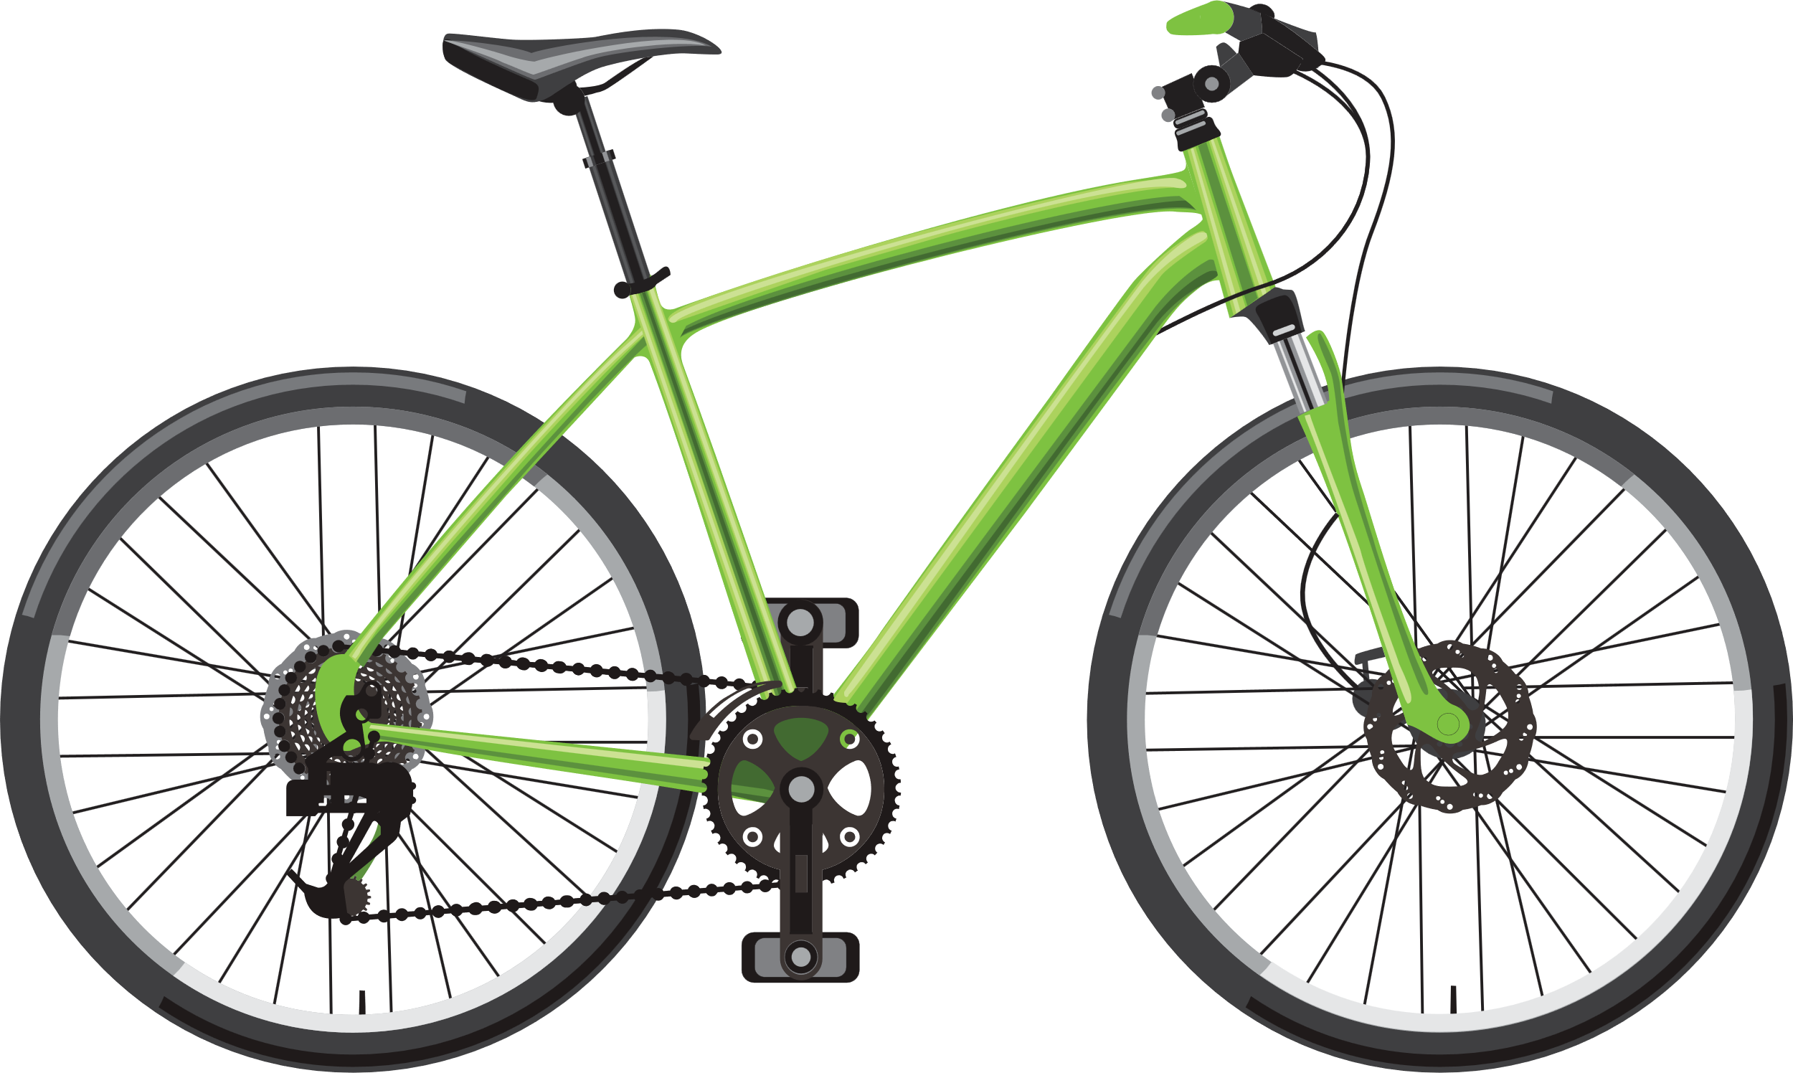
STRONG STRUCTURES
Triangles are the strongest frame shape. When designing structures to be strong, designers will often include triangular shapes into the structures to increase the strength of the structure.
KNOWLEDGE

Slide 17
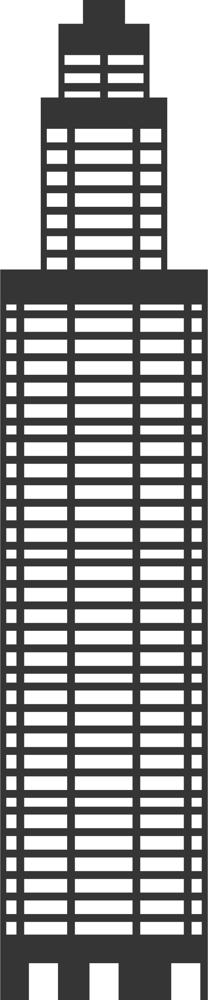
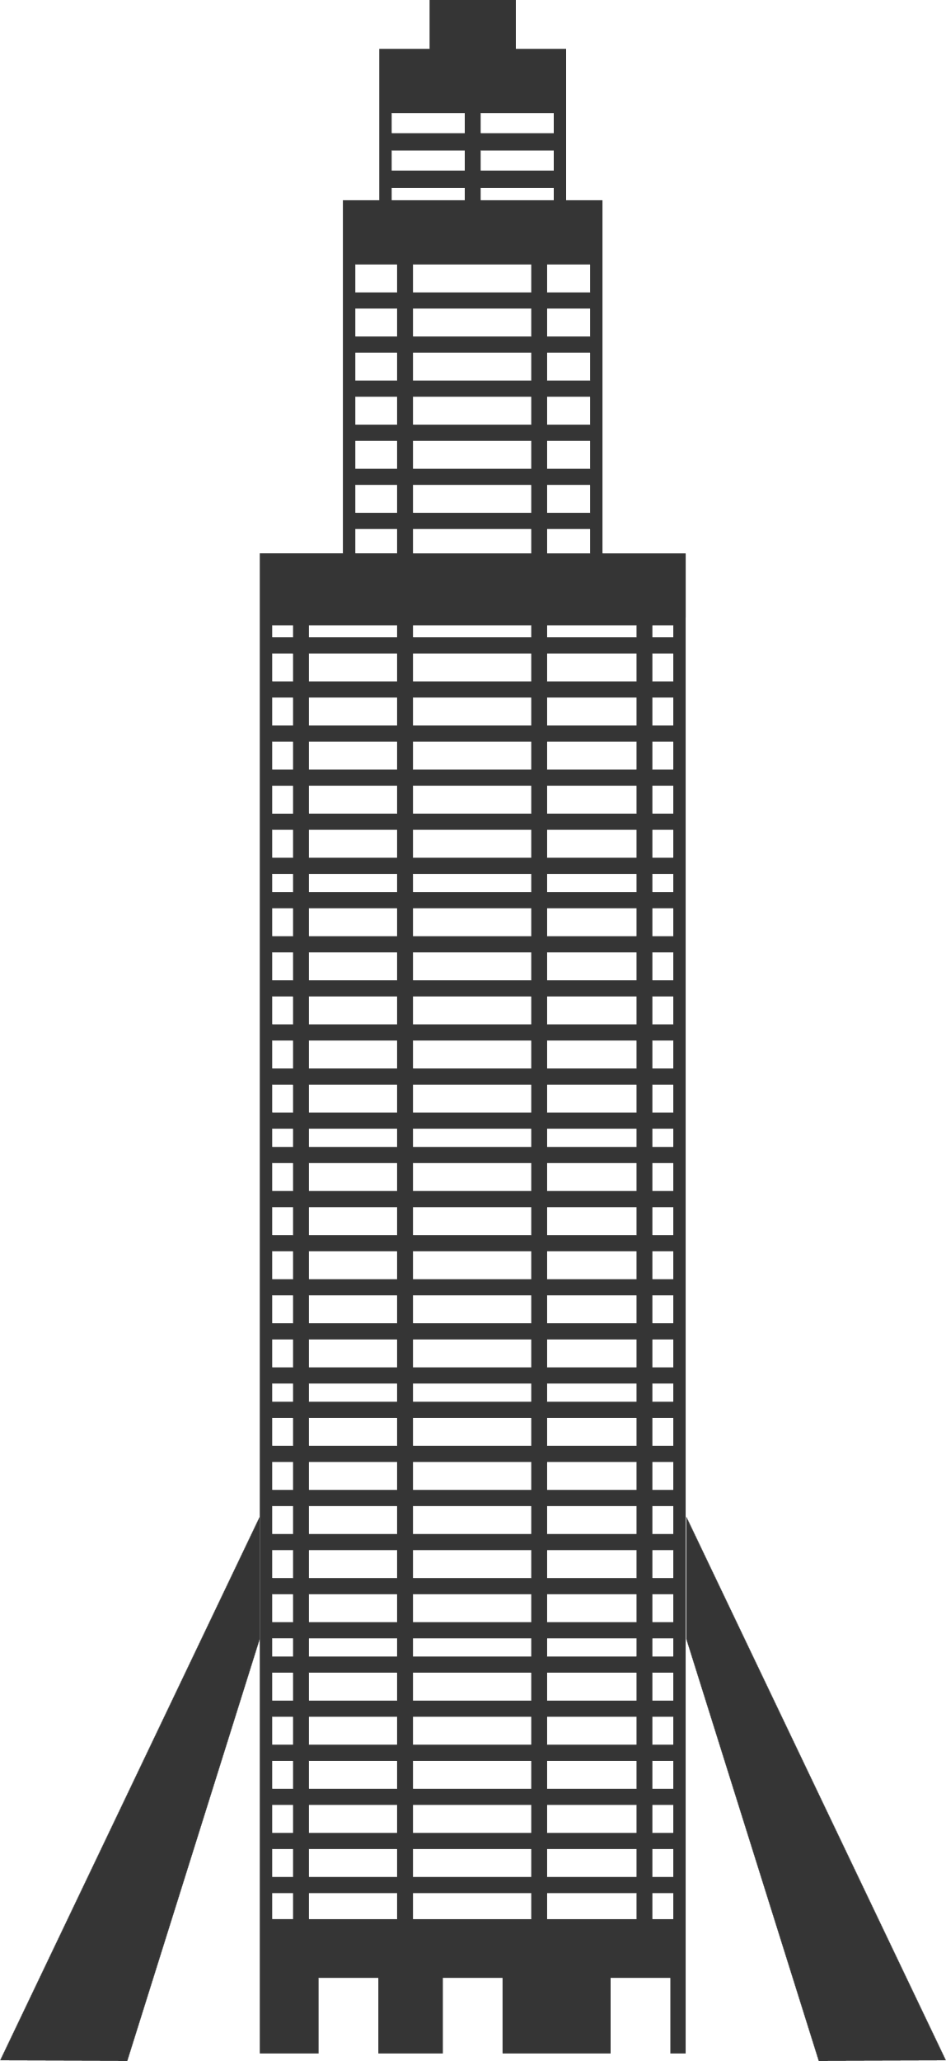
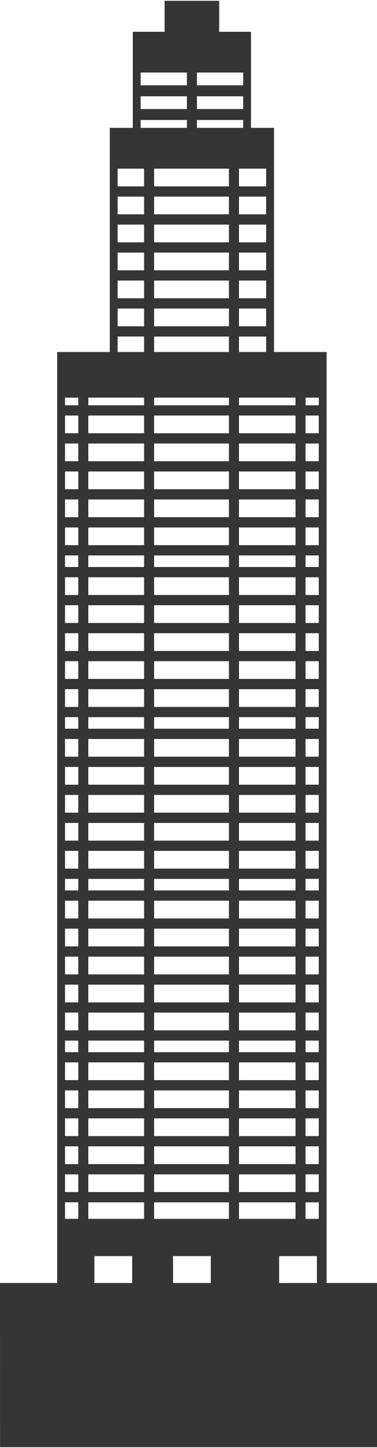
STABLE STRUCTURES
A stable structure is less likely to fall over. Structures are more stable when they have a wide base, have a heavy base or are supported by buttresses.
KNOWLEDGE
wider base
heavy base
buttress

Slide 18
FRAMEWORK STRUCTURES
Framework structures are composed of vertical and horizontal pieces known as columns (vertical) and beams (horizontal).
beam
KNOWLEDGE
Struts are used to create triangles between the columns and beams to increase strength and stability.
column
strut

Slide 19
FRAMEWORK STRUCTURES
Framework structures can be made stronger, stiffer and more stable by using triangulation.
KNOWLEDGE
Triangular card can be added to the corners to strengthen the corners.

Slide 20
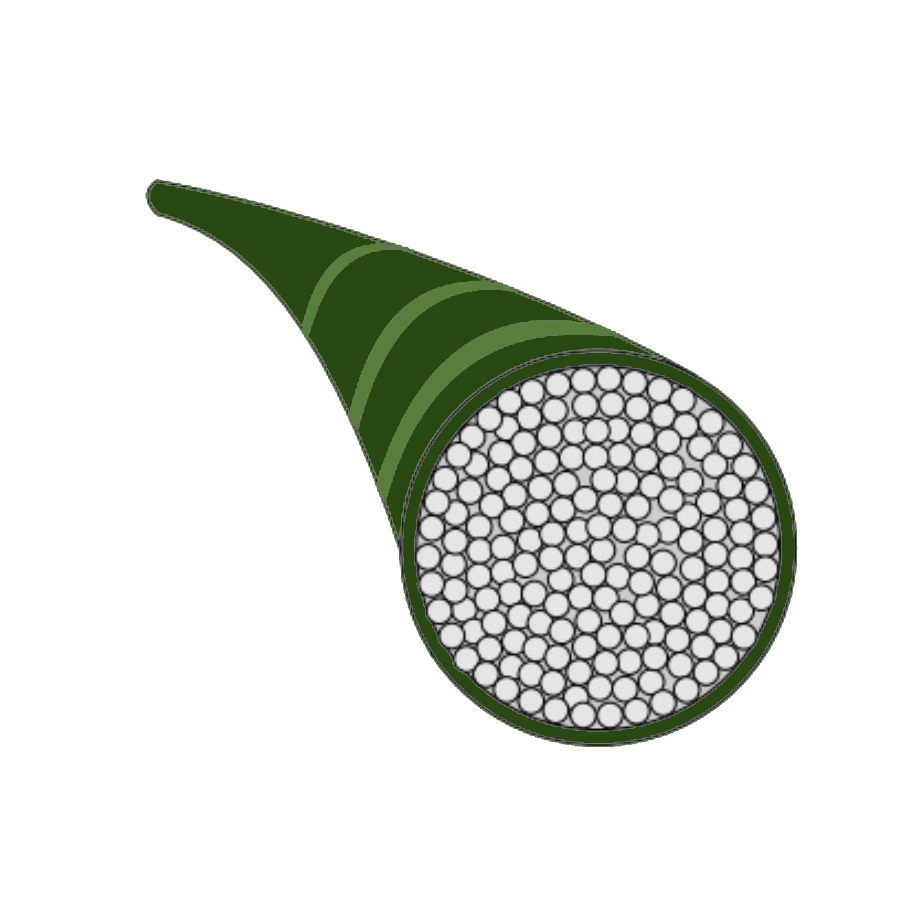
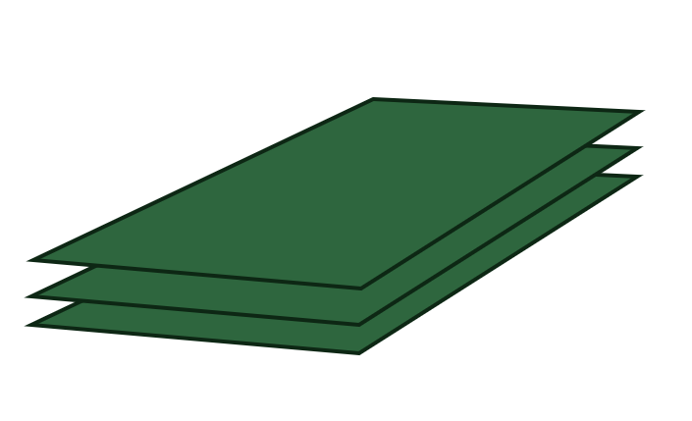
STRONG STRUCTURES
Some materials are stronger than others and using them will make a structure stronger. Adding layers of materials will make a structure stronger.
Laminating is gluing together several layers of material
Cables for bridges are made from many individual wires arranged in circular layers
Columns can be arranged in layers so that each column takes a little of the weight.

Slide 21
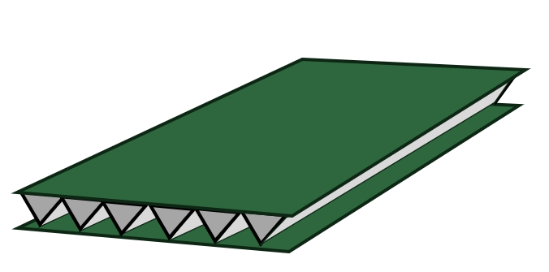
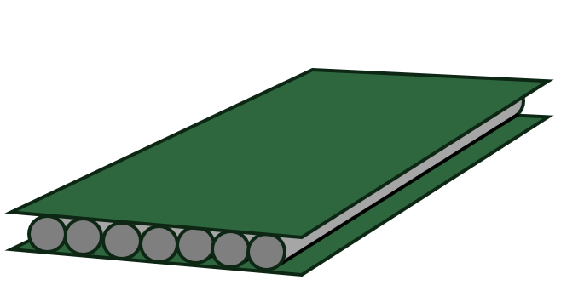

SHEET MATERIALS
Making materials stiffer and stronger will make the overall structure stiffer and stronger also. There are three types of technique to make sheet materials stronger and stiffer:
Laminating Corrugating Ribbing
Gluing together several layers of materials
Gluing a zig zag layer of material between two sheets of material
Gluing a layer of tubular material between two sheets of material
Click here to find out more about structures

Slide 22
SHEET MATERIALS: CARD
Card Cardboard
Card is thick paper. Its thickness makes it stronger and stiffer than paper.
Cardboard in engineered card. Two sheets of card sandwich a layer of folded zig-zag card.

